Slide 1
Computational Construction of Intra-Cellular Networks
Tolga Can
Associate Professor
Department of Computer Engineering
Middle East Technical University
Ankara, Turkey

Slide 2
Getting to Atlanta

Slide 3
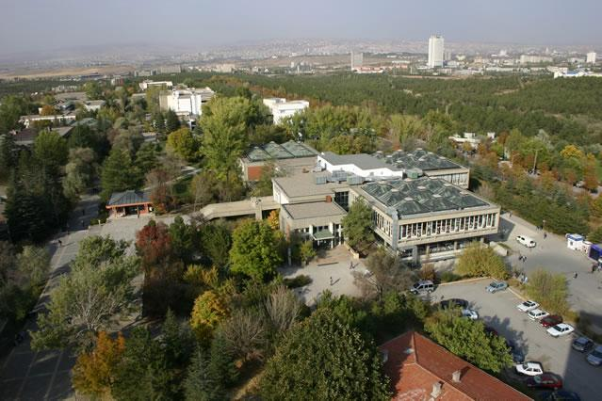
METU

Slide 4
Overview of the Tutorial (1)
Introduction to Intra-cellular networks
Protein-protein interaction networks
Signal transduction networks
Transcriptional regulation networks a.k.a gene regulatory networks (GRNs)
Metabolic networks

Slide 5
Overview of the Tutorial (2)
Computational methods to construct networks
SiPAN: simultaneous prediction and alignment of PPI networks by Alkan and Erten (March 2015, Bioinformatics)
lpNet: a linear programming approach to reconstruct signal transduction networks by Matos et al (May 2015, Bioinformatics)
Reconstructing genome-scale metabolic models with merlin by Dias et al. (April 2015, Nucleic Acids Research)

Slide 6
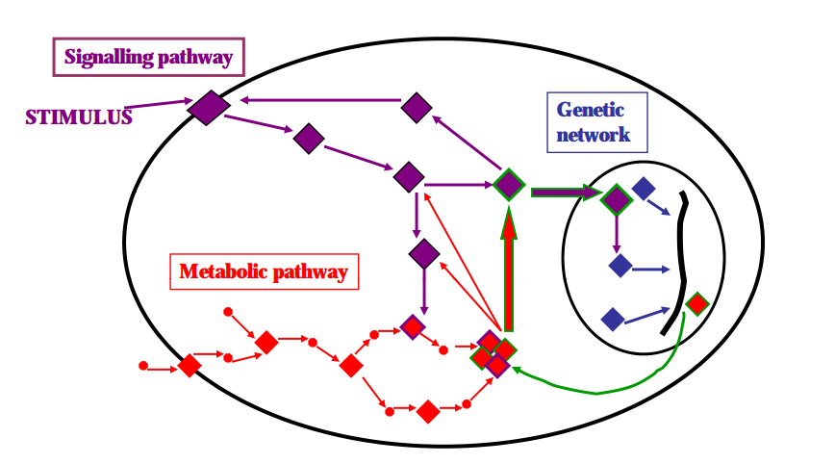
Networks are inter-linked

Slide 7
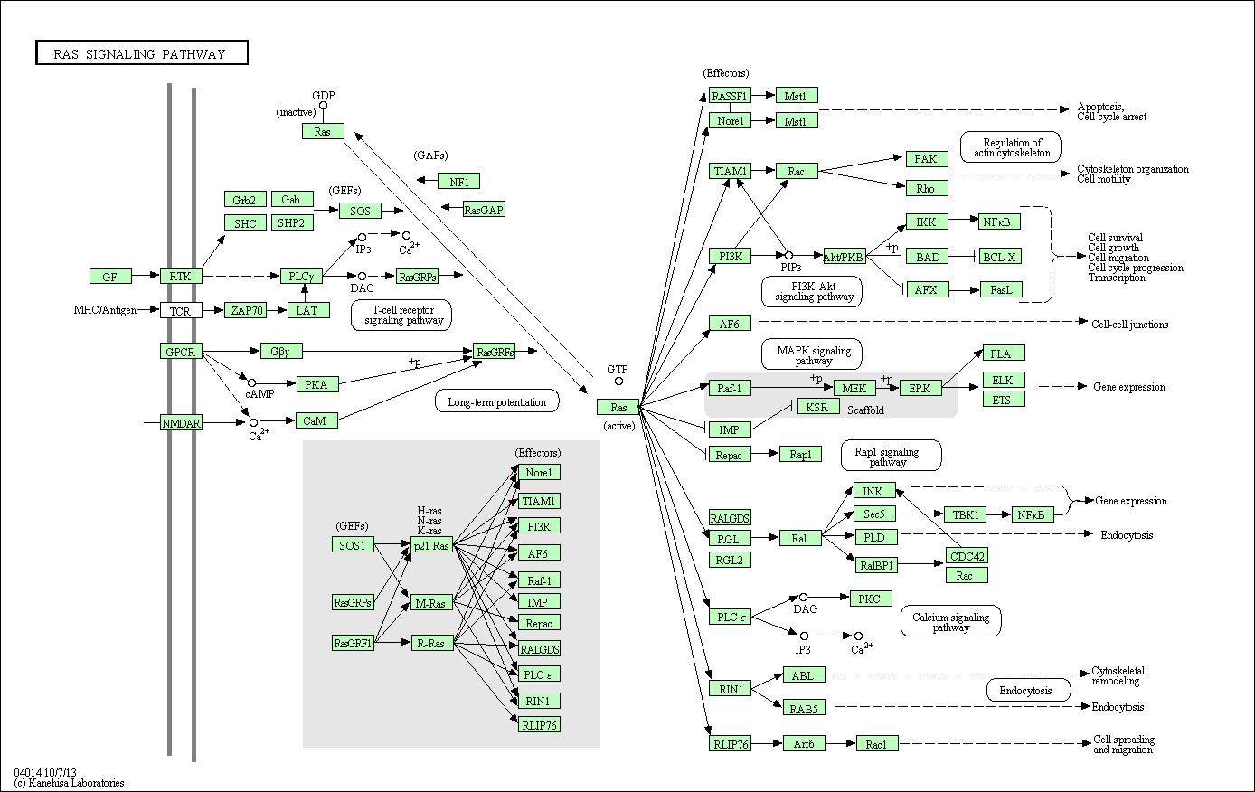
and can be complex
from the KEGG PATHWAY Database
http://www.genome.jp/kegg-bin/show_pathway?hsa04014
Notes:
This picture shows the RAS pathway in a normal human cell. An interesting question to ask is: what are the changes in this picture in a cancer cell or in a different state? In that specific condition, experimental observations give us clues about the possible changes in these pathways.

Slide 8
Protein-protein interaction networks
Can be stable or transient physical interactions

Slide 9
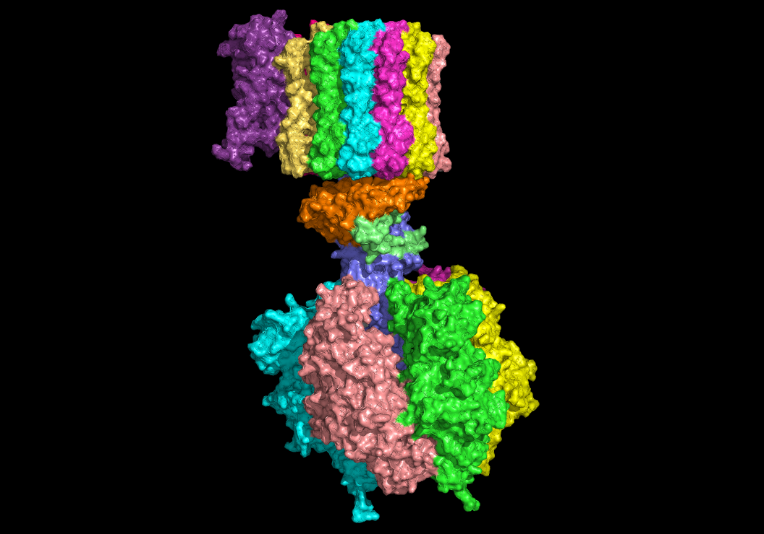
Stable interactions in protein complexes
E.g., ATPase

Slide 10
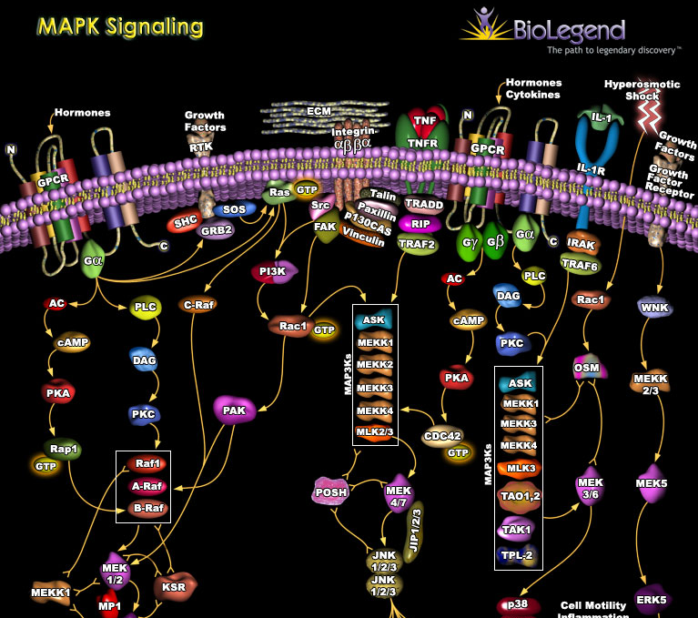
Transient interactions
MAPK Signaling Pathway
http://www.biolegend.com/pop_pathway.php?id=52

Slide 11
Transient interactions
Examples:
protein kinases add a phosphate group to a target protein
Transport proteins such as nuclear pore importins can carry other proteins
These interactions form the dynamic part of PPI networks
A PPI network downloaded from a database may contain mixed stable and transient interactions

Slide 12
Signal Transduction Networks
PIP3 signalling module in B lymphocytes
Unravelling the signal-transduction network in B lymphocytes, Sambrano, Nature, December 2002

Slide 13
Sources for interaction data
Interaction databases:
BioGRID 3.4
215,952 physical interactions between 19,906 human genes
IntAct by EBI (curated from literature)
531,946 interactions between 89,310 interactors extracted from 13,807 publications
STRING 10 (functional associations)
Covers 9,643,763 proteins from 2,031 organisms
Experimental techniques
Focused low-throughout studies
Should be mined from free-text research literature

Slide 14
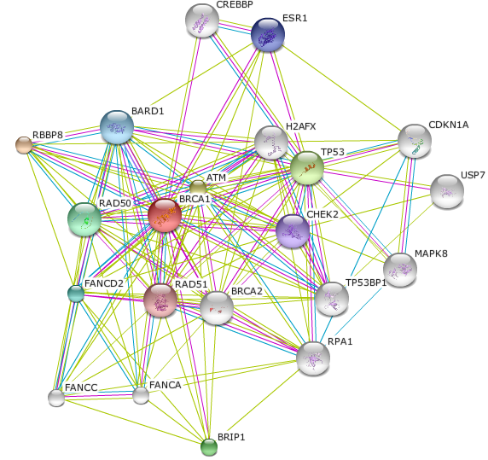
Functional associations
E.g. The String Database
The network around the BRCA1
gene in human.
The snapshot is from the STRING
Database at string.embl.de

Slide 15
Experimental techniques
Yeast Two-hybrid
Tagged Fusion Proteins
Coimmunoprecipitation
APMS – Affinity Purification-Mass Spectrometry
A tool for the characterization of protein complexes ( Bauer and Kuster, Eur. J. Biochem. 270, 570-578 (2003) )
Biacore
Atomic Force Microscopy (AFM)
Fluorescence Resonace Energy Trasfer (FRET)
X-ray Diffraction

Slide 16
Gene regulatory networks
Interactions between transcription factors and their target proteins
Post translational regulation by other factors such as microRNAs lead to hierarchical networks of diverse components (TFs, miRNAs, RNA binding proteins (RBPs))

Slide 17
The gene regulatory network of E. coli
Shen-Orr et. al. Nature Genetics 2002
shallow network, few long cascades.
modular
compact in-degree (promoter size limitation)

Slide 18
Network motifs
Blue nodes
x
y
z
FFL

Slide 19
Metabolic pathways
Network of biochemical reactions in a cell
Reactions, metabolites, reaction dynamics
Data sources
KEGG (Kyoto Encyclopedia of Genes and Genomes)
BioCyc, EcoCyc, MetaCyc – focus on particular species

Slide 20
Metabolic pathways
Overview of the basic metabolic pathways of D. radiodurans
How radiation kills cells: Survival of Deinococcus radiodurans and Shewanella oneidensis under oxidative stress, by Ghosal et al, FEMS Microbiology Reviews, 2005

Slide 21
Genome-scale metabolic networks
May take days to construct
We will discuss the detailed workflow of a metabolic network construction tool: merlin
1867 reactions, 1467 metabolites in the K. lactis metabolic model

Slide 22
Computational methods to construct networks
SiPAN: simultaneous prediction and alignment of PPI networks by Alkan and Erten (March 2015, Bioinformatics)
lpNet: a linear programming approach to reconstruct signal transduction networks by Matos et al (May 2015, Bioinformatics)
Reconstructing genome-scale metabolic models with merlin by Dias et al. (April 2015, Nucleic Acids Research)

Slide 23
SiPAN overview
Protein-protein interactions can be inferred by transferring interactions from a similar organism: interologs
We need to align networks of two different organisms for identification of interologs
However, network alignment methods assume error-free networks
Propose an EM like strategy to iteratively refine the networks and converge to a better alignment and networks

Slide 24
SiPAN overview
SPINAL
RWS

Slide 25
SiPAN overview on an example

Slide 26
The algorithm

Slide 27
Non-conservation
Non-conservation
Given a pair mappings (u,u’) and (v,v’) in an alignment (u,v in G₁ and u’,v’ in G₂) , if the edge (u,v) exists and (u’,v’) does not exist (or vice verso), this is called a non-conservation and it can be resolved by either inserting the missing edge or deleting the existing edge.
The objective of the algorithm is to resolve non-conservations that are significant.

Slide 28
Candidate set
Candidate sets C₁ and C₂
The set of non-conserved edges in G₁ and G₂, respectively

Slide 29
Breakpoint
The candidate sets are sorted separately with respect to interaction confidence scores (as computed by RWS)
Increasing order with respect to edge confidence scores
A breakpoint on a candidate set is an index on the sorted list of candidates such that the resolved deletions have smaller indices and the resolved insertions have higher indices than this index.

Slide 30
Indel
If an edge-pair in both candidate sets is still non-conserved after committing both insertions/deletions in the two candidate sets such an edge-pair is called an indel and should be resolved by giving a higher priority to the operation on one of the candidate sets.

Slide 31
Resolving indels
Indels are resolved from from higher to lower priority
Small weight → higher priority
Weight of an indel is
w(u,v) x w(u’,v’)
Let in be the index of (u,v) and in’ be the index of (u’,v’) in their corresponding candidate sets
w(u,v)=in/|C₁| and w(u’,v’)=(|C₂|-in’)/|C₂| or
w(u,v)=(|C₁|-in)/|C₁| and w(u’,v’)=in’/|C₂|

Slide 32
Resolving indels

Slide 33
Steps of SiPAN on an example

Slide 34
Steps of SiPAN on an example

Slide 35
Steps of SiPAN on an example

Slide 36
Inference of Signaling Networks

Slide 37
HPN-DREAM breast cancer network inference challenge
The goal of the breast cancer network inference challenge is to quickly and effectively advance our ability to infer causal signaling networks and predict protein phosphorylation dynamics in cancer.
Dataset
extensive training data from experiments on four breast cancer cell lines stimulated with various ligands. The data comprise protein abundance time-courses under inhibitor perturbations.
https://www.synapse.org/#!Synapse:syn1720047/wiki/

Slide 38
In silico challenge
Infer the causal edges in a 20 node network given a dataset containing the 20 nodes’ observations across 10 time points and 4 perturbation experiments (one of these being the control)

Slide 39
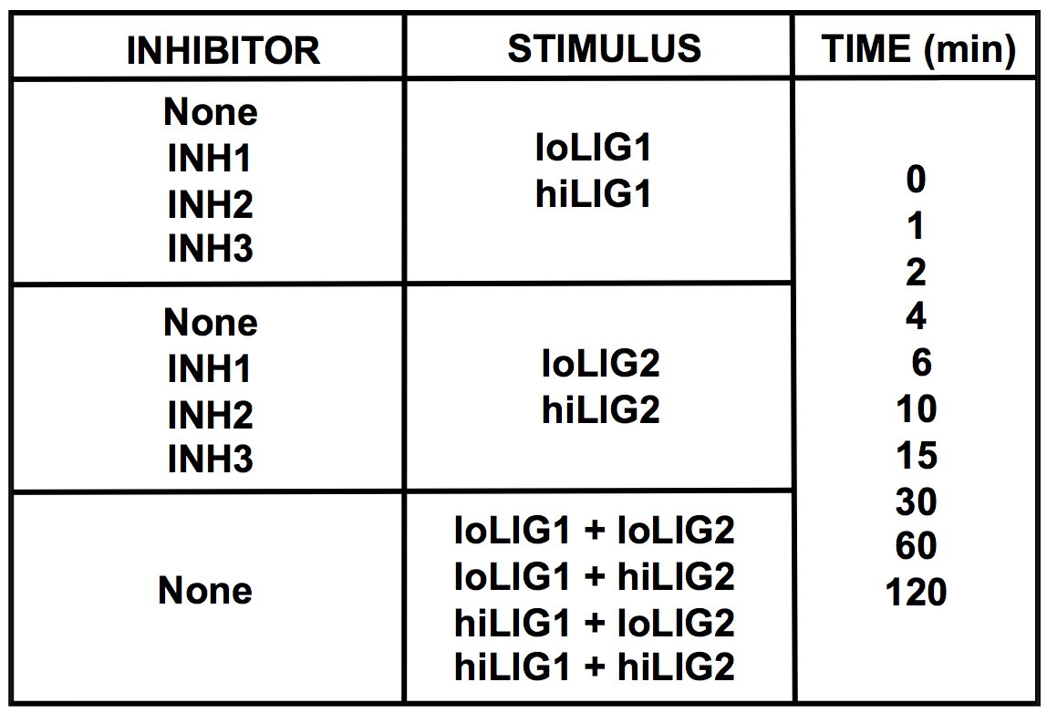
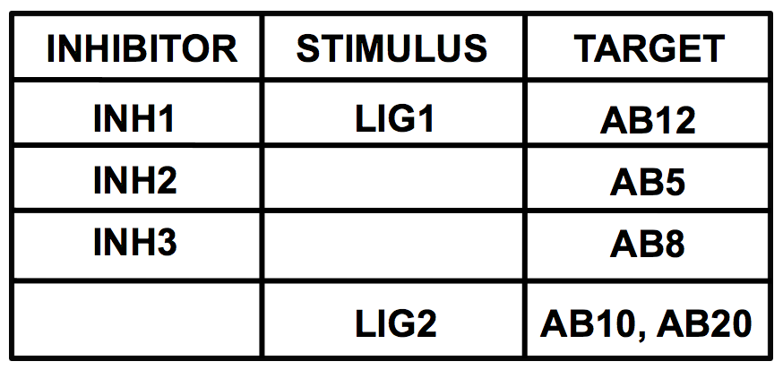
In silico challenge

Slide 40
Experimental challenge
Infer 32 causal networks, one for each combination of cell line and stimulus
4 cell lines
8 different stimuli.
Each of the 32 datasets contains 45 nodes’ observations across 7 time points and 4 inhibition experiments (one of these being the control).

Slide 41
Experimental challenge

Slide 42
lpNet
Network inference based on linear programming
Infer interactions based on a combination of perturbation/non-perturbation and steady-state/time-series data
The signaling network to be inferred is modeled by a weighted graph G
Nodes represent proteins
A weighted edge w_{ij} represents an interaction
>0 activation, <0 inhibition

Slide 43
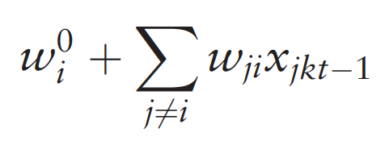
Activity of a node
Computed by the following model

Slide 44
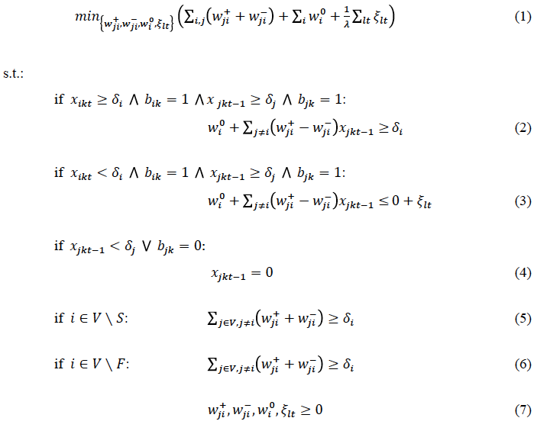
The linear programming model

Slide 45
Results
lpNet ranked 3rd in the in silico challenge and 29th in the experimental challenge among 60 participating teams.
lpNet is robust against noise
lpNet is faster than DDEPN
lpNet takes on average 15 min to infer a network with 10 nodes, 10 time points and 2 perturbations, while DDEPN takes, on average, 101 min
(computations done on an Intel Xeon X5460 @ 3 GHz, 26MB L2 cache, 32GB RAM, 64 bit Linux OS).

Slide 46
Inference of Genome-Scale Metabolic Models

Slide 47
merlin
A tool for reconstructing genome-scale metabolic models

Slide 48
Traditional GSMM reconstruction process

Slide 49
merlin architecture

Slide 50
merlin: homology data curation interface

Slide 51
merlin: Reactions viewer

Slide 52
Conclusions
Several tools, methods exist for construction of genome-scale intra-cellular networks
Challenge:
Integrate different types of genome-scale networks together in a single cell model to simulate all processes in silico.

