Slide 1
CENG 477 Introduction to Computer Graphics
Introduction
Prof. Dr. Yusuf Sahillioğlu
Slides from Prof. Dr. Oğuz Akyüz

Slide 2
Computer Graphics
What is Computer Graphics (CG)?
Any use of computers to create and manipulate images
Tools and algorithms used to make such pictures, software, and hardware
Ken Perlin: What you need to show other people your dreams!

Slide 3
Computer Graphics
CG consists of three main subfields:
Modeling
Rendering
Animation

Slide 4
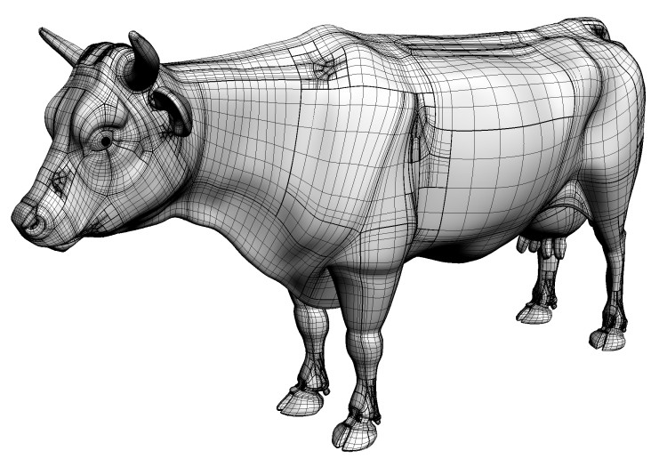
Modeling
Modeling is the process of representing 3D shapes
Many modeling techniques exist
Headus COW Model

Slide 5
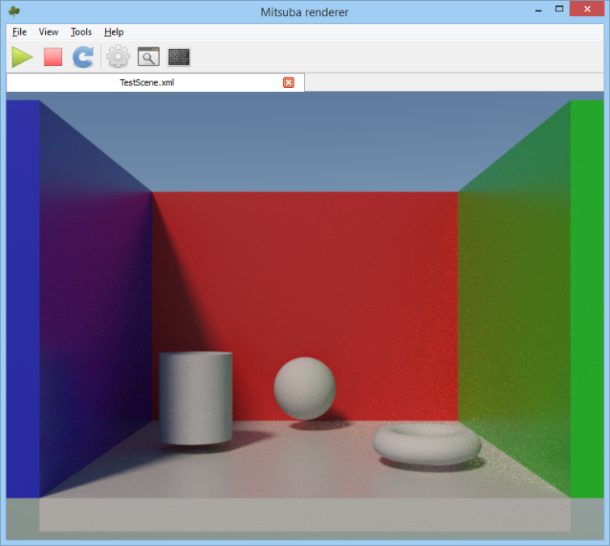
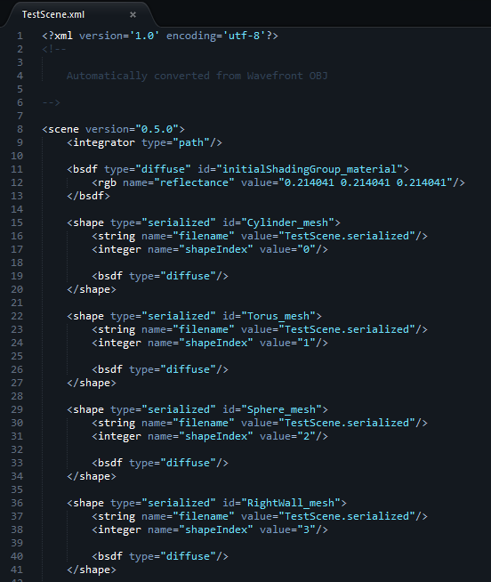
Rendering
Rendering is the actual process of generating an image from a scene definition file
Similar to modeling, there are various rendering techniques

Slide 6
Animation
Animation is the process of bringing life to virtual objects

Slide 7
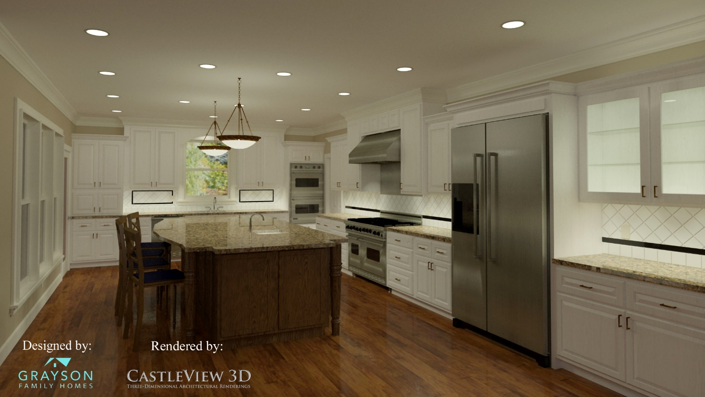
The Goal
The main goal of CG is to create realistic images as fast as possible

Slide 8
The Goal
This often requires vast computational resources
A photo of the LucasFilm Rendering Farm (by Peter Sciretta)

Slide 9
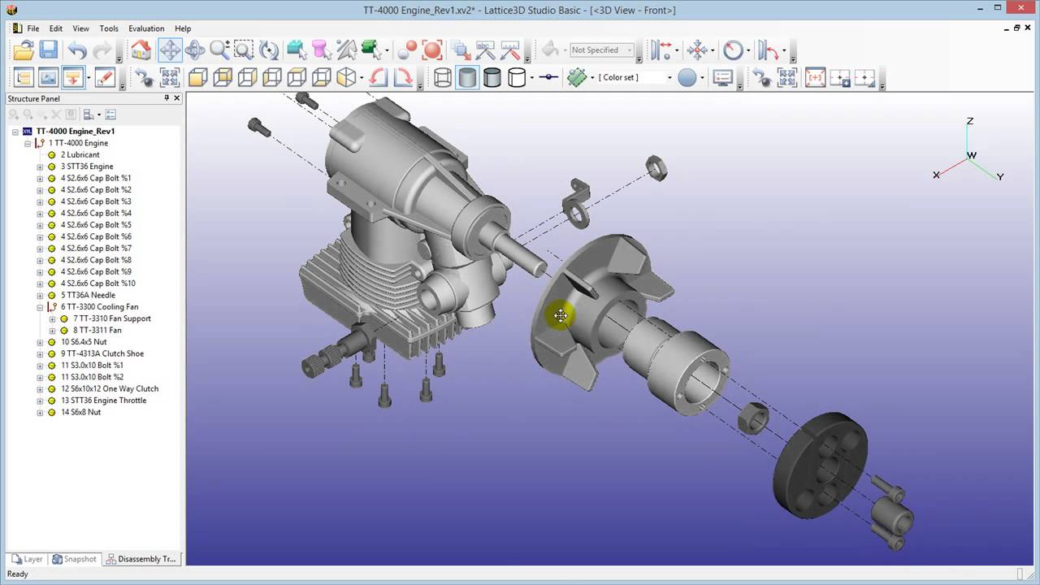
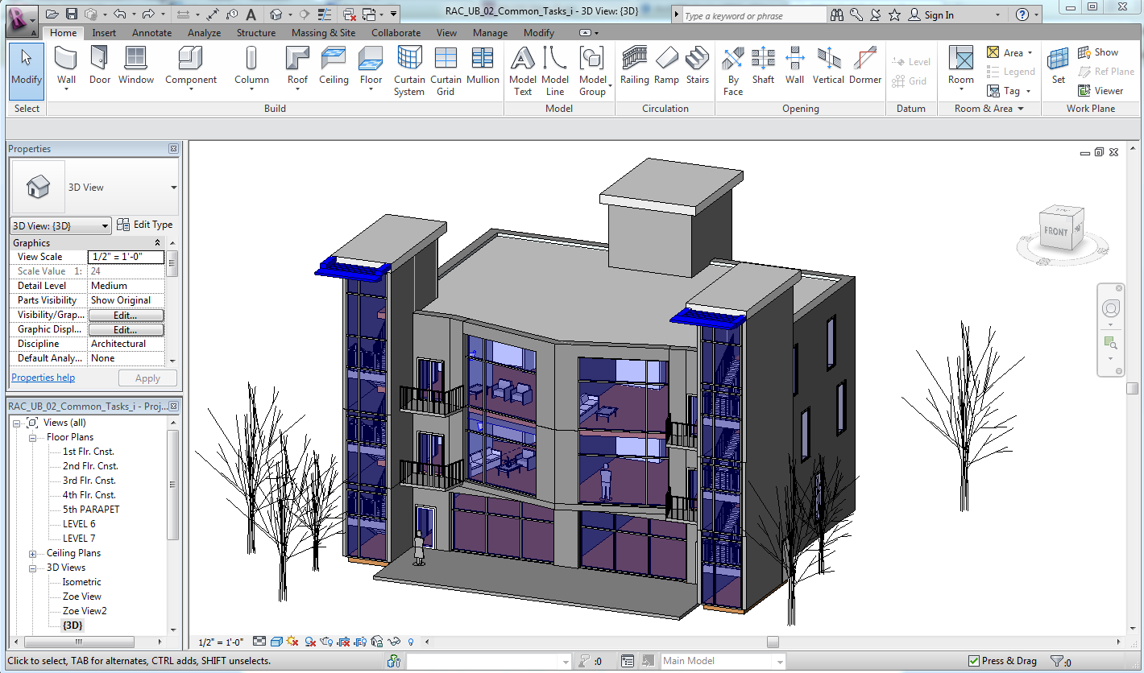
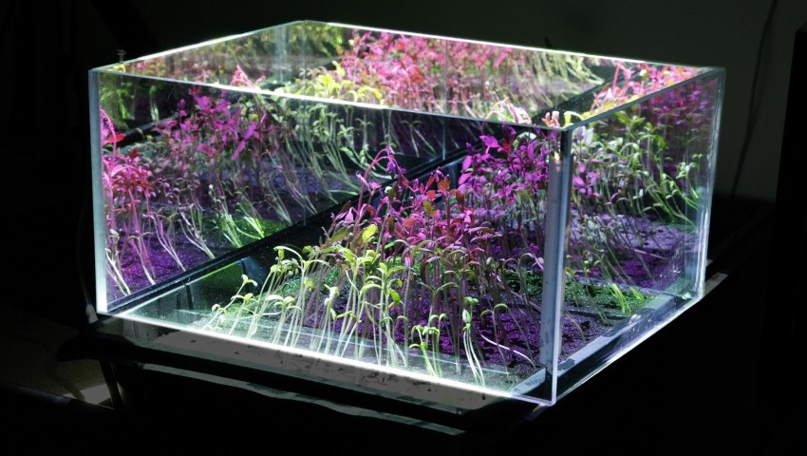
Other Goals
Besides creating realistic images CG also aims to create
informative technical illustrations
architectural drawings
nonphotorealistic images
geeky (and very cool) art

Slide 10
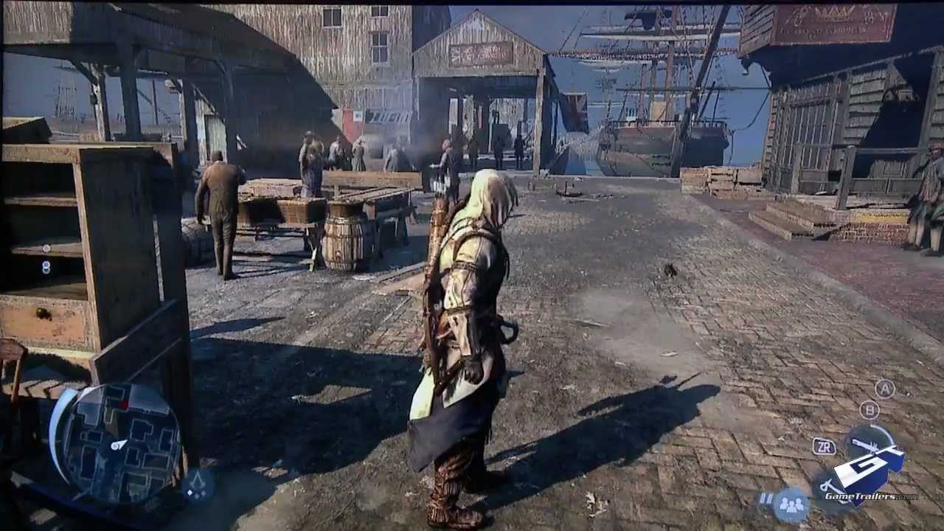
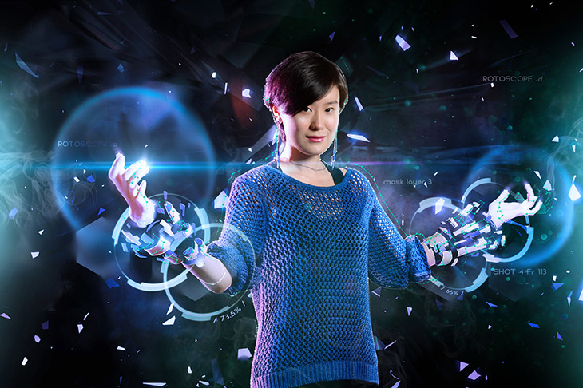
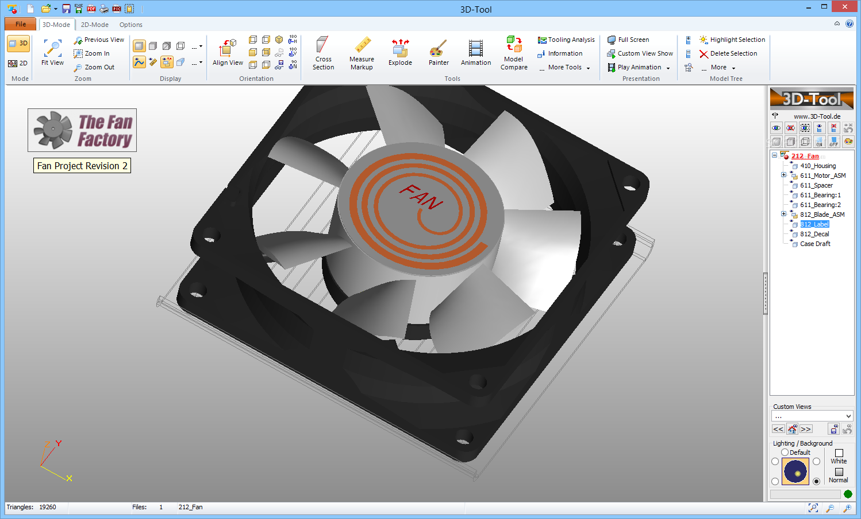
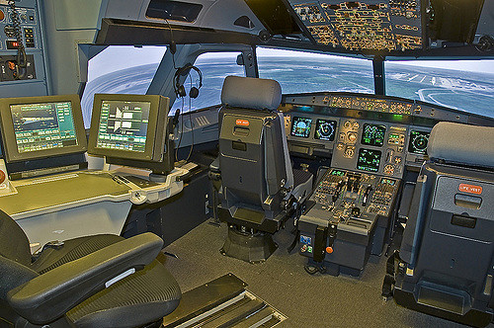
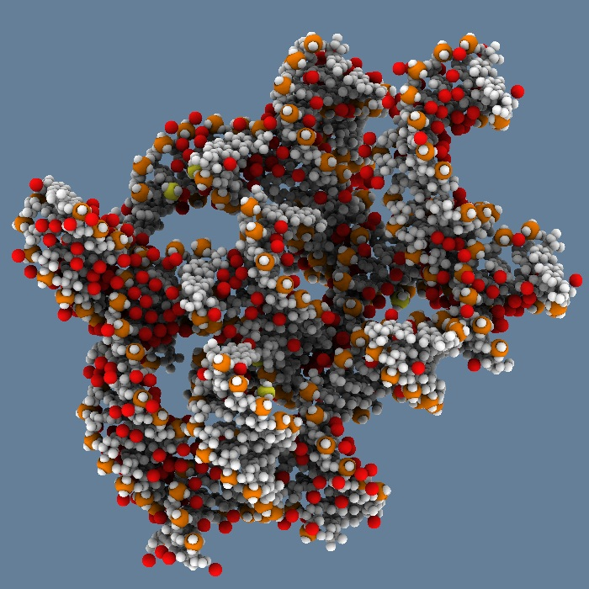
Application Areas
CG is extensively used for:
video games
animation movies
visual effects
CAD/CAM tools
simulation/training
scientific visualization

Slide 11
2D vs 3D
Both 2D and 3D rendering falls in the realm of computer graphics
Many mobile games are in fact 2D
Our primary focus on this course will be on 3D graphics
MoBu by Panteon Games

Slide 12
This Course
In this course, we will learn a little bit about all three subfields within CG
Our focus will be on 3D rendering but we will touch upon modeling and animation as well

Slide 13
The Overall Pipeline
Image generation is a result of scene definition realized by rendering which ultimately is sent to a display device
William Thompson et al. Visual perception from a computer graphics perspective. CRC Press, 2011.

Slide 14
The Overall Pipeline
The output is perceived by a human observer, who may then interact with the system

Slide 15
Display Devices and Perception
Therefore, graphic algorithms must take into consideration the target display device and the viewers’ capabilities
No need to render an 8K image if the target display device is 2K
No need to render tiny details that cannot be perceived by a human

Slide 16
Images and Video
Also, the output of rendering is an image, also known as a frame, which can be directly sent to a display device (real-time rendering) or saved for offline viewing as an image or a sequence of images stored in a video
Therefore, as a starting point, it is important to understand the basic properties of
images,
display devices,
and the human visual system

Slide 17
Course Progression
We will first start with images and displays

Slide 18
Course Progression
We will then talk a little bit of visual perception

Slide 19
Course Progression
Next, we will learn about modeling and rendering

Slide 20
Course Progression
We will finally touch upon animation

Slide 21
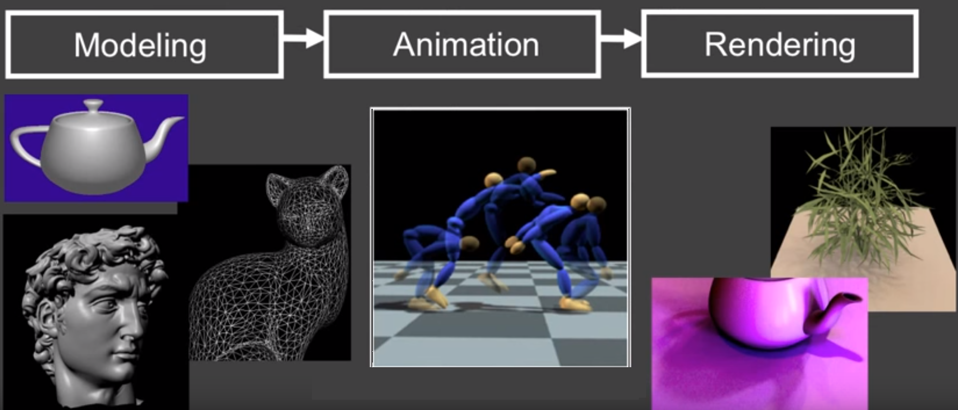
Another Way to Look At It
Create geometric model
(e.g., 2B faces)
Breathe life into them
(e.g., motion capture)
Given the geom-anim, create realistic images (e.g., light propagation)

Slide 22
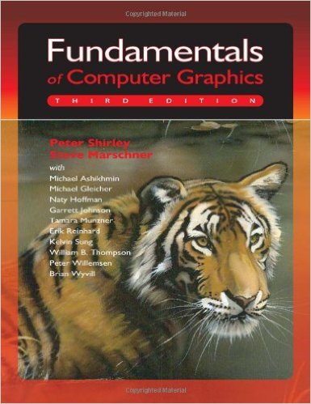
Text Book
Our text book will be Fundamentals of Computer Graphics by Shirley et al.

Slide 23
Website
Our course website is located at:
www.ceng.metu.edu.tr/courses/ceng477
Check it out for important news and updates
Also make sure to regularly check out the newsgroup:
https://cow.ceng.metu.edu.tr/News/thread.php?group=metu.ceng.course.477

Slide 24
Cool Videos for Motivation
Modeling
https://www.youtube.com/watch?v=Oie1ZXWceqM
Animation
https://www.youtube.com/watch?v=pgaEE27nsQw
Rendering
https://www.youtube.com/watch?v=322ptjCeYmw
And much much more.
Also youtube for Siggraph Technical Papers Trailer.

