Slide 1
CENG 477 Introduction to Computer Graphics
Shadows in Forward Rendering

Slide 2
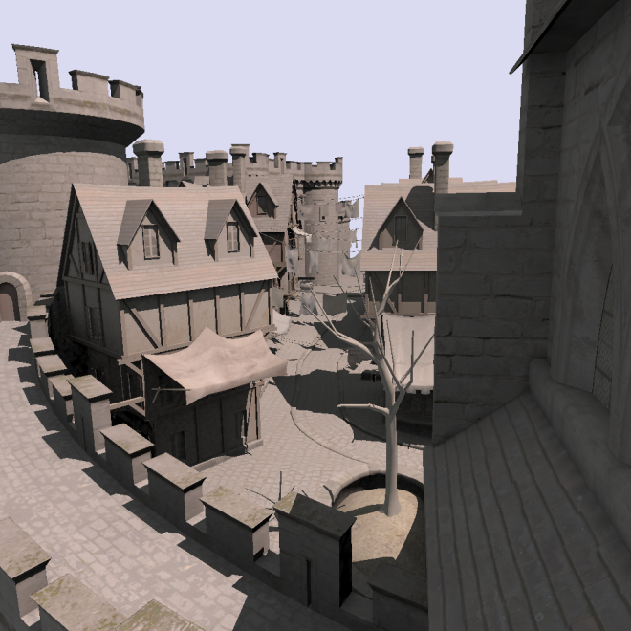
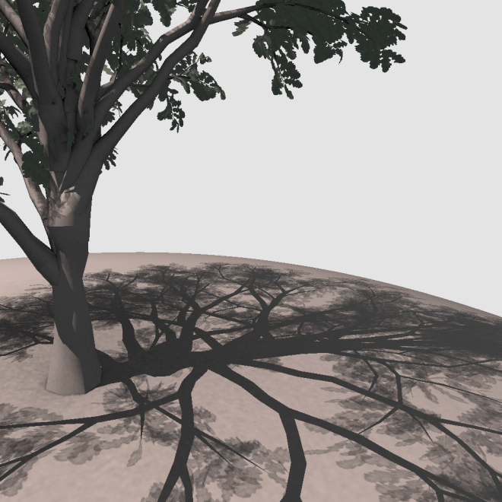
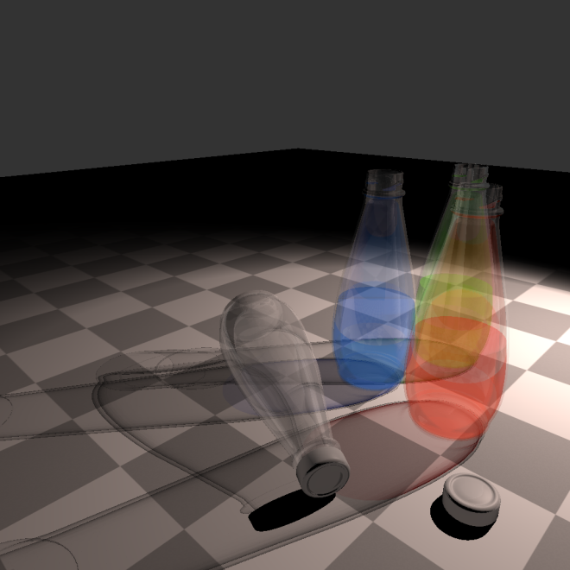
Shadows
Shadows are an important element of visual realism
From Sintorn et al. – Siggraph Asia 2012

Slide 3
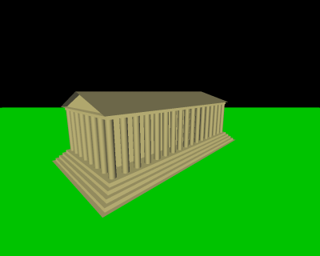
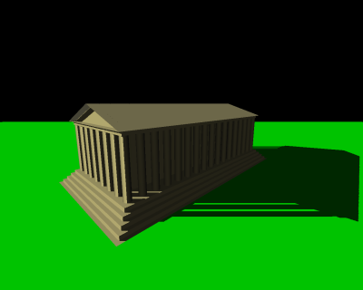
Shadows
Shadows give important cues about light positions
From wikipedia.com

Slide 4
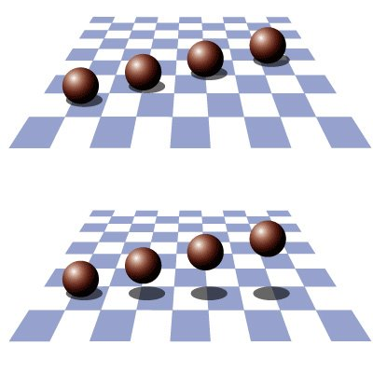
Shadows
Shadows also give cues about object positions

Slide 5
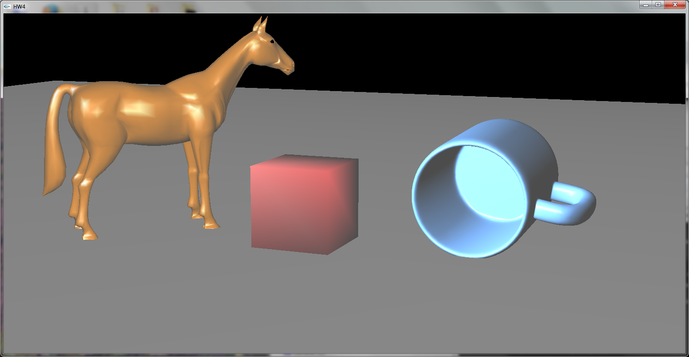
Shadows in OpenGL
OpenGL does not have built-in support for shadows

Slide 6
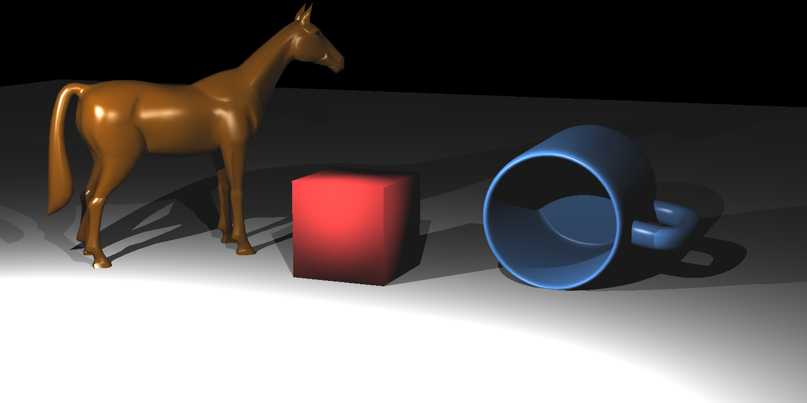
Shadows in OpenGL
Compare this to a ray traced image:
Note that it is natural to get shadows via Ray Tracing
Here we address the forward rendering pipeline, which is the opposite

Slide 7
Shadows in OpenGL
OpenGL does not natively support generating shadows (neither does D3D)
That is, it does not have a function like glMakeShadow()!
But, several shadowing algorithms can easily be implemented using features of OpenGL (or D3D)
Stencil buffer
Depth buffer
Render to texture
…

Slide 8
Generating Shadows
Two algorithms that are commonly used are:
Shadow volumes (Crow, 1977)
Shadow mapping (Williams, 1978)
Both algorithm has advantages and disadvantages and many variants
Still an active research area:
An improved shadow volume algorithm presented at Siggraph Asia 2012: An Efficient Alias-free Shadow Algorithm for Opaque and Transparent Objects using per-triangle Shadow Volumes, by Sintorn et al.
We’ll study the basic versions of these algorithms
Notes:
- CROW, F. C. 1977. Shadow algorithms for computer graphics. SIGGRAPH Comput. Graph. 11 (July), 242–248.
- WILLIAMS, L. 1978. Casting curved shadows on curved surfaces. SIGGRAPH Comput. Graph. 12 (August), 270–274.

Slide 9
Shadow Volumes
The idea is to create a 3D shape that represents the shadow that is casted by an object
Unshadowed
object
Shadow volume
(extends to infinity)
Light
Shadow
caster
Shadowed
object

Slide 10
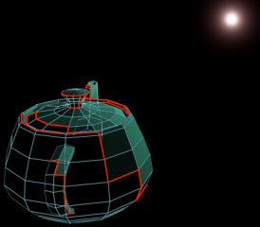
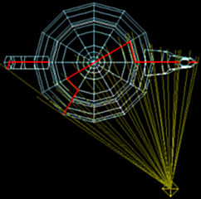
Shadow Volumes
A shadow volume can be created for any arbitrary object.
We need to determine the contour edges (silhouette-edges) of the object as seen from the light source
A contour edge has one adjacent polygon facing the light source and the other away from the light source
From John Tsiombikas

Slide 11
Contour Edges
A contour edge has one adjacent polygon facing the light source and the other away from the light source
We can use dot product to decide whether a face is toward or away from the light source
Face
normals
Light
Shadow
caster object

Slide 12
Contour Edges
// transform the light to the coordinate system of the object
LightPosition = Inverse(ObjectWorldMatrix) * LightPosition;
for (every polygon) {
IncidentLightDir = AveragePolyPosition - LightPosition;
// if the polygon faces away from the light source....
if (DotProduct(IncidentLightDir, PolygonNormal) >= 0.0) {
for (every edge of the polygon) {
if (the edge is already in the contour edge list) {
// then it can't be a contour edge since it is
// referenced by two triangles that are facing
// away from the light
remove the existing edge from the contour list;
} else {
add the edge to the contour list;
}
}
}
}
From John Tsiombikas

Slide 13
Extruding Contour Edges
Once the contours are found, we need to extrude them to create a large shadow volume
Light

Slide 14
Extruding Contour Edges
Extrusion amount should be large enough to cover all objects which can receive shadow from this light source
ExtrudeMagnitude = A_BIG_NUMBER;
for (every edge) {
ShadowQuad[i].vertex[0] = edge[i].vertex[0];
ShadowQuad[i].vertex[1] = edge[i].vertex[1];
ShadowQuad[i].vertex[2] = edge[i].vertex[1] + ExtrudeMagnitude *
(edge[i].vertex[1] - LightPosition);
ShadowQuad[i].vertex[3] = edge[i].vertex[0] + ExtrudeMagnitude *
(edge[i].vertex[0] - LightPosition);
}
From John Tsiombikas

Slide 15
Extruding Contour Edges
The shadow caster object’s contour vertices serve as the cap of the shadow volume.
The bottom can also be capped to obtain a closed volume.
Light

Slide 16
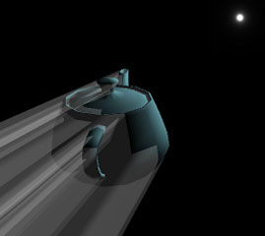
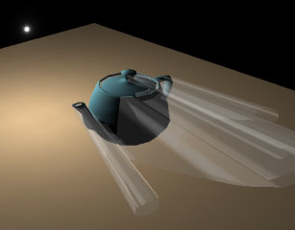
Extruding Contour Edges
This is how it looks like for a complex object
From John Tsiombikas

Slide 17
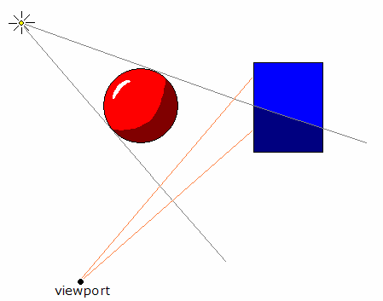
Rendering Shadows
Now what? Any ideas about how we can proceed?
light
From John Tsiombikas
camera

Slide 18
Rendering Shadows
Assume a ray originating from the eye
If it enters the shadow volume from a front face and exits from a back face, the point it reaches is not in shadow
However, if it does not exit before hitting the object, the point should be in shadow
light
camera

Slide 19
Rendering Shadows
But we are not ray tracing! How can we know if the ray enters or exits?
This is where depth and stencil buffers come in handy
Stencil buffer:
An integer buffer that stores a value for every pixel (usually an 8-bit value)
We can clear it to any value that we want (glClearStencil(int) and glClear(GL_STENCIL_BUFFER_BIT))
Has operations such as increment and decrement based on the result of the depth test (glStencilOp(sfail, dpass, dfail))
Think of stencil buffer as a counter buffer, which keeps a counter for every pixel

Slide 20
Shadow Volume Algorithm (Part I)
Clear the depth (to 1.0) and stencil buffer (to 0)
Enable depth testing and disable stencil testing
Render the scene with ambient light (note that ambient light does not produce shadows). This updates the depth buffer value for every pixel that corresponds to an object
Disable writing to the depth buffer
0 | 0 | 0 | 0 | 0 | 0 | 0 | 0
0 | 0 | 0 | 0 | 0 | 0 | 0 | 0
0 | 0 | 100 | 100 | 100 | 100 | 0 | 0
0 | 0 | 100 | 100 | 100 | 100 | 0 | 0
0 | 0 | 100 | 100 | 100 | 100 | 0 | 0
0 | 0 | 100 | 100 | 100 | 100 | 0 | 0
0 | 0 | 0 | 0 | 0 | 0 | 0 | 0
0 | 0 | 0 | 0 | 0 | 0 | 0 | 0
1.0 | 1.0 | 1.0 | 1.0 | 1.0 | 1.0 | 1.0 | 1.0
1.0 | 1.0 | 1.0 | 1.0 | 1.0 | 1.0 | 1.0 | 1.0
1.0 | 1.0 | 0.5 | 0.5 | 0.5 | 0.5 | 1.0 | 1.0
1.0 | 1.0 | 0.5 | 0.5 | 0.5 | 0.5 | 1.0 | 1.0
1.0 | 1.0 | 0.5 | 0.5 | 0.5 | 0.5 | 1.0 | 1.0
1.0 | 1.0 | 0.5 | 0.5 | 0.5 | 0.5 | 1.0 | 1.0
1.0 | 1.0 | 1.0 | 1.0 | 1.0 | 1.0 | 1.0 | 1.0
1.0 | 1.0 | 1.0 | 1.0 | 1.0 | 1.0 | 1.0 | 1.0
0 | 0 | 0 | 0 | 0 | 0 | 0 | 0
0 | 0 | 0 | 0 | 0 | 0 | 0 | 0
0 | 0 | 0 | 0 | 0 | 0 | 0 | 0
0 | 0 | 0 | 0 | 0 | 0 | 0 | 0
0 | 0 | 0 | 0 | 0 | 0 | 0 | 0
0 | 0 | 0 | 0 | 0 | 0 | 0 | 0
0 | 0 | 0 | 0 | 0 | 0 | 0 | 0
0 | 0 | 0 | 0 | 0 | 0 | 0 | 0
Color Buffer
Depth Buffer
Stencil Buffer

Slide 21
Shadow Volume Algorithm (Part II)
Draw the front faces of the shadow volume. Increment the stencil value for every pixel that passes the depth test (glStencilOp(GL_KEEP, GL_KEEP, GL_INCR)).
Draw the back faces of the shadow volume. Decrement the stencil value for every pixel that passes the depth test (glStencilOp(GL_KEEP, GL_KEEP, GL_DECR)).
Stencil Buffer – First Pass
Stencil Buffer – Second Pass
0 | 0 | 0 | 0 | 0 | 0 | 0 | 0
0 | 0 | 0 | 0 | 0 | 0 | 0 | 0
0 | 0 | 1 | 1 | 1 | 1 | 0 | 0
0 | 0 | 1 | 1 | 1 | 1 | 0 | 0
0 | 0 | 1 | 1 | 1 | 1 | 0 | 0
0 | 0 | 1 | 1 | 1 | 1 | 0 | 0
0 | 0 | 0 | 0 | 0 | 0 | 0 | 0
0 | 0 | 0 | 0 | 0 | 0 | 0 | 0
0 | 0 | 0 | 0 | 0 | 0 | 0 | 0
0 | 0 | 0 | 0 | 0 | 0 | 0 | 0
0 | 0 | 0 | 0 | 0 | 0 | 0 | 0
0 | 0 | 0 | 0 | 0 | 0 | 0 | 0
0 | 0 | 1 | 1 | 1 | 1 | 0 | 0
0 | 0 | 1 | 1 | 1 | 1 | 0 | 0
0 | 0 | 0 | 0 | 0 | 0 | 0 | 0
0 | 0 | 0 | 0 | 0 | 0 | 0 | 0

Slide 22
Shadow Volume Algorithm (Part III)
Enable stencil testing such that pixels whose stencil value is zero will be rendered.
Enable writing to the depth buffer and clear it.
Enable the point light source.
Enabling color buffer blending so the contribution of passing pixels will be added to the previous ambient values.
Color Buffer
Depth Buffer
Stencil Buffer
0 | 0 | 0 | 0 | 0 | 0 | 0 | 0
0 | 0 | 0 | 0 | 0 | 0 | 0 | 0
0 | 0 | 150 | 150 | 150 | 150 | 0 | 0
0 | 0 | 150 | 150 | 150 | 150 | 0 | 0
0 | 0 | 100 | 100 | 100 | 100 | 0 | 0
0 | 0 | 100 | 100 | 100 | 100 | 0 | 0
0 | 0 | 0 | 0 | 0 | 0 | 0 | 0
0 | 0 | 0 | 0 | 0 | 0 | 0 | 0
1.0 | 1.0 | 1.0 | 1.0 | 1.0 | 1.0 | 1.0 | 1.0
1.0 | 1.0 | 1.0 | 1.0 | 1.0 | 1.0 | 1.0 | 1.0
1.0 | 1.0 | 0.5 | 0.5 | 0.5 | 0.5 | 1.0 | 1.0
1.0 | 1.0 | 0.5 | 0.5 | 0.5 | 0.5 | 1.0 | 1.0
1.0 | 1.0 | 1.0 | 1.0 | 1.0 | 1.0 | 1.0 | 1.0
1.0 | 1.0 | 1.0 | 1.0 | 1.0 | 1.0 | 1.0 | 1.0
1.0 | 1.0 | 1.0 | 1.0 | 1.0 | 1.0 | 1.0 | 1.0
1.0 | 1.0 | 1.0 | 1.0 | 1.0 | 1.0 | 1.0 | 1.0
0 | 0 | 0 | 0 | 0 | 0 | 0 | 0
0 | 0 | 0 | 0 | 0 | 0 | 0 | 0
0 | 0 | 0 | 0 | 0 | 0 | 0 | 0
0 | 0 | 0 | 0 | 0 | 0 | 0 | 0
0 | 0 | 1 | 1 | 1 | 1 | 0 | 0
0 | 0 | 1 | 1 | 1 | 1 | 0 | 0
0 | 0 | 0 | 0 | 0 | 0 | 0 | 0
0 | 0 | 0 | 0 | 0 | 0 | 0 | 0

Slide 23
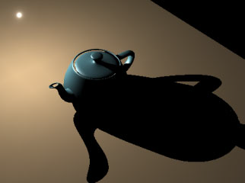
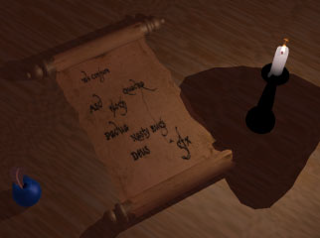
Shadow Volume Algorithm
No blending versus blending:
From John Tsiombikas

Slide 24
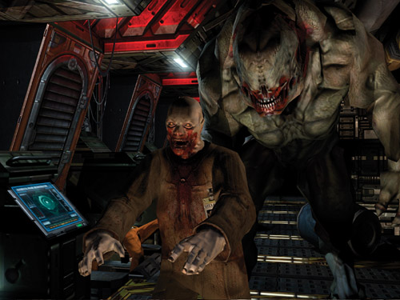
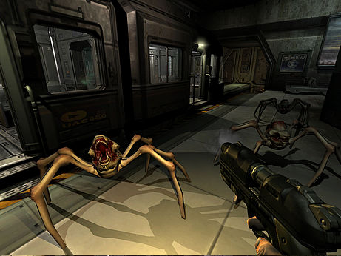
Used Applications
Doom 3 is the most well-known example.
From http://http.developer.nvidia.com/GPUGems/gpugems_ch09.html

Slide 25
Pros and Cons
Requires preprocessing of the scene geometry to create the shadow volume.
Needs to be updated if lights and/or objects move.
Can be time consuming for complex geometry.
Requires 4 rendering passes for each frame.
Ambient pass, SV front-face pass, SV back-face pass, final light source pass.
No need to update shadow volume if only the camera moves.

Slide 26
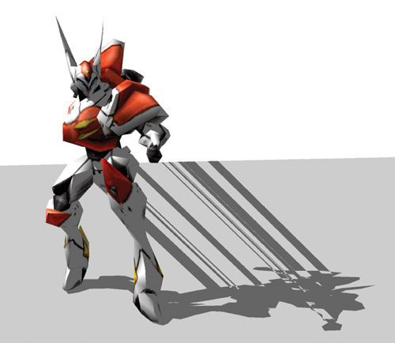
Pros and Cons
Inaccurate models can cause leaking artifacts.
From http://http.developer.nvidia.com/GPUGems/gpugems_ch09.html

Slide 27
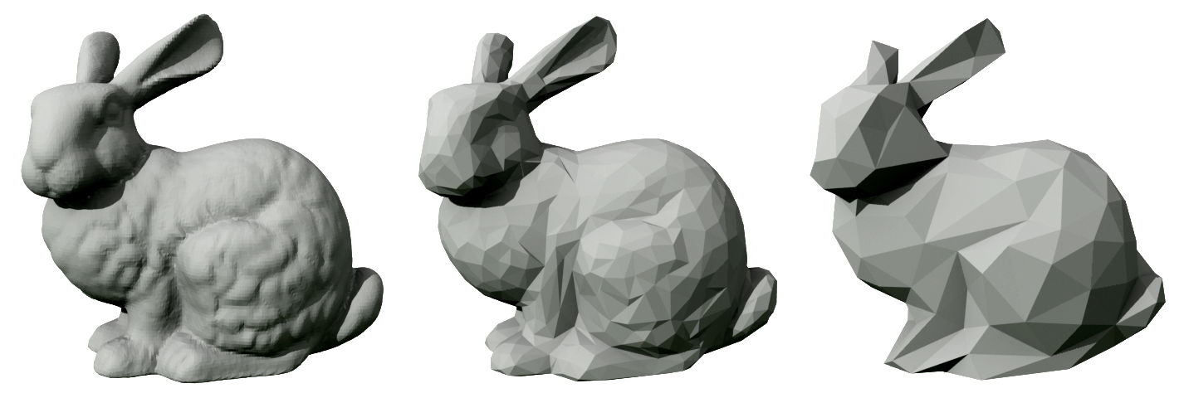
Pros and Cons
For speed-up, two versions of objects can be created.
High polygon version is used for actual rendering of the object.
Low polygon version is used to cast shadows of the object.
From wikipedia.com

Slide 28
Exercises and Questions
How can the shadow volume algorithm be extended to deal with:
Camera inside the shadow volume?
Multiple light sources and multiple shadow casters?
Transparent shadow casters?
Further reading:
http://http.developer.nvidia.com/GPUGems/gpugems_ch09.html
For the adventurous:
Read the recent Siggraph Asia 2011 paper that proposes an improvement for shadow volumes:
Sintorn, E., Olsson, O., Assarsson, U. 2011. An Efficient Alias-free Shadow Algorithm for Opaque and Transparent Objects using per-triangle Shadow Volumes. ACM Trans. Graph. 30, 6, Article 153 (December 2011), 10 pages. http://doi.acm.org/10.1145/2024156.2024187.

Slide 29
Shadow Mapping
The idea introduced by Lance Williams in his 1978 paper “Casting Curved Shadows on Curved Surfaces”.
Image space technique.
Advantages:
No knowledge or processing of scene geometry is required!
No need to use stencil buffer.
Fewer rendering passes than shadow volumes for a single light source.
Disadvantages:
Need an extra rendering pass for each additional light.
Aliasing artifacts may occur (shadows may look jaggy).

Slide 30
Shadow Mapping
Part 1: Render the scene from the point of view of the light source (as if the light source was a camera).
Objects that are not visible are in shadow with respect to that light source.
Part II: Determine whether an object as seen from the camera is in shadow in the “light’s view”.

Slide 31
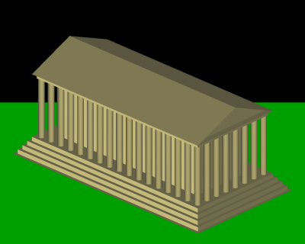
Part I: Rendering from the Light Source
Pretend that there is a camera at the light position.
Use perspective projection for spot (and point) lights.
Use orthographic projection for directional lights.
Original camera view
Light source view

Slide 32
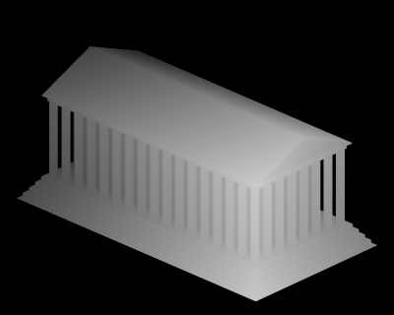
Part I: Extracting the Depth Map
Actually, we only need the depth buffer values from the light source view.
Save this depth buffer to an off-screen texture.
Depth map from the light’s view

Slide 33
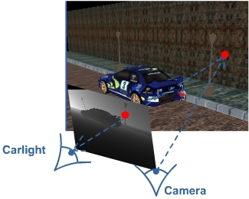
Part I: Extracting the Depth Map
To implement this idea, apply model view projection matrix of the light source to each scene point (glVertex)
Now the transformed vertices have the desired depth values to be compared for shadow situation
If the depth of point A is larger than that of B, then A is in shadow (behind B w.r.t. light’s position)

Slide 34
Projective Texturing
For every pixel in the camera view, we need to find the corresponding pixel in the light’s view.
From http://www.riemers.net/images/Tutorials/DirectX/Csharp/Series3

Slide 35
Projective Texturing
Assume inPos represents the world coordinates of an object. Its camera coordinates are computed by:
Its light view coordinates are computed by:
We can use Output.ShadowMapSamplingPos to fill the depth texture
Output.Position = mul(inPos, cameraWorldViewProjection);
Output.ShadowMapSamplingPos = mul(inPos, lightWorldViewProjection);

Slide 36
Shadow Mapping
We have omitted some minor details but you can read more online:
Projective texturing:
http://developer.nvidia.com/object/Projective_Texture_Mapping.html http://en.wikipedia.org/wiki/Projective_texture_mapping
OpenGL fixed function implementation:
http://www.paulsprojects.net/tutorials/smt/smt.html
OpenGL shader (GLSL) implementation:
www.gamedev.net/community/forums/topic.asp?topic_id=316147
http://sombermoon.com/shadowmappingdoc.html

Slide 37
Importance of Shadow Map Resolution
Camera is close to object A, but light is far
When we move camera to light’s position, A will occupy few pixels, so there will be few depth values to be used in shadow computation
This may cause artifacts as we loose info from a distant cam
To fix this, use a larger viewport (higher resolution) while rendering the distant camera at the light’s position
Can be done easily because we are actually rendering to frame buffer, which is not an actual texture image

Slide 38
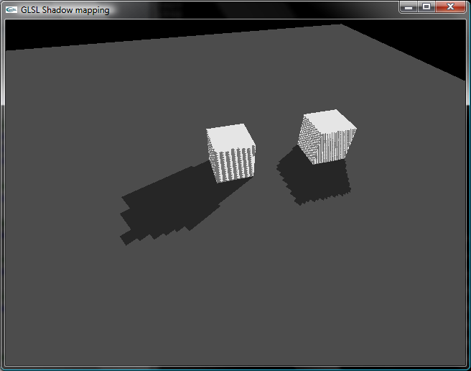
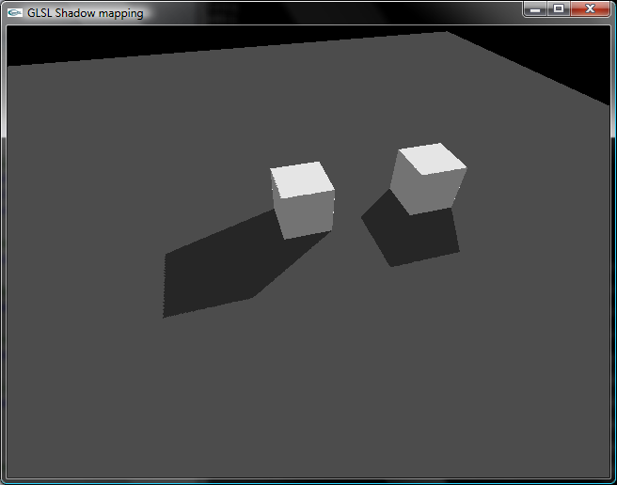
Importance of Shadow Map Resolution
If the depth texture we create in Part I does not have enough resolution, we can see blocking artifacts:
From http://bytechunk.net
160x120 shadow map
1280x960 shadow map

Slide 39
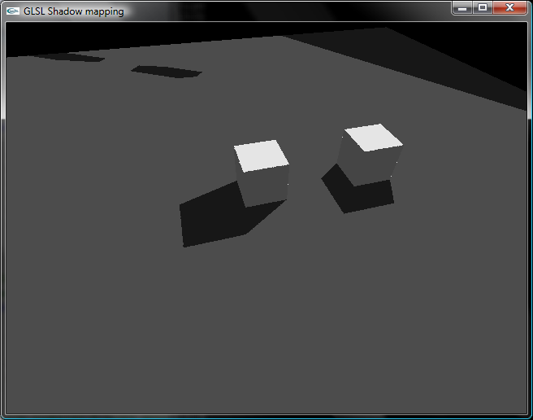
Projection Artifacts
If an object falls outside the viewing frustum of the light, we can see artifacts with a naïve implementation:
For how to fix these, read more at:
http://bytechunk.net/shadowmapping/index.php

Slide 40
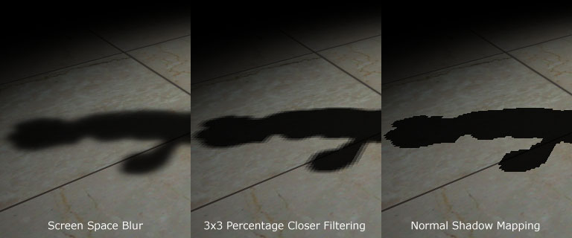
Improving the Shadow Quality
Shadow map can be filtered in various ways to create soft shadows:
From http://www.gamedev.net

Slide 41
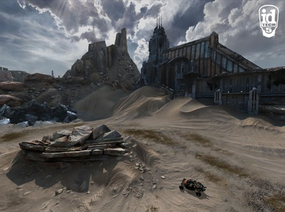
Applications Using Shadow Maps
Most games use shadow mapping.
Rage

Slide 42
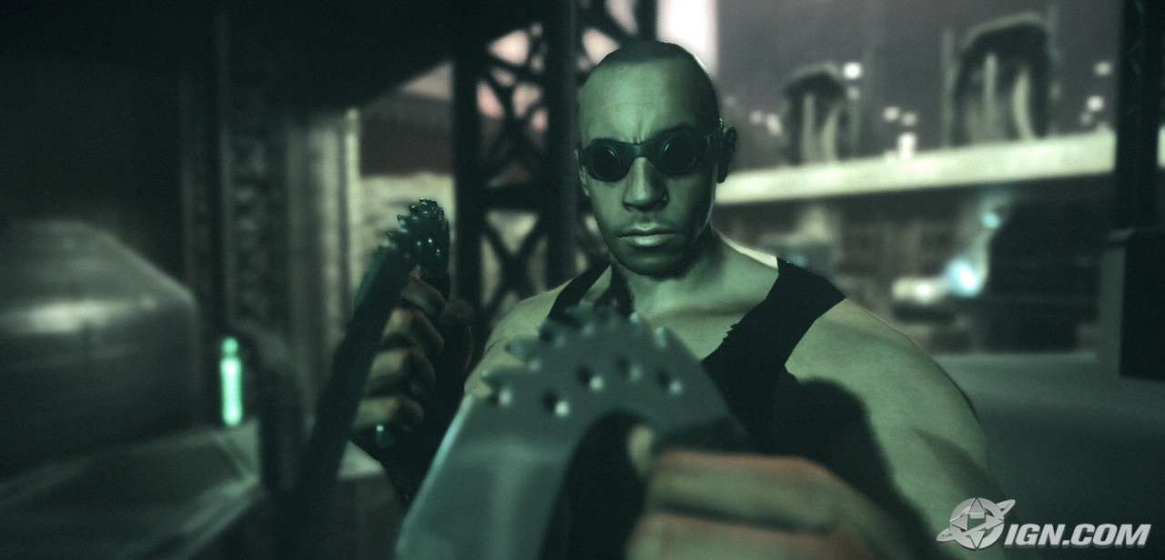
Applications Using Shadow Maps
Riddick 2: Assault on Dark Athena
From http://uk.ps3.ign.com

Slide 43
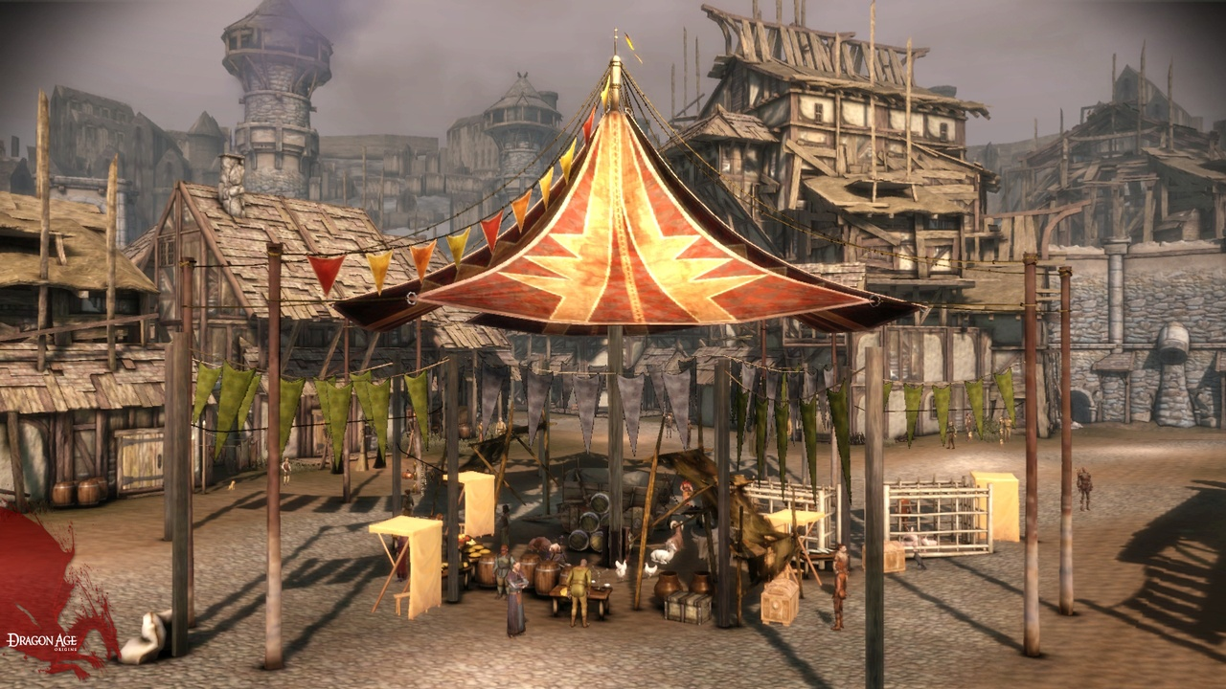
Applications Using Shadow Maps
Dragon Age
From https://graphics.stanford.edu

Slide 44
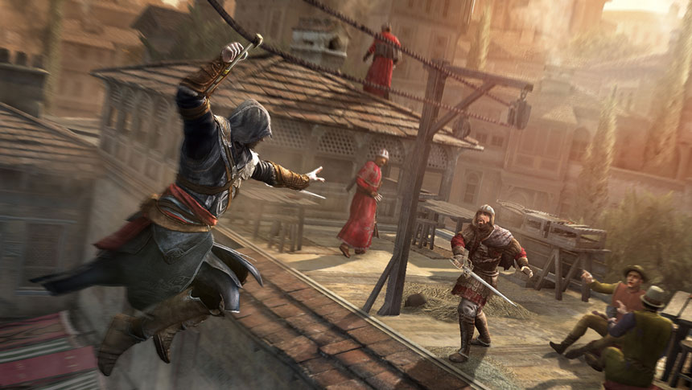
Applications Using Shadow Maps
Assassin’s Creed
From http://kotaku.com

