Slide 1
CENG 538 Advanced Graphics and UIs
Data Structures for Graphics

Slide 2
Until Now
We rendered virtual objects
Ray tracing
Ray are easy: r(t) = o + dt
Mathematical objects also easy: x² + y² + z² = R²
How about arbitrary objects embedded in 2D/3D scenes?
Today we will learn how to
explicitly represent those objects
triangle meshes
implicitly represent those objects as well as organize them
spatial structures

Slide 3
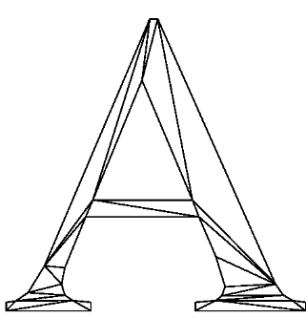
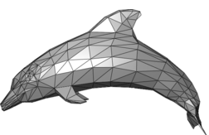
Triangle Meshes
The most popular way of representing geometry embedded in 2D or 3D.

Slide 4
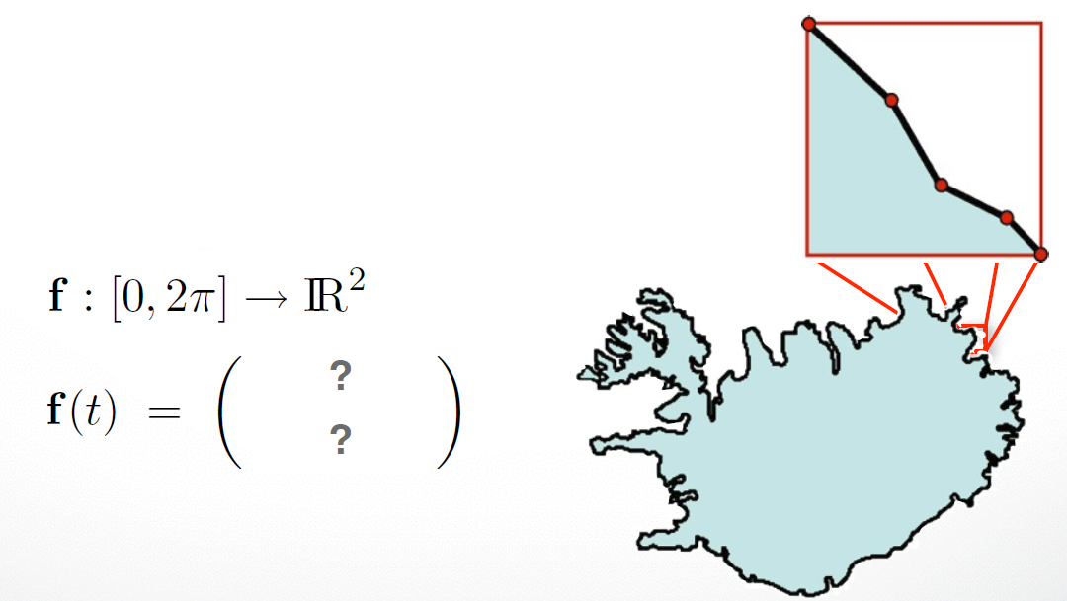
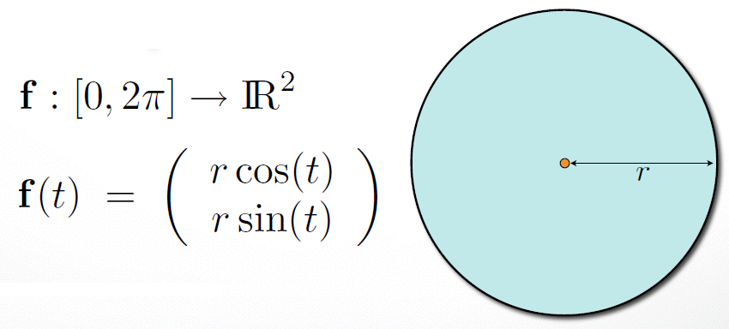
Triangle Meshes
The most popular way of representing geometry embedded in 2D or 3D.
A triangle mesh is a piecewise linear surface representaton.
Parametric Representation vs Piecewise Representation
More flexible! Good
for arbitrary objects

Slide 5
Triangle Meshes
The most popular way of representing geometry embedded in 2D or 3D.
A triangle mesh is a piecewise linear surface representaton.
Analogous to piecewise functions
Each function (surface patch) needs to approximate the given shape only locally

Slide 6
Triangle Meshes
1D: This line piece approximates the given shape (circle) only locally.
2D: This triangle piece approximates the given shape (sphere) only locally.

Slide 7
Triangle Meshes
Approximation error is quadratic.
As # pieces get doubled, error decreases one fourth.
Any other way to decrease this approx. error?
Use nonlinear pieces. However, smoothness conditions b/w pieces hard to satisfy now ☹

Slide 8
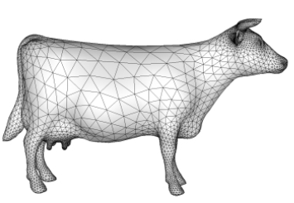
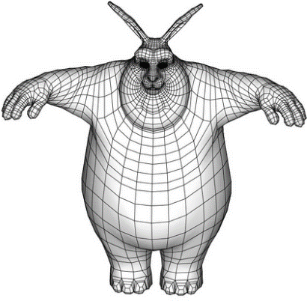
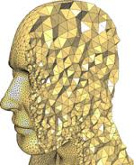
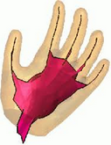
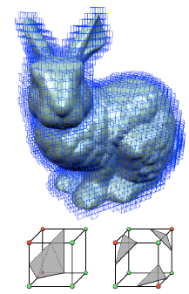
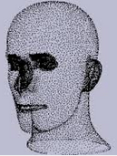
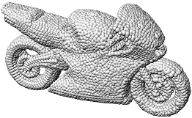
Triangle Meshes
We are interested in thin-shell surfaces, represented by triangle meshes: set of triangles representing a 2D surface embedded in 3D.
quad mesh
Other representations
implicit

Slide 9
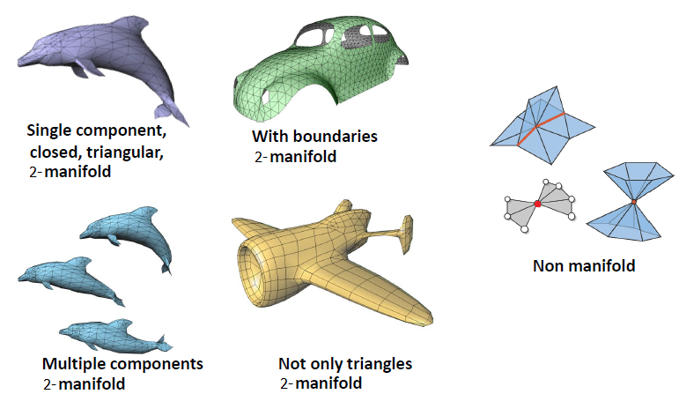
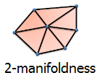
Triangle Meshes
Terminology
Locally homeomorphic
to a disk (or half disk)

Slide 10
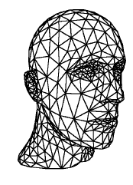
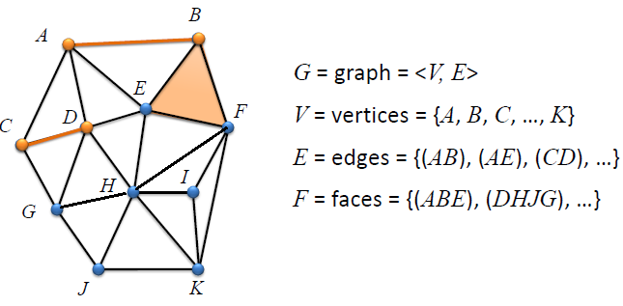
Triangle Meshes
Triangle mesh is an undirected graph with triangle faces

Slide 11
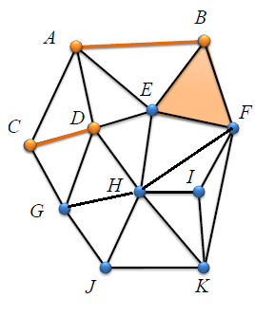
Triangle Meshes
Triangle mesh is an undirected graph with triangle faces
Vertex degree or valence = # incident edges
deg(A) = 4 deg(B) = 3
k-regular mesh if all vertex degrees are equal to k.

Slide 12
Triangle Meshes
Triangle mesh is an undirected graph with triangle faces
Connected if every pair of vertices
are connected by a path (of edges).

Slide 13
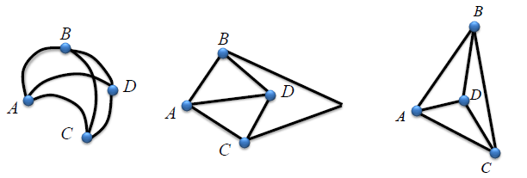
Triangle Meshes
Triangle mesh is an undirected graph with triangle faces
A special one: straight-line plane graph where every face is a triangle, a.k.a. triangulation.
Planar graph: graph whose vertices and edges can be embedded in 2D without intersecting edges.
Planar graph Plane graph Straight-line plane graph

Slide 14
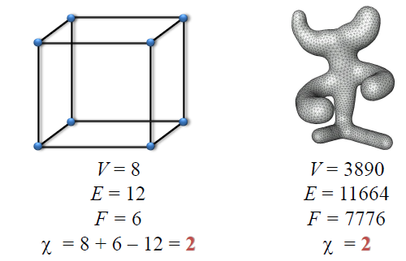
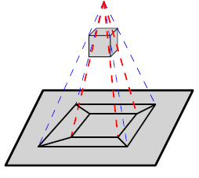
Mesh Statistics
Euler formula for planar graphs to derive mesh statistics
Holds for all polygon faces: triangle, quad, pentagon, ..
V – E + F = 2

Slide 15
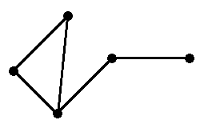
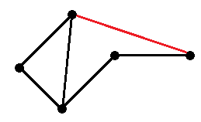
Mesh Statistics
Euler formula proof by induction
Induct on E, # edges
Base Case: 2 – 1 + 1 = 2 //holds ☺
Inductive Step: Assume formula is True for planar subgraph with E edges. Show that it must also be T for planar graph with E+1 edges
→
Add new (red) edge → V – (E + 1) + (F + 1) = 2 ☺ because
V – E + F = 2 by inductive hypothesis.

Slide 16
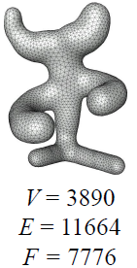
Mesh Statistics
Based on Euler’s formula
F ~ 2V
E ~ 3V
AVD ~ 6
(Average Vertex Degree)

Slide 17
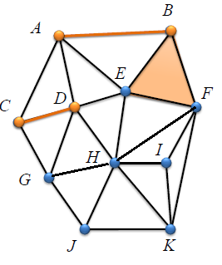
Mesh Statistics
E ~ 3V
Count 3 edges for each face → E = 3F
Note that each edge counted twice → 2E = 3F
Euler → V – E + 2E/3 = 0 (2 negligible) → E ~ 3V
F ~ 2V
Euler → V – 3F/2 + F = 0 (2 negligible) → F ~ 2V
AVD = sum of all degrees / V = 2E / V ~ 6V / V
(handshaking lemma: sum = 2E)

Slide 18
Mesh Structures
How to store geometry & connectivity of a mesh.
3D vertex coordinates Vertex adjacency
Attributes also stored: normal, color, texture coords, labels,
Efficient algorithms on meshes to get:
All vertices/edges of a face
All incident vertices/edges/faces of a vertex

Slide 19
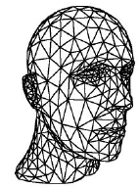
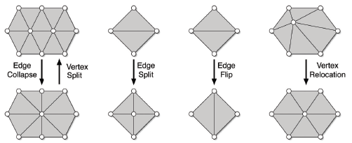
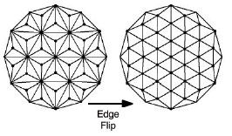
Mesh Structures
Classical queries
What are the vertices of face 77?
Is vertex 7 adjacent to vertex 17?
Which edges are incident to vertex 27?
Which faces are incident to vertex 27?
Classical operations:
Remove/add vertex/face
Split/collapse/flip edges
Change vertex coordinates
Topological vs. geometrical

Slide 20
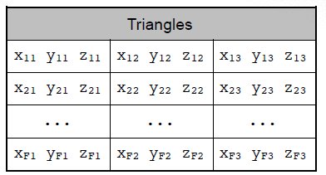
Face-based Structures
Face-Set Data Structure (.stl format)
Aka polygon soup as there is no connectivity information
Vertices and associated data replicated ☹
Using 32-bit single precision numbers to represent vertex coords, we need 32/8 (bytes) * 3 (x-y-z coords) * 3 (# vertices) = 36 bytes per triangle. By Euler formula (F ~ 2V), each vertex consumes 72 bytes on average.

Slide 21
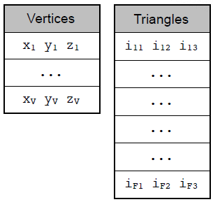
Face-based Structures
Indexed Face-Set Data Structure (.obj, .off, .ply format)
Aka shared-vertex data structure
No vertex replication ☺
Using 32-bit single precision numbers to represent vertex coords, we need 4 (bytes) * 3 (# indices) = 12 bytes per triangle (24 bytes per vertex). We also need 4 (bytes) * 3 (x-y-z coords) = 12 bytes per vertex. Total = 36 bytes per vertex, half of Face-Set structure ☺

Slide 22
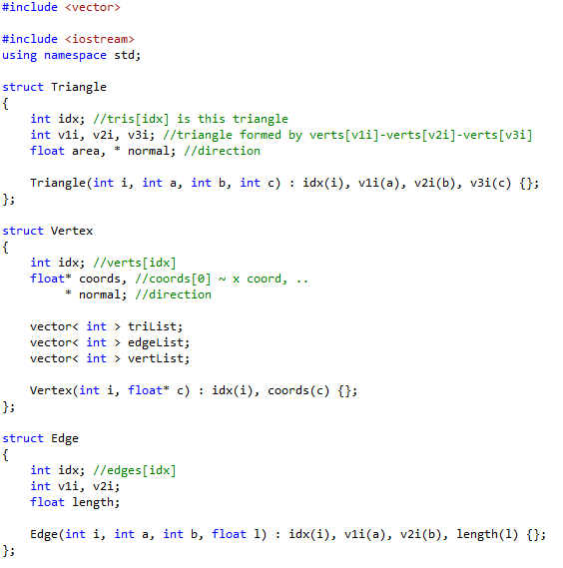
Face-based Structures
A sample implementation of Indexed Face-Set Data Structure

Slide 23
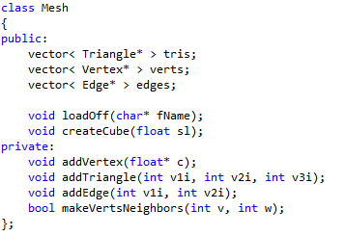
Face-based Structures
A sample implementation of Indexed Face-Set Data Structure

Slide 24
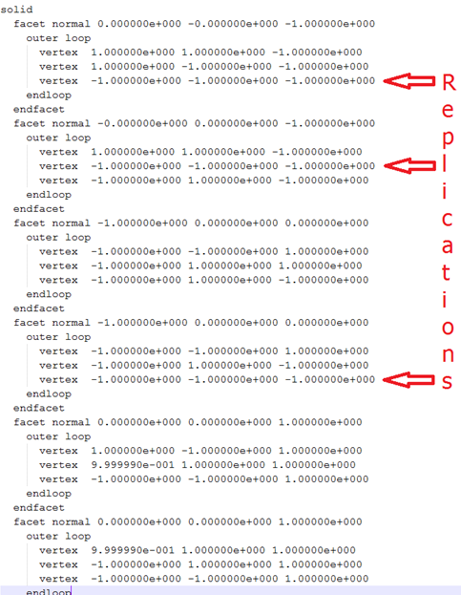
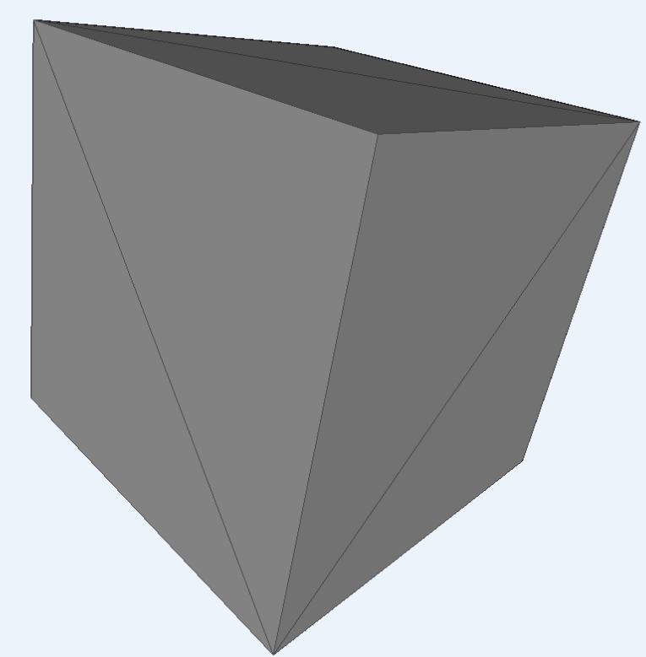
Face-based Structures
Face-Set Data Structure

Slide 25
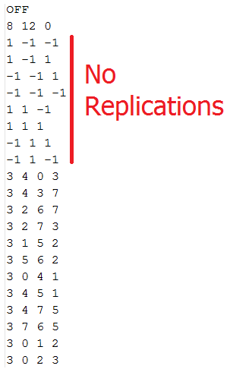
Face-based Structures
Indexed Face-Set Data Structure

Slide 26
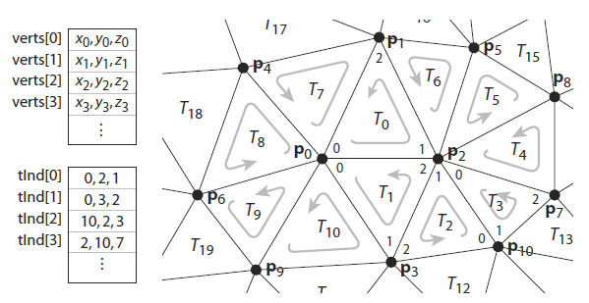
Face-based Structures
Regardless of the structure, triangle vertices are stored in a consistent order
Mostly counterclockwise (CCW)

Slide 27
Edge-based Structures
Note that explicit storage of edges, e.g., Edge struct above, enables efficient implementations for
one ring enumeration
traversal of edges of a face
access to incident faces of an edge
access to endpoints of an edge
We can also use edge-based structures to address these requests

Slide 28
Edge-based Structures
Winged-edge structure
Each edge stores references to
its endpoint vertices
its two incident faces
the next and previous edge within the left and right face

Slide 29
Edge-based Structures
Halfedge-based structure
Split each edge into 2 oriented halfedges
Each halfedge stores references to
the vertex it points to,
its adjacent face (a zero pointer if it is a boundary halfedge),
the next halfedge of the face or boundary (in ccwise direction),
the previous halfedge in the face, and
its opposite (or inverse) halfedge.

Slide 30
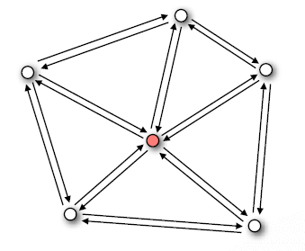
Edge-based Structures
Halfedge-based structure one-ring traversal demo
Start at vertex

Slide 31
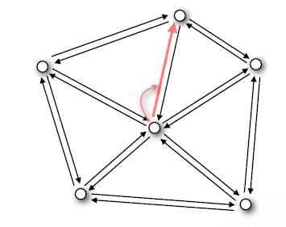
Edge-based Structures
Halfedge-based structure one-ring traversal demo
Outgoing halfedge

Slide 32
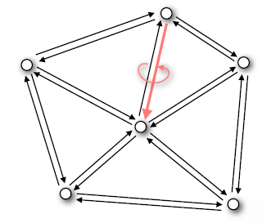
Edge-based Structures
Halfedge-based structure one-ring traversal demo
Opposite halfedge

Slide 33
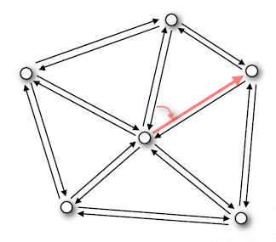
Edge-based Structures
Halfedge-based structure one-ring traversal demo
Next halfedge

Slide 34
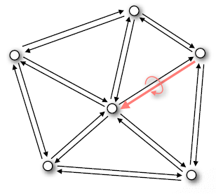
Edge-based Structures
Halfedge-based structure one-ring traversal demo
Opposite halfedge

Slide 35
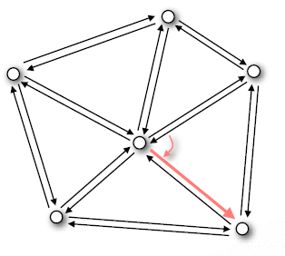
Edge-based Structures
Halfedge-based structure one-ring traversal demo
Next halfedge
And so on..

Slide 36
Edge-based Structures
Halfedge-based structure one-ring traversal demo
Code

Slide 37
Mesh Structure Libraries
CGAL
OpenMesh

Slide 38
Spatial Structures
So far we learnt how to represent shapes explicitly using efficient mesh structures
Now we learn how to represent shapes implicitly using spatial structures
Also we learn how to organize/index shapes in a scene using spatial structures

Slide 39
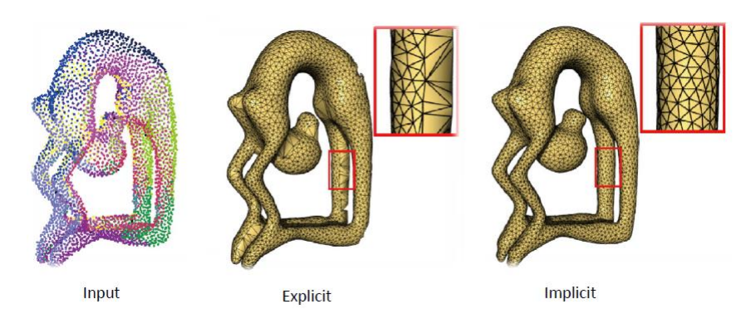
Regular Grid
Given a set of 3D points, explicit vs. implicit reconstruction of the underlying surface looks like this

Slide 40
Regular Grid
Given a set of 3D points, explicit vs. implicit reconstruction of the underlying surface looks like this

Slide 41
Regular Grid
Explicit reconstruction
Connect sample points by triangles
Exact interpolation of sample points
Bad for noisy or misaligned data (common in scans)
May lead to holes or non-manifoldness

Slide 42
Regular Grid
Implicit reconstruction
Estimate signed distance function (SDF) for each grid point (scalar-valued grid)
Extract level zero iso-surface from this grid (Marching Cubes)
Approximation of input points (better in noisy situations)
Manifoldness by construction

Slide 43
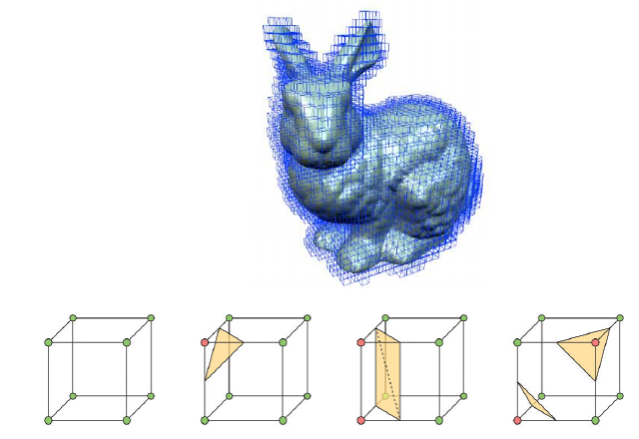
Regular Grid
A continuous scalar field F is discretized in some bounding box around the object using a dense grid with nodes g

Slide 44
Regular Grid
F is computed as a Signed Distance Function
F(g) = (g-o_{i}).n_{i}

Slide 45
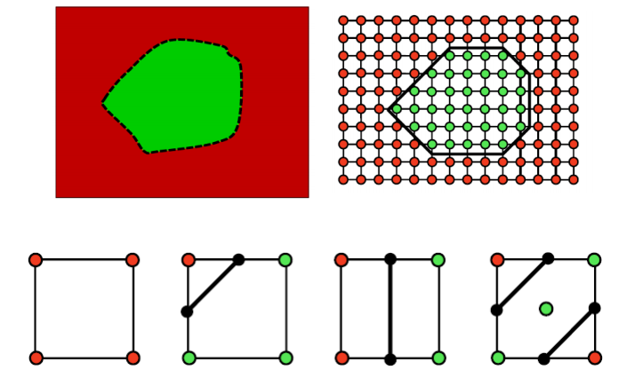
Regular Grid
F(g) = (g-o_{i}).n_{i} //Positive F(g) in red, negative in green
Extract surface (or curve in this 2D case) where F = 0

Slide 46
Regular Grid
F(g) = (g-o_{i}).n_{i} //Positive F(g) in red, negative in green
Extract surface where F = 0

Slide 47
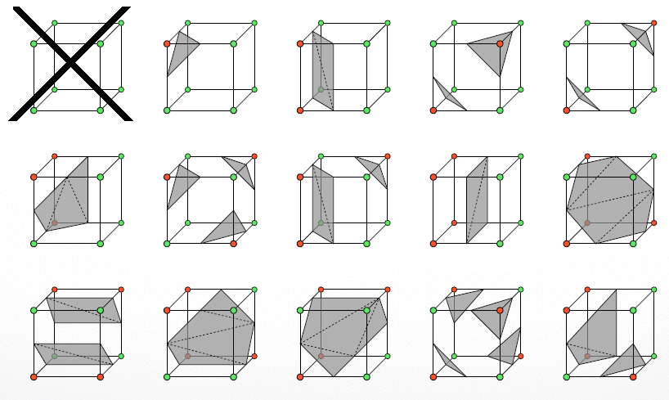
Regular Grid
There are actually 2⁸ cell configurations
Only 14 is enough though. How?

Slide 48
Regular Grid
Halve the size by reversing red/green nodes
2 are trivially off: all red and all green
Flips & rotations: cancels 4 in 2D, 8 in 3D

Slide 49
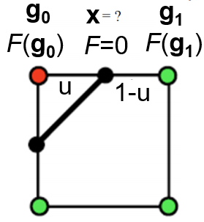
Regular Grid
Given a red/green configuration, find the intersection point to locate the surface triangle’s vertex position x
F = F(g₀)*(1-u) + F(g₁)*u ➔ for F=0, u = F(g₀)/(F(g₀) - F(g₁))
x = g₀ + u*(g₁ - g₀)

Slide 50
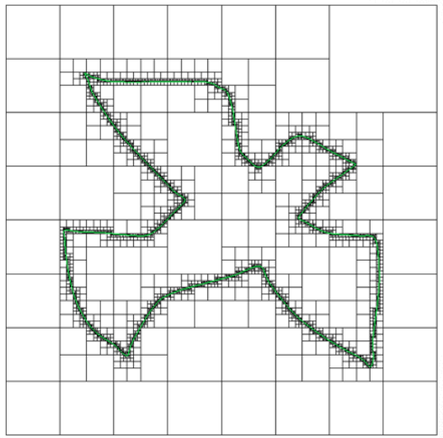
Adaptive Grid
It’d have been inefficient if I used small cells everywhere
It’d have been inaccurate if I used big cells everywhere

Slide 51
Adaptive Grid
It’d have been inefficient if I used small cells everywhere
It’d have been inaccurate if I used big cells everywhere

Slide 52
Adaptive Grid
Besides reconstruction, grids are also useful for the organization/indexing of objects in the scene
Ray-triangle intersection
Consider triangles in the cell intersected by the ray, not all 1M surface triangles.
ray1
ray2
Adaptively refining only those cells that are intersected by the surface, yields different-sized grid cells
Since this is more efficient than regular grids, let’s focus on them

Slide 53
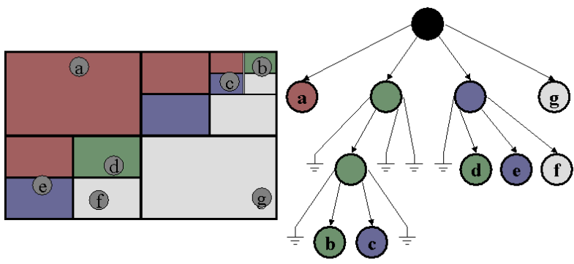
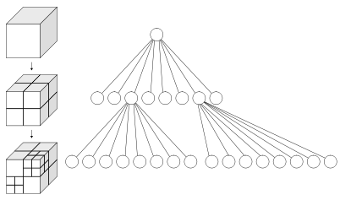
Adaptive Grid
Use different-sized grid cells for efficiency
Called quadtree in 2D and octree in 3D

Slide 54
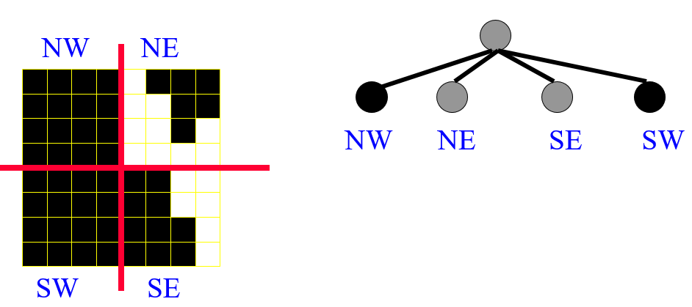
Adaptive Grid
Quadtree example

Slide 55
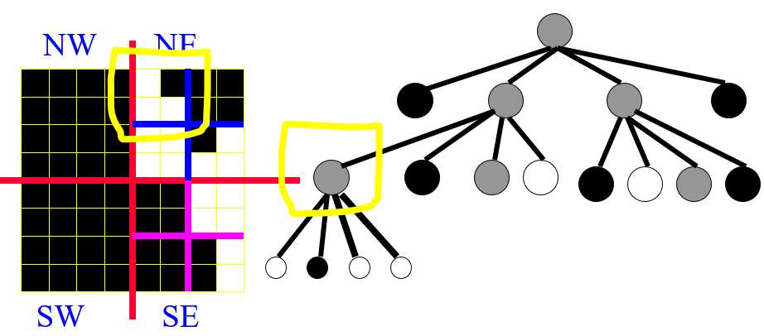
Adaptive Grid
Quadtree example

Slide 56
Adaptive Grid
Quadtree example

Slide 57
Adaptive Grid
In a binary space partitioning (BSP) tree, a scene/space is recursively divided into 2 convex sets by hyperplanes
Quadtree BSP tree
Notes:
In geometry a hyperplane is a subspace of one dimension less than its ambient space. If a space is 3-dimensional then its hyperplanes are the 2-dimensional planes, while if the space is 2-dimensional, its hyperplanes are the 1-dimensional lines.

Slide 58
Adaptive Grid
BSP tree example

Slide 59
Adaptive Grid
BSP tree example

Slide 60
Adaptive Grid
BSP tree example

Slide 61
Adaptive Grid
In a k-d tree, a scene/space is recursively divided into 2 convex sets by axis-aligned hyperplanes, a special case of BSP tree

Slide 62
Adaptive Grid
In a k-d tree, each node has 2 children
Unlike quadtree (up to 4 children) and octree (up to 8 children)

Slide 63
Adaptive Grid
In a k-d tree, space splitting is different than quad/octree
quad/octree splits around a point: center of the subdivision of that node: , but k-d tree splits along a
dimension:

Slide 64
Adaptive Grid
k-d tree has guaranteed logn depth to store n points
Construction algorithm
If there is just one point/object, form a leaf with that point
Else, divide the points by a line perpendicular to one of the axes; dividing line passes through the median of the region points
Every time you go down in tree, change decision-making dimension to the next

Slide 65
Adaptive Grid
k-d tree has guaranteed logn depth to store n points
Construction algorithm
A 2-d example, i.e., k=2 in our k-d tree

Slide 66
Adaptive Grid
k-d tree has guaranteed logn depth to store n points
Construction algorithm
A 2-d example, i.e., k=2 in our k-d tree
Note that dividing lines are not necessarily axis-aligned in BSP
Note that region areas are multiples
of 4 in quadtree (arbitrary areas here)

Slide 67
Adaptive Grid
Using k-d tree for faster ray tracing
Ray-triangle intersection will be accelerated
70000-triangle bunny rendered in 2 hrs (no k-d tree) vs 2 secs (k-d)

Slide 68
Adaptive Grid
Bunny located in the center of the frame
Rays cast from the corner and edge pixels will check for intersection with 70K triangles despite being far from bunny
Improve this with simple bounding boxes (volumes)

Slide 69
Adaptive Grid
What if a ray intersects the bounding box?
Again test with 70K triangles, which is still inefficient
Solution: use hierarchy of bounding boxes
Aka Bounding Volume Hierarchy (BVH)
k-d tree helps here

Slide 70
Adaptive Grid
k-d tree of bounding boxes
Each tree node has
a bounding box containing the related triangles
pointers to triangles in the bounding box
pointers to 2 children nodes

Slide 71
Adaptive Grid
To build the k-d tree
Start at the root which contains all triangles and the bounding box surrounding the whole thing
As we go down in the tree, split on different dimension: X-Y-Z-X-Y-..
For each level of the tree
Find the midpoint of all the triangles in the node
Decide the split dimension, e.g., it is Y if the previous was X
For each triangle in the node, check whether, for the current dimension, it is less than or greater than the midpoint (use the current dimension of the midpoint)
If less, push the triangle to the left child
Else, push the triangle to the right child //just like binary search tree
Stopping condition
Subdivide all the way down to 1 triangle per box/node //unnecessary
Subdivide when more than 50% of the triangles in each child is different

Slide 72
Adaptive Grid
To make ray-triangle intersection test on k-d tree
Check the root for intersection with the big bounding box
Recurse down the structure until we reach a leaf where we test ray for intersection with all of the leaf’s triangles
Let’s see a 2D demo

Slide 73
Adaptive Grid

Slide 74
Adaptive Grid

Slide 75
Adaptive Grid

Slide 76
Adaptive Grid

Slide 77
Adaptive Grid

Slide 78
Adaptive Grid

Slide 79
Adaptive Grid

Slide 80
Adaptive Grid
An intersection test with red ray below will visit black, red (ray does not hit red box so prune out the whole subtree below), green, yellow, pink
An intersection test with black ray above will visit black, red, light blue (ray not hit lightblue so prune out below), darkblue, green, yellow, pink
An intersection with orange ray above will visit black only

Slide 81
Adaptive Grid
Recursion will look something like this
bool KDNode::intersects(KDNode* node, Ray* ray)
{
if (node->bbox.hits(ray))
{
..
..
..
..
..
..
}
return false;
}

Slide 82
Adaptive Grid
Recursion will look something like this
bool KDNode::intersects(KDNode* node, Ray* ray)
{
if (node->bbox.hits(ray))
{
if (! node->left->triangles.empty() || ! node->right->triangles.empty() || )
return intersects(node->left, ray) || intersects(node->right, ray)
else //reached a leaf node
for (i=0 to node->triangles.size-1)
if (node->triangles[i]->hit(ray))
return true; //use something like t_min to maintain the closest triangle
}
return false;
}

