Slide 1
CENG 477
Introduction to Computer Graphics
Graphics Hardware and OpenGL
Yusuf Sahillioglu (slides Oguz Akyuz)

Slide 2
Introduction
Until now, we focused on graphic algorithms rather than hardware and implementation details
But graphics, without using specialized tools and/or hardware would simply be too slow for most applications
We will now learn about how a GPU works and how to program it using a specific API: OpenGL
The presented ideas should apply to other APIs such as Direct3D with some modifications

Slide 3
Graphics Hardware (GH)
GH is a set of components which implements the forward rendering pipeline at a chip level called GPU
Modern GPUs are programmable
GPUs are massively parallel (orders of magnitude more parallel than CPUs)
GPUs change continuously mainly due to the demands of the video game industry
Big players:
  AMD, Nvidia, Intel, Microsoft, Apple, Qualcomm, …

Slide 4
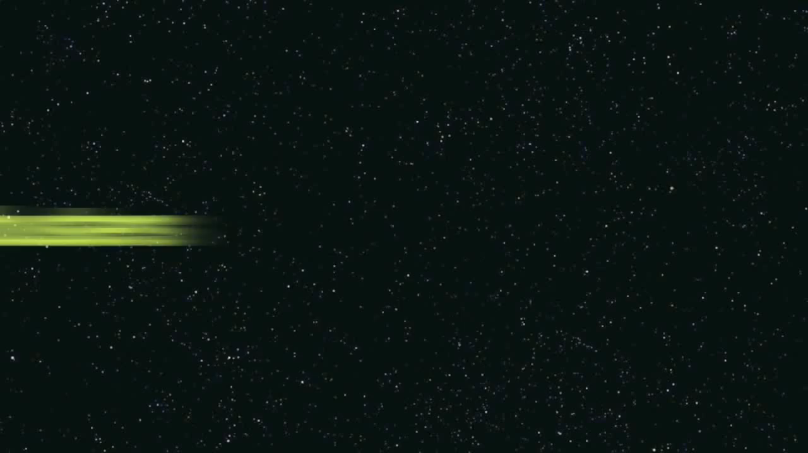
Graphics Processing Unit (GPU)
How parallel are GPUs? Let’s watch this demo:

Slide 5
GPGPU
As a result of this performance, GPUs are used in many tasks that are not related to graphics at all:
  Called GPGPU: General-purpose computing on GPU
Nvidia developed the CUDA language for GPGPU
OpenCL is supported by AMD, Nvidia, and Intel
Nowadays, many computational intensive tasks are performed on the GPU:
  Image and video processing
  Analyzing big data
  Bioinformatics
  Optimization
  Machine learning, …

Slide 6
GPU Architecture
GPUs are similar to CPUs in their building blocks (in fact they are somewhat simpler than CPUs):
  Some logic to decode the instruction to be performed
  Registers
  Arithmetic logic units (ALUs)
  Cache
  Memory
But they are massively parallel:
  Data parallelism
  Pipeline parallelism

Slide 7
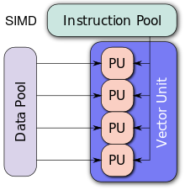
GPU Parallelism
What makes GPUs parallel?
GPUs are SIMD architectures
  SIMD: Single instruction multiple data
  The same instruction is applied to thousands of data elements at the same time
wikipedia.com

Slide 8
GPU Parallelism
This works well for independent tasks such as:
  Transforming vertices
  Computing shading for each fragment
Ideal if the task is the same but the data is different:
Data length
1 | 2 | 3 | 4 | 5 | 6 | 7 | 8 | 9 | 10
…
/2 | /2 | /2 | /2 | /2 | /2 | /2 | /2 | /2 | /2
Pipeline length
0.5 | 1 | 1.5 | 2 | 2.5 | 3 | 3.5 | 4 | 4.5 | 5
…
…

Slide 9
GPU vs CPU
GPUs have a larger number of ALUs allowing for data parallelism:

Slide 10
GPU vs CPU
Let’s compare a good GPU with a good CPU
Intel i7-4790K | Nvidia GTX 1060
Cores: 4 (8 threads) | Cores: 1280
Clock: 4 – 4.4 GHz | Clock: 1.5 – 1.7 GHz
Power: 88W | Power: 120W
Memory BW: 25.6 GB/s | Memory BW: 192 GB/s

Slide 11
Overall GPU Architecture
Application
Application
Data Assembler
Setup / Rstr / ZCull
Vertex assembly
Vtx Thread Issue
Prim Thread Issue
Frag Thread Issue
Vertex operations
SP
SP
SP
SP
SP
SP
SP
SP
SP
SP
SP
SP
SP
SP
SP
SP
Primitive assembly
Thread Processor
Primitive operations
TF
L1
TF
L1
TF
L1
TF
L1
TF
L1
TF
L1
TF
L1
TF
L1
Rasterization
Fragment operations
L2
L2
L2
L2
L2
L2
FB
FB
FB
FB
FB
FB
Framebuffer
NVIDIA GeForce 8800
OpenGL Pipeline

Slide 12
GPU Data Flow Model
User Program
Geometry Processing
Fragment Processing
Bus
CPU
GPU
GPU
Displayed Image
Framebuffer
VGA,
DVI,
HDMI,
…
Monitor
GPU

Slide 13
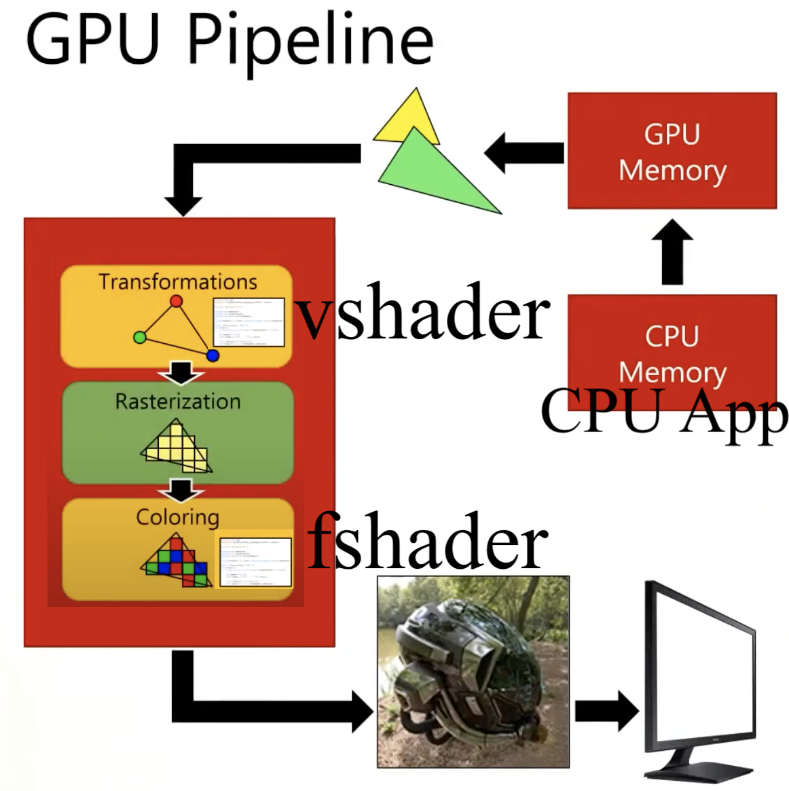
GPU Data Flow Model
From Cem Yuksel’s course

Slide 14
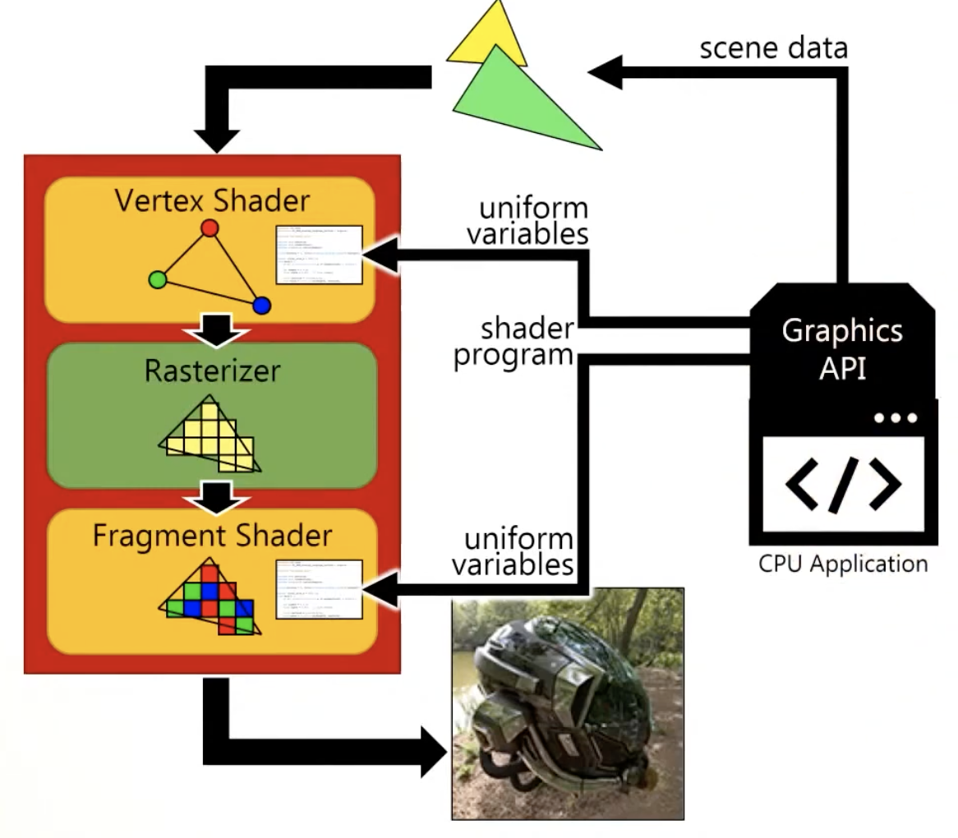
GPU Data Flow Model
From Cem Yuksel’s course

Slide 15
User Program
The user program is an OpenGL (or Direct3D) program which itself runs on the CPU
Also initially all data is in the main system memory
The user program is responsible to arbitrate the overall flow and send data to GPU:
  Open a window
  Manage user interaction (mouse, keyboard, etc.)
  Decide what to draw and when to draw
  Ask GPU to compile shaders (programs to be later run on the GPU)

Slide 16
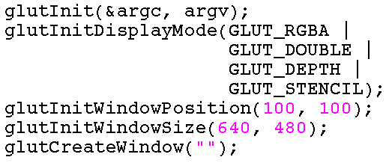
Opening a Window
Opening a window for rendering is not part of OpenGL
  Each OS has a different mechanism
Fortunately, there are some high-level APIs that simplify this process
  Perhaps the simplest of these APIs is GLUT
Buffers that
we want

Slide 17
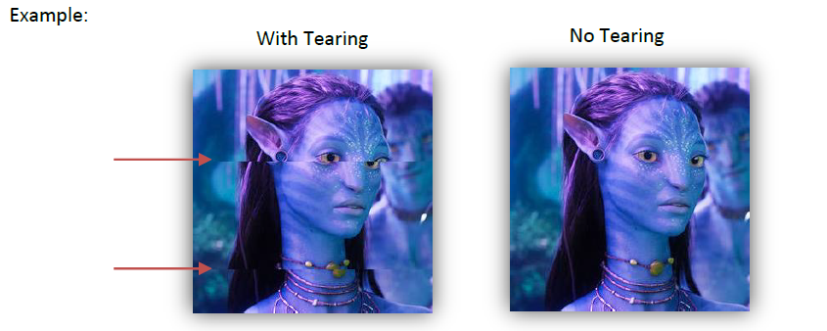
Double Buffering
Double buffering is a technique to avoid tearing/flickering
  Problem happens when drawing and displaying the same buffer
  Front (visible) and back (working) buffers
  Swap them when back is ready

Slide 18
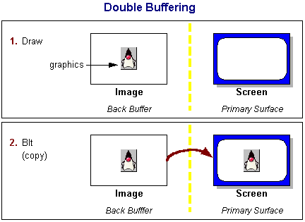
Double Buffering
To avoid such artifacts, we render to an invisible buffer and show that buffer only when drawing is complete
  Windowed more requires a copy:
oracle.com

Slide 19
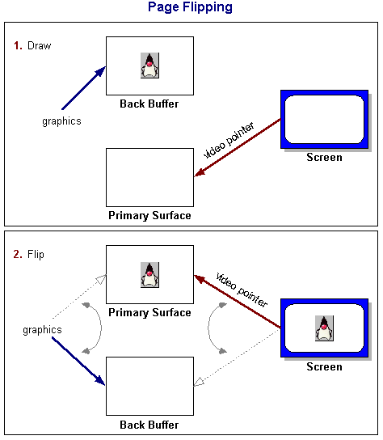
Double Buffering
In fullscreen mode, only the video pointer is flipped:
oracle.com

Slide 20

Managing User Interaction
The user may interact with the program through input devices: traditionally keyboard and mouse
GLUT also simplifies this task by registering callbacks:

Slide 21
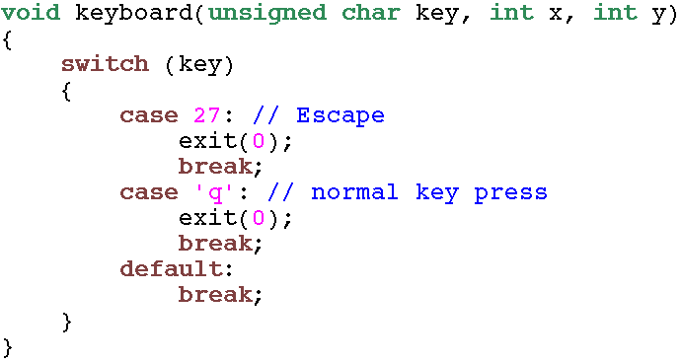
Managing User Interaction
Sample keyboard callback:

Slide 22
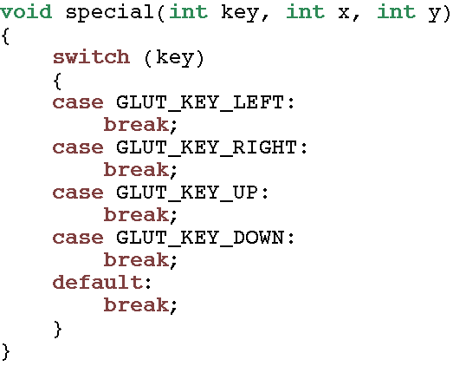
Managing User Interaction
Sample special key-press callback:

Slide 23
Displaying/Resizing the Window
Whenever a window is displayed or resized, certain settings (such as the viewport) may need to be updated:
This function can also be registered by using GLUT:

Slide 24
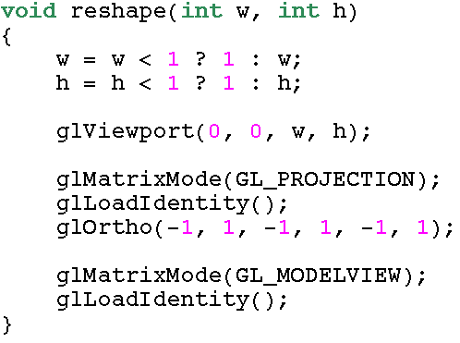
Displaying/Resizing the Window
Here, we typically reset the viewport and transformation matrices
Window width and height

Slide 25
Rendering Each Frame
Each frame must be redrawn from scratch
  Not incremental
Again, we first register a callback for this task
The registered function is automatically called by the windowing system whenever required
  May be called hundreds of times per second

Slide 26
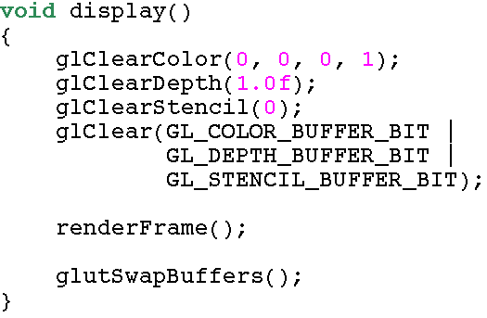
Rendering Each Frame
We first clear all buffers, then render our frame, and finally swap buffers (remember double buffering)

Slide 27
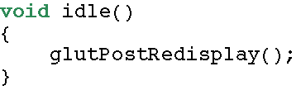
Animation
If we have animation, we must make sure that the window system calls our display function continuously
For that purpose, we register another callback:
In this function, we simply ask our display function to be called:

Slide 28
Sending Geometry Data
The user program must communicate the geometry information to the GPU
A simple approach:
We tell GPU that we want to draw a line from (x₀, y₀, z₀) to (x₁, y₁, z₁)
glBegin(GL_LINES);
glVertex3f(x0, y0, z0);
glVertex3f(x1, y1, z1);
glEnd();

Slide 29
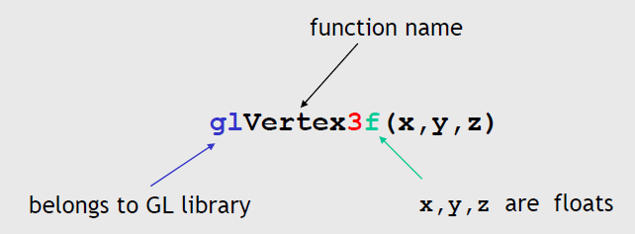
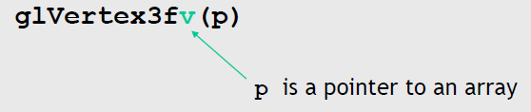
Sending Geometry Data
The user program must communicate the geometry information to the GPU
glBegin(GL_LINES);
glVertex3f(x0, y0, z0);
glVertex3f(x1, y1, z1);
glEnd();

Slide 30
Sending Geometry Data
Attributes besides position can be sent as well:
We tell GPU that we want to draw a line from (x₀, y₀, z₀) to (x₁, y₁, z₁)
The endpoint colors are (1, 0, 0) and (0, 0, 1)
glBegin(GL_LINES);
glColor3f(1, 0, 0); // red
glVertex3f(x0, y0, z0);
glColor3f(0, 1, 0); // green
glVertex3f(x1, y1, z1);
glEnd();

Slide 31
Sending Geometry Data
Triangles are similar:
Every group of three vertices define a triangle
Drawing two triangles:
glBegin(GL_TRIANGLES);
glVertex3f(x0, y0, z0);
glVertex3f(x1, y1, z1);
glVertex3f(x2, y2, z2);
glEnd();
glBegin(GL_TRIANGLES);
glVertex3f(x0, y0, z0); glVertex3f(x1, y1, z1); glVertex3f(x2, y2, z2);
glVertex3f(x3, y3, z3); glVertex3f(x4, y4, z4); glVertex3f(x5, y5, z5);
glEnd();

Slide 32
Sending Geometry Data
With this approach m triangles require 3m vertex calls
An improved method is to use triangle strips for meshes
The first three vertices define the first triangle
Every vertex afterwards defines a new triangle
m triangles require m+2 vertex calls
glBegin(GL_TRIANGLE_STRIP);
glVertex3f(x0, y0, z0);
glVertex3f(x1, y1, z1);
glVertex3f(x2, y2, z2);
glVertex3f(x3, y3, z3);
glEnd();
0
2
0, 1, 2
2, 1, 3
1
3

Slide 33
Winding Order
Winding order determines the facing of a triangle
Here both triangles are facing toward the viewer:
glBegin(GL_TRIANGLE_STRIP);
glVertex3f(x0, y0, z0);
glVertex3f(x1, y1, z1);
glVertex3f(x2, y2, z2);
glVertex3f(x3, y3, z3);
glEnd();
0
2
0, 1, 2
2, 1, 3
1
3

Slide 34
Winding Order
Winding order determines the facing of a triangle
Here both triangles are facing away from the viewer:
It is important to use a consisting winding order when drawing a mesh due to backface culling
glBegin(GL_TRIANGLE_STRIP);
glVertex3f(x0, y0, z0);
glVertex3f(x2, y2, z2);
glVertex3f(x1, y1, z1);
glVertex3f(x3, y3, z3);
glEnd();
0
2
0, 2, 1
1, 2, 3
1
3

Slide 35
Graphics State
Graphics APIs are state machines
Various states are preserved until we change them
In the example below, the color of each vertex is set to (0, 1, 0), that is green:
glColor3f(0, 1, 0)
glBegin(GL_TRIANGLE_STRIP);
glVertex3f(x0, y0, z0);
glVertex3f(x2, y2, z2);
glVertex3f(x1, y1, z1);
glVertex3f(x3, y3, z3);
glEnd();

Slide 36
Graphics State
Below the first three vertices have the same color and normal
The fourth vertex has a different color and normal:
glColor3f(0, 1, 0)
glNormal3f(0, 0, 1)
glBegin(GL_TRIANGLE_STRIP);
glVertex3f(x0, y0, z0);
glVertex3f(x2, y2, z2);
glVertex3f(x1, y1, z1);
glColor3f(1, 0, 0)
glNormal3f(1, 0, 1)
glVertex3f(x3, y3, z3);
glEnd();

Slide 37
Graphics State
OpenGL is a state machine
OpenGL functions are of two types
  Primitive generating
    Can cause output if primitive is visible
    How vertices are processed and appearance of primitives, are controlled by the state
  State changing
    Transformation functions
    Attribute functions
    Viewing functions

Slide 38
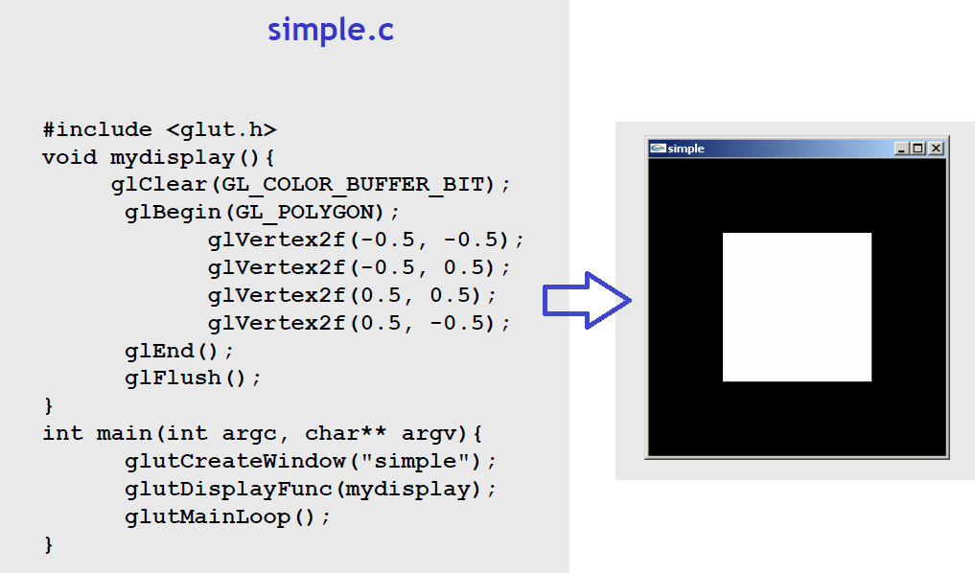
A Complete Sample Code

Slide 39
A Complete Sample Code
Every OpenGL/glut program must have a display callback
The display callback is executed whenever OpenGL decides that the display must be refreshed, for example when the window is opened or resized
Main function ends w/ the program entering an event loop

Slide 40
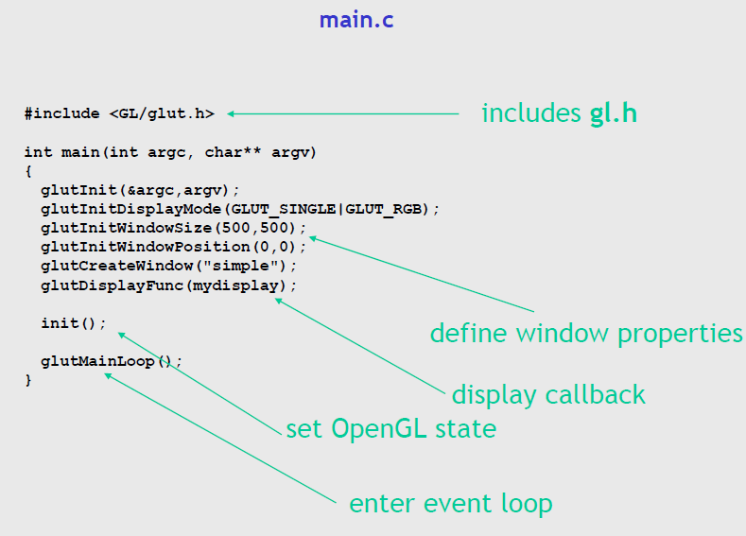
A Complete Sample Code
Let’s overwrite some default values in simple.c

Slide 41
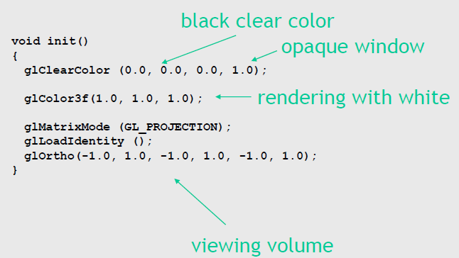
A Complete Sample Code
Let’s overwrite some default values in simple.c

Slide 42
Coordinate Systems
The units of in glVertex are determined by the application and are called world coordinates
The viewing specifications are also in world coordinates and it is the size of the viewing volume that determines what will appear in the image
Internally, OpenGL will convert to camera coordinates and later to screen (or image) coordinates

Slide 43
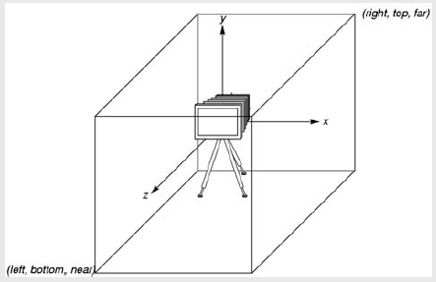
OpenGL Camera
OpenGL places a camera at the origin pointing in the negative z direction
The default viewing volume is a box centered at the origin with a side of length 2

Slide 44
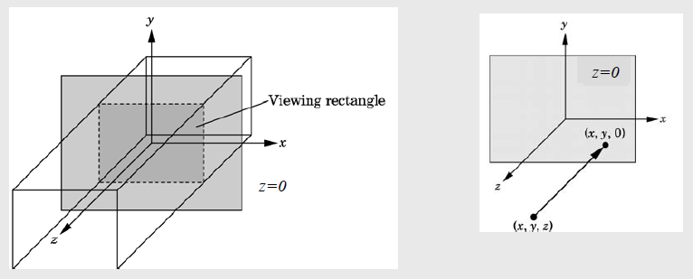
Orthographic Viewing
In the default orthographic view, points are projected forward along the z axis onto the plane z=0

Slide 45
Projection and Matrix Mode
In OpenGL, the projection is carried out by a projection matrix
There is only one set of matrix manipulation functions so we must set the matrix mode first
  glMatrixMode (GL_PROJECTION)
Matrix functions are incremental so we start with an identity matrix and alter it with a projection matrix that gives the view volume
  glLoadIdentity ();
  glOrtho(-1.0, 1.0, -1.0, 1.0, -1.0, 1.0);

Slide 46
2- and 3-D Viewing
In glOrtho(left, right, bottom, top, near, far) the near and far distances are measured from the camera
Two-dimensional vertex commands place all vertices in the plane z = 0
If the application is in two dimensions, we can use the function
  gluOrtho2D(left, right,bottom,top)
In two dimensions, the view or clipping volume becomes a clipping window

Slide 47
Color and State
The color as set by glColor becomes part of the state and will be used until changed
  Colorsand other attributes are not part of the object but are assigned when the object is rendered
We can create conceptual vertex colors by code such as
  glColor
  glVertex
  glColor
  glVertex

Slide 48
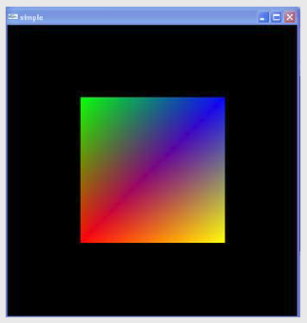
Smooth Color
Default is smooth shading
  OpenGL interpolates vertex colors across visible polygons
Alternative is flat shading
  Color of first vertex determines fill color
glShadeModel
  (GL_SMOOTH) or GL_FLAT

Slide 49
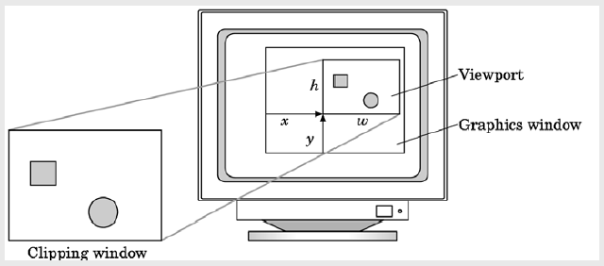
Viewport
Do not have to use the entire window for the image: glViewport(x,y,w,h)
Values in pixels (screen coordinates)

Slide 50
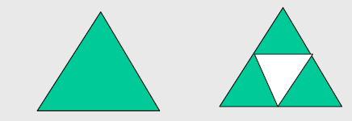
A Complete Example
Sierpinski gasket: a fractal
  Start with a triangle
  Connect bisectors of sides and remove central triangle
  Repeat

Slide 51
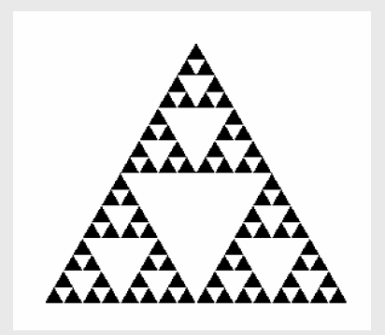
A Complete Example
Sierpinski gasket: a fractal
  Start with a triangle
  Connect bisectors of sides and remove central triangle
  Repeat
  how many
  subdivision here? (5)

Slide 52
A Complete Example
Fun fact
  Not an ordinary object (fractal: fractional dimension)
  As we continue subdividing
    Area goes to zero
    Perimeter goes to infinity

Slide 53
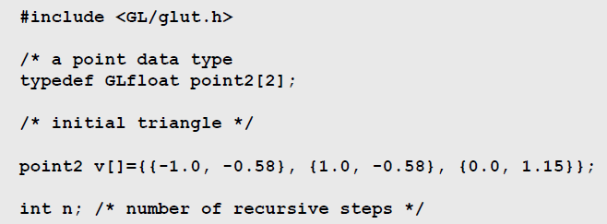
A Complete Example

Slide 54
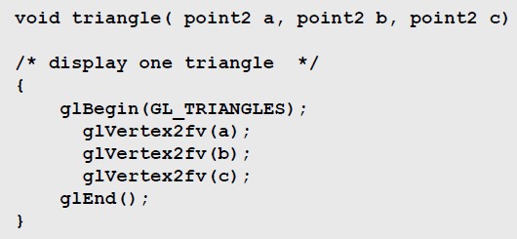
A Complete Example

Slide 55
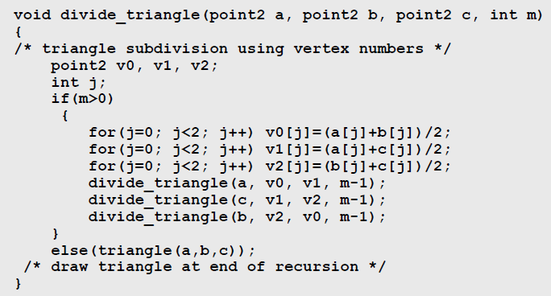
A Complete Example

Slide 56
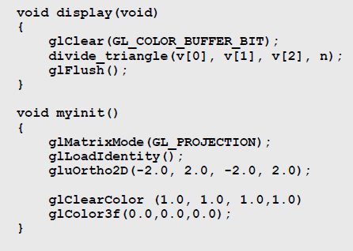
A Complete Example

Slide 57
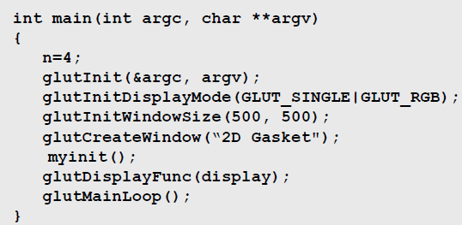
A Complete Example

Slide 58
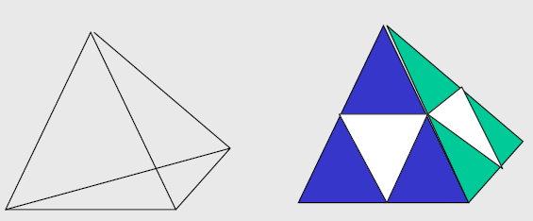
A Complete Example
Let’s move to 3D to demonstrate hidden surface removal
3D gasket
Appears as if we remove a solid tetrahedron from the center leaving four smaller tetrahedra

Slide 59
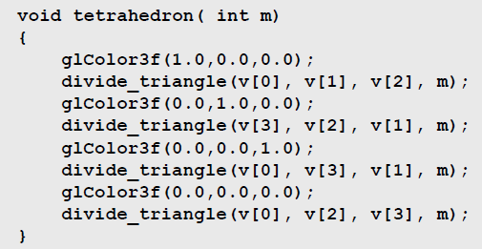
A Complete Example

Slide 60
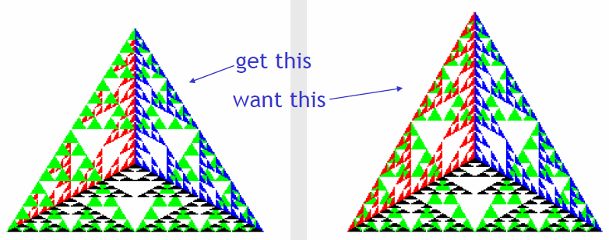
A Complete Example
Because the triangles are drawn in the order they are defined in the program, the front triangles are not always rendered in front of triangles behind them

Slide 61
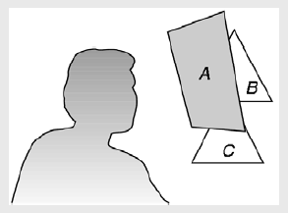
A Complete Example
We want to see only those surfaces in front of other surfaces
OpenGL uses a hidden-surface method called the z-buffer algorithm that saves depth information as objects are rendered so that only the front objects appear in the image

Slide 62
A Complete Example
The algorithm uses an extra buffer, the z-buffer, to store depth information as geometry travels down the pipeline
It must be
  Requested in main
    glutInitDisplayMode(GLUT_SINGLE | GLUT_RGB | GLUT_DEPTH)
  Enabled in init
    glEnable(GL_DEPTH_TEST)
  Cleared in the display callback
    glClear(GL_COLOR_BUFFER_BIT | GL_DEPTH_BUFFER_BIT)

Slide 63
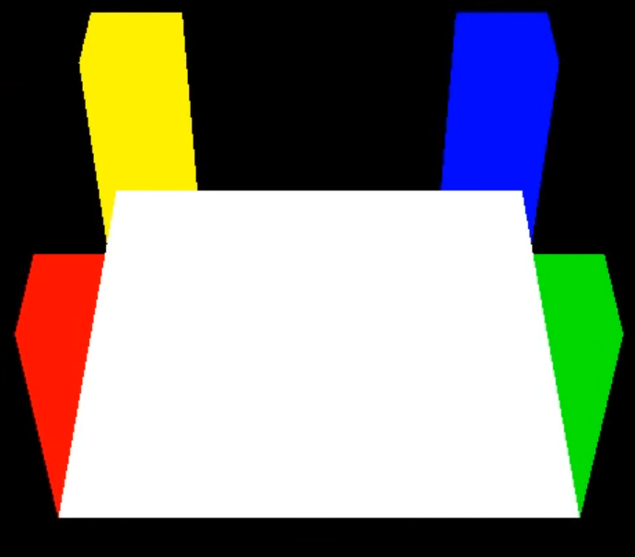
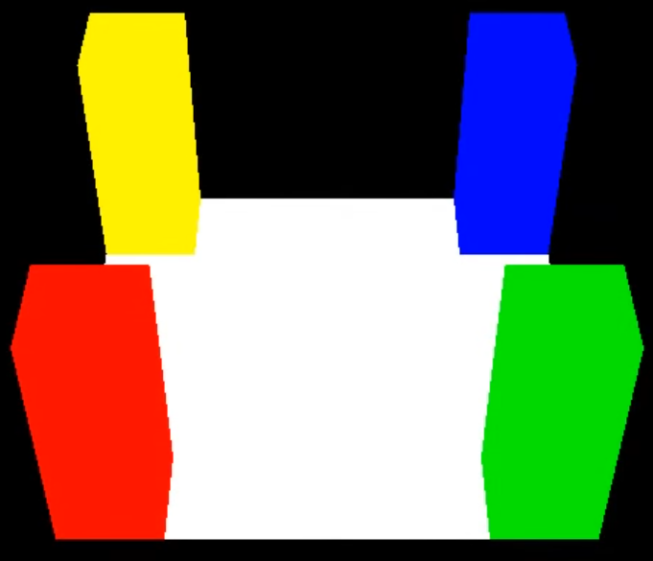
A Complete Example
    glDisable(GL_DEPTH_TEST); glEnable(GL_DEPTH_TEST);
    //floor drawn last //floor drawn last

Slide 64
Sending Geometry Data
Previous examples send data in immediate mode
Inefficient: A large model would require too many glVertex calls
Each glVertex call is executed on the CPU and the corresponding data is sent to the GPU
A better approach would be to send all vertex data to the GPU using a single call
That’s what vertex arrays are for

Slide 65
Vertex Arrays
There are several arrays such as vertex position array, vertex color array, vertex normal array, …
Below is an example of vertex position array:
You must enable an array before using it:
glVertexPointer(size, type, stride, pointer)
Pointer to vertex
position data
Number of coordinates
per vertex
Type of each
coordinate
Byte offset between
consecutive vertices
glEnableClientState(GL_VERTEX_ARRAY)

Slide 66
Vertex Arrays
There are several arrays such as vertex position array, vertex color array, vertex normal array, …
Below is an example of vertex position array:
float pvertex[3][3] = {{0,0,0}, {1,0,0}, {0,0,1}};
glEnableClientState(GL_VERTEX_ARRAY);
glVertexPointer(3, GL_FLOAT, 0, pvertex);
glVertexPointer(size, type, stride, pointer)

Slide 67
Vertex Arrays
In modern OpenGL, these explicit attribute names are replaced by a generic attribute array function:
Don’t forget to enable it:
glVertexAttribPointer(index, size, type, normalized, stride, pointer)
Array index
Whether integer data
should be normalized
Pointer to vertex
position data
Number of coordinates
per vertex
Type of each
coordinate
Byte offset between
consecutive vertices
glEnableVertexAttribArray(index)

Slide 68
Vertex Arrays
In modern OpenGL, these explicit attribute names are replaced by a generic attribute array function:
glEnableVertexAttribArray(0); //we like submitting vertices on stream 0 for no special reason
glVertexAttribPointer(0, 3, GL_FLOAT, GL_FALSE, 0, pvertex);
glVertexAttribPointer(index, size, type, normalized, stride, pointer)
Array index
Whether integer data
should be normalized
Pointer to vertex
position data
Number of coordinates
per vertex
Type of each
coordinate
Byte offset between
consecutive vertices

Slide 69
Drawing with Vertex Arrays
We use a single draw call to draw using vertex arrays:
glDrawElements(mode, count, type, indices)
Primitive
type
Number of elements
to be rendered
Type of the values
in indices
Pointer to location
where indices are
stored

Slide 70
Drawing with Vertex Arrays
We use a single draw call to draw using vertex arrays:
glDrawElements(GL_TRIANGLES, 36, GL_UNSIGNED_SHORT, pvertexIndices);
glDrawElements(mode, count, type, indices)

Slide 71
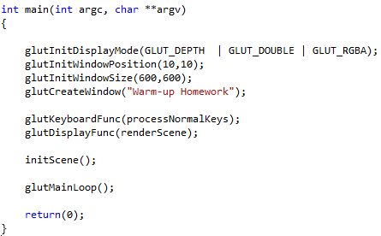

Vertex Arrays Example

Slide 72
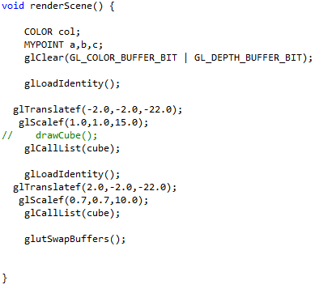
Vertex Arrays Example

Slide 73
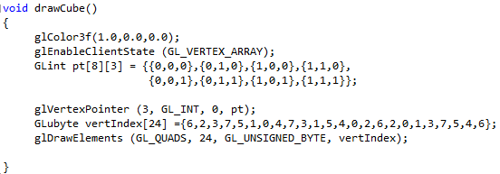
Vertex Arrays Example
Compare this GL_VERTEX_ARRAY cube drawing with ..

Slide 74
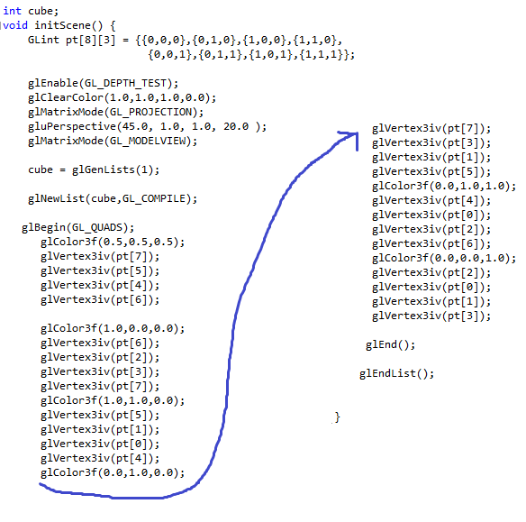
Vertex Arrays Example
.. with old-school cube drawing w/o GL_VERTEX_ARRAY

Slide 75
Drawing with Vertex Arrays
When using client-side vertex arrays, the vertex attribute data is copied from the system memory (user pointer) to the GPU memory at every draw call
There is a better alternative, known as vertex buffers
glVertexPointer(size, type, stride, pointer)
……………………………
……………………………
copy at draw call
System memory
GPU memory

Slide 76
Vertex Buffer Objects
Previous methods required the data to be copied from the system memory to GPU memory at each draw
Vertex Buffer Objects (VBOs) are designed to allow this copy to take place only once
The copied data is reused at each draw

Slide 77
Vertex Buffer Objects
To use VBOs, we generate two buffers:
  Vertex attribute buffer (position, color, normal, etc.)
  Element array buffer (indices)
GLuint vertexAttribBuffer, indexBuffer;
glGenBuffers(1, &vertexAttribBuffer);
glGenBuffers(1, &indexBuffer);

Slide 78
Vertex Buffer Objects
Next, we bind these buffers to locations that are meaningful for the GPU:
glBindBuffer(GL_ARRAY_BUFFER, vertexAttribBuffer);
glBindBuffer(GL_ELEMENT_ARRAY_BUFFER, indexBuffer)

Slide 79
Vertex Buffer Objects
We then ask the GPU to allocate memory for us and copy our data into this memory
Attribute data size
in bytes
Attribute data pointer
glBufferData(GL_ARRAY_BUFFER, aSize, aPtr, GL_STATIC_DRAW);
glBufferData(GL_ELEMENT_ARRAY_BUFFER, iSize, iPtr, GL_STATIC_DRAW);
Index data size
in bytes
Index data pointer

Slide 80
Vertex Buffer Objects
Once this is done, the CPU data can safely be deleted:
Attribute data size
in bytes
Attribute data pointer
glBufferData(GL_ARRAY_BUFFER, aSize, aPtr, GL_STATIC_DRAW);
glBufferData(GL_ELEMENT_ARRAY_BUFFER, iSize, iPtr, GL_STATIC_DRAW);
Index data size
in bytes
Index data pointer
delete[] aPtr;
delete[] iPtr;

Slide 81
Vertex Buffer Objects
Before drawing, we can specifying an offset into our buffers
It is accomplished by the same function as before
But this time, pointer indicates a byte offset into our buffer (similar for glColorPointer, etc.)
glVertexPointer(size, type, stride, pointer)
Offset to vertex
position data
Number of coordinates
per vertex
Type of each
coordinate
Byte offset between
consecutive vertices

Slide 82
Vertex Buffer Objects
Drawing is the same as before where index pointer is now also an offset to the element array buffer:
glDrawElements(mode, count, type, indices)
Primitive
type
Offset to
indices
Number of indices
to be rendered
Type of
each index

Slide 83
Vertex Buffer Objects
The relevant buffers must still be enabled:
Unfortunately, this is a very bad naming as it suggests client-side data is being used
In modern OpenGL, these are replaced with:
glEnableClientState(GL_VERTEX_ARRAY)
glEnableClientState(GL_COLOR_ARRAY)
…
glEnableVertexAttribArray(0);
glEnableVertexAttribArray(1);
…

Slide 84
A Complete VBO Example
struct MyVertex
{
float x, y, z; //Vertex
float nx, ny, nz; //Normal
float s0, t0; //Texcoord0
};
MyVertex pvertex[3];
//VERTEX 0
pvertex[0].x = 0.0; pvertex[0].y = 0.0; pvertex[0].z = 0.0;
pvertex[0].nx = 0.0; pvertex[0].ny = 0.0; pvertex[0].nz = 1.0;
pvertex[0].s0 = 0.0; pvertex[0].t0 = 0.0;
//VERTEX 1
pvertex[1].x = 1.0; pvertex[1].y = 0.0; pvertex[1].z = 0.0;
pvertex[1].nx = 0.0; pvertex[1].ny = 0.0; pvertex[1].nz = 1.0;
pvertex[1].s0 = 1.0; pvertex[1].t0 = 0.0;
//VERTEX 2
pvertex[2].x = 0.0; pvertex[2].y = 1.0; pvertex[2].z = 0.0;
pvertex[2].nx = 0.0; pvertex[2].ny = 0.0; pvertex[2].nz = 1.0;
pvertex[2].s0 = 0.0; pvertex[2].t0 = 1.0;
GLuint vertexAttribBuffer, indexBuffer;
glGenBuffers(1, &vertexAttribBuffer);
glBindBuffer(GL_ARRAY_BUFFER, vertexAttribBuffer);
glBufferData(GL_ARRAY_BUFFER, sizeof(MyVertex)*3, &pvertex[0].x, GL_STATIC_DRAW);

Slide 85
A Complete VBO Example
ushort pindices[3];
pindices[0] = 0;
pindices[1] = 2;
pindices[2] = 1; //3 vertices above will make 1 triangle, namely VERTEX 0-2-1
glGenBuffers(1, &indexBuffer);
glBindBuffer(GL_ELEMENT_ARRAY_BUFFER, indexBuffer);
glBufferData(GL_ELEMENT_ARRAY_BUFFER, sizeof(ushort)*3, pindices, GL_STATIC_DRAW);
//now that GPU allocated memo for the above buffers (via glBufferData), they can be deleted from CPU memory
//delete [] pvertex; delete [] pindices; //n/a because memory not allocated via new[]
//Define this somewhere in your header file
define BUFFER_OFFSET(i) ((char *)NULL + (i))
glBindBuffer(GL_ARRAY_BUFFER, vertexAttribBuffer);
glEnableVertexAttribArray(0); //We like submitting vertices on stream 0 for no special reason
glVertexAttribPointer(0, 3, GL_FLOAT, GL_FALSE, sizeof(MyVertex), BUFFER_OFFSET(0)); //The starting point of the VBO, for the vertices
glEnableVertexAttribArray(1); //We like submitting normals on stream 1 for no special reason
glVertexAttribPointer(1, 3, GL_FLOAT, GL_FALSE, sizeof(MyVertex), BUFFER_OFFSET(12)); //The starting point of normals, 12 bytes away
glEnableVertexAttribArray(2); //We like submitting texcoords on stream 2 for no special reason
glVertexAttribPointer(2, 2, GL_FLOAT, GL_FALSE, sizeof(MyVertex), BUFFER_OFFSET(24)); //The starting point of texcoords, 24 bytes away
glBindBuffer(GL_ELEMENT_ARRAY_BUFFER, indexBuffer);
glDrawElements(GL_TRIANGLES, 3, GL_UNSIGNED_SHORT, BUFFER_OFFSET(0)); //The starting point of the IBO

Slide 86
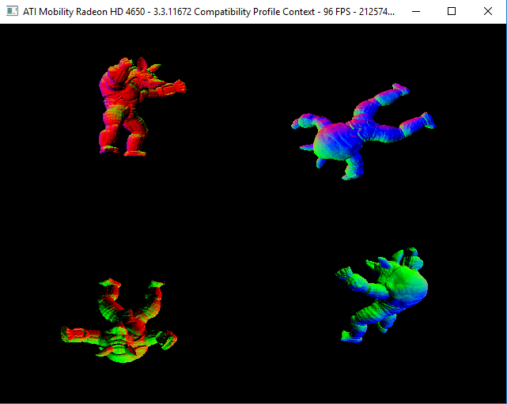
Performance Comparison
Drawing an Armadillo model comprised of 212574 triangles at four distinct locations (resulting in a total of 850296 triangles):
Notes:
Show basic_obj_draw example

Slide 87
Performance Comparison
On AMD Mobility Radeon HD4650 and at resolution 640x480:
  Using VBOs the frame rate was about 100 FPS
  Using client-side glDrawElements, the frame rate was about 20 FPS
Therefore, almost all modern games use VBOs for drawing complex models

Slide 88
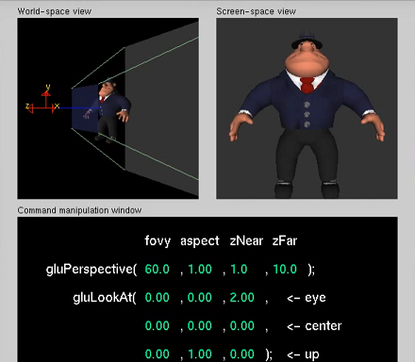
gluPerspective Parameters
Along with gluLookAt(), control the projection as shown

Slide 89
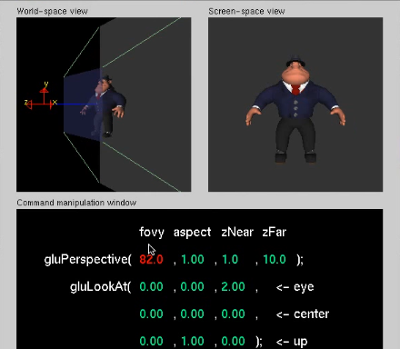
gluPerspective Parameters
Filed of view angle updates viewing frustum

Slide 90
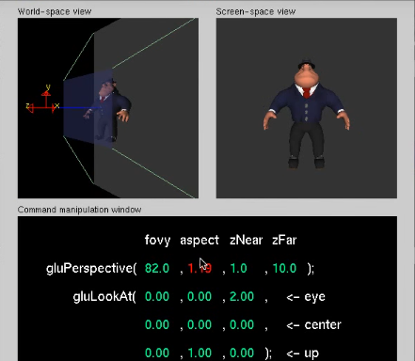
gluPerspective Parameters
Aspect ratio of width to height; should match viewport ratio

Slide 91
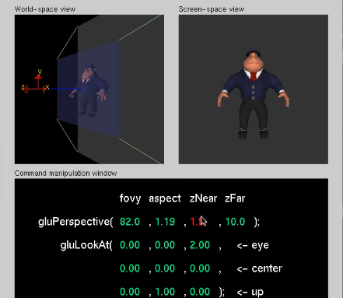
gluPerspective Parameters
Distance between eye and near plane

Slide 92
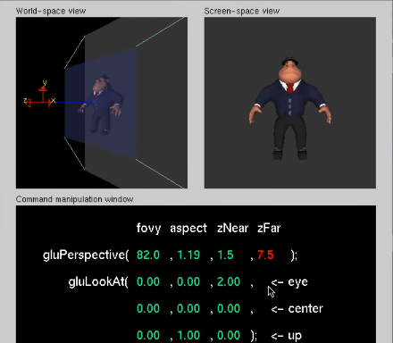
gluPerspective Parameters
Distance between eye and far plane

Slide 93
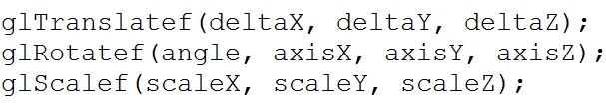
Transformations in OpenGL
In classic OpenGL, transformations are performed using three commands:
These commands effect the current matrix
Therefore the current matrix should be set as GL_MODELVIEW before calling these commands
Note that angle is in degrees (not radians)!

Slide 94
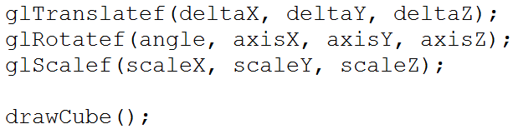
Transformations in OpenGL
Transformations apply in the reverse order
The command closest to the draw call takes effect first
Here, the cube is first scaled, then rotated, and finally translated

Slide 95
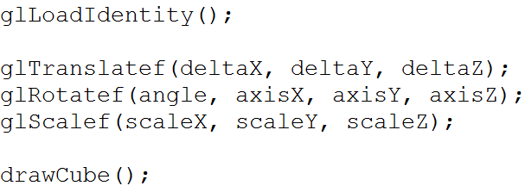
Transformations in OpenGL
Transformations keep effecting the current matrix
If you want to draw an object at the same position at each frame you need to reset the matrix to identity:
Otherwise your object will quickly disappear!

Slide 96
Transformations in OpenGL
In OpenGL, we do not specify a camera position
It is assumed that the camera is at (0, 0, 0) and looking down the negative z axis
You can view a modelview transformation in two ways:
  Transform all objects drawn after the transformation by keeping the camera fixed
  Transform the camera (i.e. coordinate system) by the opposite transformations by keeping the objects fixed
In reality, objects are transformed but both would produce the same result

Slide 97
Transformations in OpenGL
Assume we have an object at (0, 0, 4):
y
-z
x
Apply glRotatef(90, 1, 0, 0)
Apply glTranslatef(0, 0, -5)
y
y
-z
-z
x
x

Slide 98
Transformations in OpenGL
Now imagine applying the opposite to the camera (i.e. coordinate system):
Apply glTranslatef(0, 0, 5)
x
y
Original result
Apply glRotatef(-90, 1, 0, 0)
y
x
-z
-z
y
x
-z
The object position w.r.t. the camera
is exactly the same in these two cases

Slide 99
Transformations in OpenGL
See http://user.ceng.metu.edu.tr/~ys/ceng477-gfx/OpenGL/ for complete Transformations examples in OpenGL

Slide 100
Shaders
Shaders:
  Programmable logical units
  on the GPU which can
  replace the “fixed”
  functionality of
  OpenGL with
  user-generated code

Slide 101
Shaders
Shaders:
  Programmable logical units on the GPU which can replace the “fixed” functionality of OpenGL with user-generated code
By installing custom shaders, the user can now completely override the existing implementation of core per-vertex and per-pixel behavior
  Vertex shader for per-vertex behavior
  Fragment shader for per-pixel behavior
    Fragment shader is sometimes called pixel shader
Shaders execute on GPU

Slide 102
Shaders
Motivation
  Efficiency
    Use the parallel nature of GPU for quick transformations and/or coloring
  Quality
    Operate on pixel level to obtain cool renderings

Slide 103
Shaders
Motivation - Efficiency
  See the next 4 slides to understand why GPU’s are naturally fast for graphics applications, where we have lots of simple independent tasks
    Movement of a vertex does not need to know the movement of others
    Coloring of a pixel does not need to know the coloring of others

Slide 104
GPU Parallelism
What makes GPUs parallel?
GPUs are SIMD architectures
  SIMD: Single instruction multiple data
  The same instruction is applied to thousands of data elements at the same time
wikipedia.com

Slide 105
GPU Parallelism
This works well for independent tasks such as:
  Transforming vertices
  Computing shading for each fragment
Ideal if the task is the same but the data is different:
Data length
1 | 2 | 3 | 4 | 5 | 6 | 7 | 8 | 9 | 10
…
/2 | /2 | /2 | /2 | /2 | /2 | /2 | /2 | /2 | /2
Pipeline length
0.5 | 1 | 1.5 | 2 | 2.5 | 3 | 3.5 | 4 | 4.5 | 5
…
…

Slide 106
GPU vs CPU
GPUs have a larger number of ALUs allowing for data parallelism:

Slide 107
GPU vs CPU
Let’s compare a good GPU with a good CPU
Intel i7-4790K | Nvidia GTX 1060
Cores: 4 (8 threads) | Cores: 1280
Clock: 4 – 4.4 GHz | Clock: 1.5 – 1.7 GHz
Power: 88W | Power: 120W
Memory BW: 25.6 GB/s | Memory BW: 192 GB/s

Slide 108
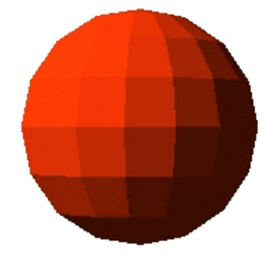
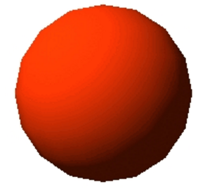
Shaders
Motivation - Quality
  With OpenGL you have access to 3 vertices of a triangle
  OpenGL then computes the per-vertex intensity using the lights and vertex normal
  Given 3 colors at 3 vertices OpenGL allows only
    Flat shading //use one of the colors
        //constantly across the triangle
    //glShadeModel(GL_FLAT);
    Gouraud shading //interpolate 3 colors
        //across the triangle
        //glShadeModel(GL_SMOOTH);

Slide 109



Shaders
Motivation - Quality
  Smooth shading, aka Gouraud shading, will not pick up the highlights due to lack of normal information across the triangle
  Gouraud shading

Slide 110

Shaders
Motivation - Quality
  Smooth shading, aka Gouraud shading, will not pick up the highlights due to lack of normal information across the triangle
  Phong shading

Slide 111



Shaders
Motivation - Quality
  Smooth shading, aka Gouraud shading, will not pick up the highlights due to lack of normal information across the triangle
  Flat Gouraud Phong
All triangle points
have the same color,
say v1.color
Linearly interpolate vertex colors
Linearly interpolate vertex normals, compute color with interpolated normal

Slide 112

Shaders
Motivation - Quality
  Consequently we have not-so-realistic rendering with OpenGL forward pipeline
  We can get realism
    with the backward pipeline (ray tracing), or
    using shaders in the forward pipeline, e.g., Phong shading

Slide 113

Shaders
Motivation - Quality
  Consequently we have not-so-realistic rendering with OpenGL forward pipeline
  We can get realism
    with the backward pipeline (ray tracing), or
    using shaders in the forward pipeline, e.g., Phong shading

Slide 114

Shaders
Motivation - Quality
  Consequently we have not-so-realistic rendering with OpenGL forward pipeline
  We can get realism
    with the backward pipeline (ray tracing), or
    using shaders in the forward pipeline, e.g., Phong shading

Slide 115

Shaders
Motivation - Quality
  Consequently we have not-so-realistic rendering with OpenGL forward pipeline
  We can get realism
    with the backward pipeline (ray tracing), or
    using shaders in the forward pipeline, e.g., Phong shading

Slide 116
Shaders
Motivation - Quality
  With a shader, e.g., Phong shader, we can compute the color explicitly per-pixel (= per-fragment) instead of interpolating 3 vertex colors of a triangle (or 4 of a quad)
per-vertex lighting
e.g. Gouraud shading
per-fragment lighting
e.g. Phong shading

Slide 117
Shaders
Written using GPU language
  Low-level: assembly language
  High-level: GLSL
Run on GPU while the application runs at the same time on CPU
GPU is often parallel: SIMD (single instruction multiple data)
GPU is much faster than CPU
  Use GPU for other computations other than Graphics (GPGPU)

Slide 118

Shaders
http://wikipedia.org

Slide 119

Toon Shading
http://wikipedia.org

Slide 120

Toon Shading Example I
uniform vec3 lightDir; //same for each vertex
varying float intensity; //output of VS that will then go into the FS
void main() //all vertices call here
{
vec3 ld;
intensity = dot(lightDir,gl_Normal);
gl_Position = ftransform(gl_Vertex); //deprecated in new GLSL
//gl_Position = gl_ModelViewProjectionMatrix * gl_Vertex;
//gl_Position = gl_ProjectionMatrix * gl_ModelViewMatrix * gl_Vertex; }
1. Vertex
Shader:
2. Rasterizer
(invisible to us)
varying float intensity; //coming from vertex shader,
//interpolated by rasterizer
void main() //all pixels call here
{
vec4 color;
if (intensity > 0.95) color = vec4(1.0,0.5,0.5,1.0);
else if (intensity > 0.5) color = vec4(0.6,0.3,0.3,1.0);
else if (intensity > 0.25) color = vec4(0.4,0.2,0.2,1.0);
else color = vec4(0.2,0.1,0.1,1.0);
gl_FragColor = color; } //per-pixel coloring
3. Fragment
Shader:

Slide 121

Toon Shading Example II
varying vec3 normal;
void main()
{
normal = gl_Normal; //color = gl_Color; gets the color (irrelevant here)
gl_Position = ftransform(gl_Vertex);
}
Vertex
Shader
uniform vec3 lightDir;
varying vec3 normal; //normal per-pixel is provided (by rasterizer)
void main() //better result thanks to better normals
{
float intensity;
vec4 color;
intensity = dot(lightDir,normalize(normal)); //compute w/ normal
if (intensity > 0.95) color = vec4(1.0,0.5,0.5,1.0);
else if (intensity > 0.5) color = vec4(0.6,0.3,0.3,1.0);
else if (intensity > 0.25) color = vec4(0.4,0.2,0.2,1.0);
else color = vec4(0.2,0.1,0.1,1.0);
gl_FragColor = color;
}
Fragment
Shader

Slide 122
Shading languages
There are several popular languages for describing shaders, such as:
  HLSL, the High Level Shading Language
    Author: Microsoft
    DirectX 8+
  Cg
    Author: nvidia
  GLSL, the OpenGL Shading Language
    Author: the Khronos Group, a self-sponsored group of industry affiliates (ATI, 3DLabs, etc)

Slide 123
Vertex shader – inputs and outputs
Color
Normal
Position
Texture coord
etc…
Vertex
Shader
Color
Position
Texture data
Custom variables
Modelview matrix
Material
Lighting
etc…
Custom variables
Per-vertex attributes

Slide 124
Fragment shader – inputs and outputs
Color
Texture coords
Fragment coords
Front facing
Fragment
Shader
Fragment color
Fragment depth
Texture data
Modelview matrix
Material
Lighting
etc…
Custom variables

Slide 125
Vertex Shader
Vertex shader executed once for each vertex
Vertex position transformation usually using the modelview and projection matrices
Normal transformation, normalization
Texture coordinate generation and transformation
Lghting per vertex
Color computation
Notes:
no connectivity information
at least write variable gl_Position
can access lighting, materials, textures
no access to frame buffer

Slide 126
Fragment Shader
Fragment - per pixel data
Fragment shader executed once for each fragment/pixel
Computing colors and texture coordinates per pixel
Texture application
Fog computation
Computing normals for lighting per pixel
Can discard the fragment or compute color
Notes:
operates on single fragments - no neighbor information
can’t change pixel coordinate but has access to it
depth can be written
no access to frame buffer (blending occurs after fragment shader)

Slide 127
How do the shaders communicate?
There are three types of shader parameter in GLSL:
Uniform parameters
  Set throughout execution
  Ex: surface color
Attribute parameters
  Set per vertex
  Ex: local tangent
Varying parameters
  Passed from vertex processor to fragment processor
  Ex: transformed normal
Attributes
Vertex
Shader
Uniform
params
Varying
params
Fragment
Shader

Slide 128
What happens when you install a shader?
All the fixed functionality is overridden
It’s up to you to replace it
  You’ll have to transform each vertex into viewing coordinates manually
  You’ll have to light each vertex manually
  You’ll have to apply the current interpolated color to each fragment manually
The installed shader replaces all OpenGL fixed functionality for all renders until you remove it

Slide 129
How to install a shader?
void setShaders() {
char *vs,*fs;
v = glCreateShader(GL_VERTEX_SHADER);
f = glCreateShader(GL_FRAGMENT_SHADER);
vs = textFileRead("toon.vert"); //put the whole shader code in a string
fs = textFileRead("toon.frag");
const char * vv = vs;
const char * ff = fs;
glShaderSource(v, 1, &vv,NULL);
glShaderSource(f, 1, &ff,NULL);
free(vs);free(fs);
glCompileShader(v);
glCompileShader(f);
p = glCreateProgram();
glAttachShader(p,v);
glAttachShader(p,f);
glLinkProgram(p);
glUseProgram(p);
}

Slide 130
How to install a shader?
GLSL shaders themselves are simply a set of strings that are passed to the hardware vendor's driver for compilation from within an application using the OpenGL API's entry points
Shaders can be created on the fly from within an application, or read-in as text files, but must be sent to the driver in the form of a string
Each hardware vendor (e.g, NVIDIA, AMD, Intel) includes the GLSL compiler in their driver, thus allowing each vendor to create code optimized for their particular graphics card’s architecture

Slide 131

What are we targeting?
OpenGL shaders give the user control over each vertex and each fragment (each pixel or partial pixel) interpolated between vertices
After vertices are processed, polygons are rasterized. During rasterization, values like position, color, depth, and others are interpolated across the polygon. The interpolated values are passed to each pixel fragment.

Slide 132
Vertex Shaders
Vertex shaders have several kinds of output. The most important are the transformed vertices and the color associated with each vertex. Of course, the vertex shader can compute or re-compute normals and texture coordinates as well as vertex coordinates
The actual display coordinates gl_Position are set by multiplying by uniform mat4 uModelViewProjectionMatrix to apply the model, view, and projection transformations
  Alternatively you can use
    gl_Position = ftransform(gl_Vertex); //deprecated
    gl_Position = gl_ModelViewProjectionMatrix * gl_Vertex;
Output of the vertex shader are often rasterized/interpolated and given to the fragment shader

Slide 133
Fragment Shaders
We know that rasterization operations interpolate quantities such as colors, depths, and texture coordinates. Fragment shaders, aka pixel shaders, use these interpolated values, as well as many other kinds of information, to determine the color of each fragment’s pixel
In other words,
  Takes in fragments from the rasterizer
    Vertex values have been interpolated over primitive by rasterizer
  Performs fragment operations, such as coloring, texture mapping, fog, anti-aliasing, scissoring, blending, etc.

Slide 134



Cool Shader Outputs
Above: Demo of Microsoft’s XNA game platform
Right: Product demos by nvidia (top) and Radeon (bottom)

Slide 135



Cool Shader Outputs
Above: Kevin Boulanger (PhD thesis, “Real-Time Realistic Rendering of Nature Scenes with Dynamic Lighting”, 2005)
Above: Ben Cloward (“Car paint shader”)

Slide 136




Cool Shader Outputs
Gooch shading

Slide 137



Cool Shader Outputs
Texture mapping can also be done through shaders
smooth shading
environment
mapping
bump mapping

Slide 138
More Shader Examples: ambient lighting
// Vertex Shader
void main() {
gl_Position =
gl_ModelViewProjectionMatrix * gl_Vertex;
}
// Fragment Shader
void main() {
gl_FragColor = vec4(0.2, 0.6, 0.8, 1);
}

Slide 139


Ambient lighting

Slide 140


Diffuse lighting

Slide 141
Diffuse lighting
// Vertex Shader
varying vec3 Norm;
varying vec3 ToLight;
void main()
{
gl_Position =
gl_ModelViewProjectionMatrix * gl_Vertex;
Norm =
gl_NormalMatrix * gl_Normal;
ToLight = vec3(
gl_LightSource[0].position - (gl_ModelViewMatrix *
gl_Vertex));
}
// Fragment Shader
varying vec3 Norm;
varying vec3 ToLight;
void main()
{
const vec3 DiffuseColor = vec3(0.2, 0.6, 0.8);
float diff = clamp(dot(normalize(Norm), normalize(ToLight)), 0.0, 1.0);
gl_FragColor = vec4(DiffuseColor * diff, 1.0);
}

Slide 142

More Shader Examples: moving vertices via vertex shader
//free fall under gravity
uniform vec3 vel;
uniform float g, t;
void main()
{
vec3 object_pos;
object_pos.x = gl_Vertex.x + vel.x*t;
object_pos.y = gl_Vertex.y + vel.y*t + g/(2.0)*t*t;
object_pos.z = gl_Vertex.z + vel.z*t;
gl_Position =
gl_ModelViewProjectionMatrix*vec4(object_pos,1);
}

Slide 143

More Shader Examples:
RGB Cube
varying vec3 vc; //written in VS, read in FS w/ interpolation
void main() {
gl_Position = ftransform();
vc = gl_Vertex.xyz; //same as vec3(gl_Vertex)
} //end of Vertex Shader
varying vec3 vc; //value is interpolated by rasterizer
//across each primitive (usually triangle)
void main() {
gl_FragColor = vec4(vc, 1.0);
} //end of Fragment Shader
Notice how colors are smoothly interpolated (varying)
xyz unnormalized but OK ‘cos GLSL clamps gl_FragColor values into [0,1]
Use gl_Normal.xyz instead to see ??????

Slide 144
More Shader Examples:
RGB Cube
varying vec3 vc; //written in VS, read in FS w/ interpolation
void main() {
gl_Position = ftransform();
vc = gl_Vertex.xyz; //same as vec3(gl_Vertex)
} //end of Vertex Shader
varying vec3 vc; //value is interpolated by rasterizer
//across each primitive (usually triangle)
void main() {
gl_FragColor = vec4(vc, 1.0);
} //end of Fragment Shader
Notice how colors are smoothly interpolated (varying)
xyz unnormalized but OK ‘cos GLSL clamps gl_FragColor values into [0,1]
Use gl_Normal.xyz instead to see the normals encoded as RGB

Slide 145
Interesting Questions
As fragment shader gets interpolated colors from rasterizer, how can you implement Flat shading with a shader?
Fragment shader computes colors for potential pixels in that some computations (gl_FragColor) may not make into a pixel and discarded if, for instance, that 2D point happens to be invisible (occluded by a front obj). Can we ask the rasterizer (who feeds FS) to do something about it?

Slide 146
Interesting Questions Answered
As fragment shader gets interpolated colors from rasterizer, how can you implement Flat shading with a shader?
  Duplicate the triangle vertices in OpenGL and keep the same color on all of them. Interpolation of the sames will give the same across triangle
Fragment shader computes colors for potential pixels in that some computations (gl_FragColor) may not make into a pixel and discarded if, for instance, that 2D point happens to be invisible (occluded by a front obj). Can we ask the rasterizer (who feeds FS) to do something about it?
  Rasterizer knows x,y (e.g., endpoints of a line to be rasterized) and z. It can contact with the depth buffer and decide that current z is behind someone. Updating depth buffer in the presence of high parallelism is nontrivial (race conditions); so it is OK to keep the rasterizer simple and make it feed everything to the FS.

Slide 147
GLSL
The remaining slides are devoted to the explanation of GLSL
You can study them and/or other sources/tutorials around the web to become an expert at this interesting language
See sample codes in http://user.ceng.metu.edu.tr/~ys/ceng477-gfx/GLSL and many other places to practice GLSL

Slide 148
GLSL
Part of OpenGL 2.0
High level C-like language, but different
New data types
  Matrices
  Vectors
  Samplers
Built-in variables and functions
Each shader has a main() function as the entrance point.
Compiler built into driver
  Presumably they know your card best
  IHV’s must produce (good) compilers

Slide 149
GLSL – design goals
GLSL was designed with the following in mind:
  Work well with OpenGL
    Shaders should be optional extras, not required.
    Fit into the design model of “set the state first, then render the data in the context of the state”
  Support upcoming flexibility
  Be hardware-independent
    The GLSL folks, as a broad consortium, are far more invested in hardware-independence than, say, nvidia.
    Not %100 compatibility: different compiler behavior and different crash-handling between an high-end home nVidia chip and a laptop Intel x3100.
  Support inherent parallelization
  Keep it streamlined, small and simple

Slide 150
GLSL
The language design in GLSL is strongly based on ANSI C, with some C++ added.
  There is a preprocessor--#define, etc!
  Basic types: int, float, bool
    No double-precision float
  Vectors and matrices are standard: vec2, mat2 = 2x2; vec3, mat3 = 3x3; vec4, mat4 = 4x4
  Texture samplers: sampler1D, sampler2D, etc are used to sample multidemensional textures
  New instances are built with constructors, C++ style
  Functions can be declared before they are defined, and operator overloading is supported.

Slide 151
GLSL
GLSL is like C without
  Pointers
  Recursion
  Dynamic memory allocation
GLSL is like C with
  Built-in vector, matrix and sampler types
  Constructors
  A great math library
  Input and output qualifiers
Allow us to write concise, efficient shaders.

Slide 152
GLSL
Some differences from C/C++:
  No pointers, strings, chars; no unions, enums; no bytes, shorts, longs; no unsigned. No switch() statements.
  There is no implicit casting (type promotion):
  float foo = 1;
  fails because you can’t implicitly cast int to float.
  Explicit type casts are done by constructor:
  vec3 foo = vec3(1.0, 2.0, 3.0);
  vec2 bar = vec2(foo); // Drops foo.z
Function parameters are labeled as in (default), out, or inout.
  Functions are called by value-return, meaning that values are copied into and out of parameters at the start and end of calls.

Slide 153
The GLSL API
To install and use a shader in OpenGL:
Create one or more empty shader objects with glCreateShader.
Load source code, in text, into the shader with glShaderSource.
Compile the shader with glCompileShader.
  The compiler cannot detect every program that would cause a crash.
Create an empty program object with glCreateProgram.
Bind your shaders to the program with glAttachShader.
Link the program with glLinkProgram.
Register your program for use with glUseProgram.
Vertex
shader
Fragment
shader
Program
Compiler
Linker
OpenGL

Slide 154

Process Overview
Notes:
create & get source & compile vertex and fragment shaders separately
create program, attach & link shaders, then use program

Slide 155
Process Overview
void glShaderSource(GLuint shader, int numOfStrings, const char **strings, int *lenOfStrings);
shader – the handler to the shader.
numOfStrings – the number of strings in the array.
strings – the array of strings.
lenOfStrings – an array with the length of each string, or NULL, meaning that the strings are NULL terminated.

Slide 156
void setShaders() {
char *vs,*fs;
v = glCreateShader(GL_VERTEX_SHADER);
f = glCreateShader(GL_FRAGMENT_SHADER);
vs = textFileRead("toon.vert");
fs = textFileRead("toon.frag");
const char * vv = vs;
const char * ff = fs;
glShaderSource(v, 1, &vv,NULL);
glShaderSource(f, 1, &ff,NULL);
free(vs);free(fs);
glCompileShader(v);
glCompileShader(f);
p = glCreateProgram();
glAttachShader(p,v);
glAttachShader(p,f);
glLinkProgram(p);
glUseProgram(p);
}

Slide 157
Debugging
Is hard
  no printf
There are functions to test compilation & linking
  e.g.
void glGetShaderiv(GLuint object, GLenum type, int *param);
Can fetch an ‘infoLog’ to get more about errors
Notes:
create - program container; can use multiple programs and switch between them
to attach, only need handles; shader can attach to multiple programs
to link, need sources compiled
one program used at any one time; multiple shaders attached

Slide 158
GLSL Syntax: in/ out/ uniform
Uniform (constant) input
Shader
Shader
Streaming input
Output
Shader
Shader

Slide 159
GLSL Syntax: in/ out/ uniform
Example
uniform: shader input constant across glDraw
#version 330
uniform mat4 u_ModelView;
in vec3 Position;
in vec3 Color;
out vec3 fs_Color;
void main(void)
{
fs_Color = Color;
gl_Position = u_ModelView * vec4(Position, 1.0);
}
in: shader input varies per vertex attribute
out: shader output

Slide 160
GLSL Syntax
GLSL has a preprocesssor
All Shaders have main()
#version 330
#ifdef FAST_EXACT_METHOD
FastExact();
#else
SlowApproximate();
#endif
// ... many others
void main(void)
{
}

Slide 161
A Simple Vertex Shader
void main(void) {
gl_Position = gl_ModelViewProjectionMatrix*gl_Vertex;
}

Slide 162
A Simple Fragment Shader
void main(void)
{
gl_FragColor = vec4(0.4,0.6,0.8, 1.0);
}

Slide 163

Vertex Shader
Input to a vertex shader?
  Per vertex attributes: e.g. glVertex, gl_Normal, gl_Color, …, and user defined.
  OpenGL states and user defined uniform variables
Output from a vertex shader
  gl_Position: coordinates in the canonic space
  Other values to be interpolated during rasterization into fragment valuces, e.g. gl_FrontColor

Slide 164

Fragment Shader Execution Model
Input to a fragment shader
  Interpolated values from the rasterizer
  OpenGL states and user defined uniform variables
Output of a fragment shader
  Pixel values to be processed by pixel tests and written to the frame buffer, e.g. gl_FragColor, gl_FragDepth

Slide 165
GLSL Data Types
scalar types: int, float, bool
  No implicit conversion between types
Vectors:
  Float: vec2, vec3, vec4
  Also int: ivec and bool: bvec
  C++ style constructors
    vec3 a = vec3(1.0, 2.0, 3.0)
    vec2 b = vec2(a)
Matrices (only float) : mat2, mat3, mat4
  Stored by columns order (OpenGL convention)
  mat2 m = mat2(1.0, 2.0, 3.0, 4.0);
  Standard referencing m[column][row]
  What is the value of m[0][1]?
Qualifiers: const, attribute, uniform, varying

Slide 166
GLSL Qualifiers
GLSL has many of the same qualifiers such as const as C/C++
  The declaration is of a compile time constant
Need others due to the nature of the execution model
  attribute
  uniform
  varying
Qualifiers used for function calls
  in, out, inout

Slide 167
Attribute Qualifier
Global variables that change per vertex
Only are used in vertex shaders and read-only.
Pass values from the application to vertex shaders.
Number is limited, e.g. 32 (hardware-dependent)
Examples:
  Built in (OpenGL state variables)
    gl_Vertex
    gl_Color
    gl_Normal
    gl_SecondaryColor
    gl_MultiTexCoordn
    gl_FogCoord
  User defined in vertex shader
    attribute float temperature;
    attribute vec3 velocity;

Slide 168
Uniform Qualifier
Global variables that change less often, e.g. per primitive or object
  May be used in both vertex and fragment shader
  Read-only
  passed from the OpenGL application to the shaders.
  may not be set inside glBegin and glEnd block
  Number is limited, but a lot more than attribute variables
Built-in uniforms
  uniform mat4 gl_ModelViewMatrix;
  uniform mat4 gl_ProjectionMatrix;
  uniform mat4 gl_ModelViewProjectionMatrix;
  uniform mat4 gl_TextureMatrix[n];

Slide 169
Uniforms
Built-in uniforms
  uniform gl_LightSourceParameters gl_LightSource[gl_MaxLights];
  gl_LightSourceParameters is a built-in struct describing OpenGL light sources
  …
User-defined uniforms
  Used to pass information to shader such as the bounding box of a primitive
  Example:
    uniform float myCurrentTime;
    uniform vec4 myAmbient;

Slide 170
Varying Qualifier
Used for passing interpolated data between a vertex shader and a fragment shader.
  Available for writing in the vertex shader
  read-only in a fragment shader.
Automatically interpolated by the rasterizer
Built in
  Vertex colors: varying vec4 gl_FrontColor; // vertex
  varying vec4 gl_BackColor; // vertex
  varying vec4 gl_Color; // fragment
  Texture coordinates: varying vec4 gl_TexCoord[];//both
  …
User defined varying variables
  Requires a matching definition in the vertex and fragment shader
  For example varying vec3 normal can be used for per-pixel lighting

Slide 171
GLSL Syntax: Vectors
Swizzle: select or rearrange components
vec4 c = vec4(0.5, 1.0, 0.8, 1.0);
vec3 rgb = c.rgb; // [0.5, 1.0, 0.8]
vec3 bgr = c.bgr; // [0.8, 1.0, 0.5]
vec3 rrr = c.rrr; // [0.5, 0.5, 0.5]
c.a = 0.5; // [0.5, 1.0, 0.8, 0.5]
c.rb = 0.0; // [0.0, 1.0, 0.0, 0.5]
float g = rgb[1]; // 0.5, indexing, not swizzling

Slide 172
Swizzling and Selection
Can refer to vector or matrix elements by element using [ ] operator or selection (.) operator with
  x, y, z, w
  r, g, b, a
  s, t, p, q
  vec v4 = (1.0, 2.0, 3.0, 4.0);
  v4[2], v4.b, v4.z, v4.p are the same
  What are v4.xy, v4.rga, v4.zzz ?
Swizzling operator lets us manipulate components
  vec4 a;
  a.yz = vec2(1.0, 2.0);

Slide 173
GLSL Syntax: Matrices
Matrices are built-in types:
  Square: mat2, mat3, mat4
  Rectangular: matmxn m columns, n rows
Stored column major

Slide 174
GLSL Syntax: Matrices
Constructors
Accessing elements
mat3 i = mat3(1.0); // 3x3 identity matrix
mat2 m = mat2(1.0, 2.0, // [1.0 3.0]
3.0, 4.0); // [2.0 4.0]
Treat matrix as array of column vectors
float f = m[column][row];
float x = m[0].x; // x component of first column
vec2 yz = m[1].yz; // yz components of second column
Can swizzle too!

Slide 175
Operators
Matrix multiplication is implemented using * operator
  mat4 m4, n4;
  vec4 v4;
  m4 * v4 // a vec4
  v4 * m4 // a vec4
  m4 * n4 // a mat4

Slide 176
GLSL Syntax: Vectors and Matrices
Matrix and vector operations are easy and fast:
vec3 xyz = // ...
vec3 v0 = 2.0 * xyz; // scale
vec3 v1 = v0 + xyz; // component-wise
vec3 v2 = v0 * xyz; // component-wise
mat3 m = // ...
mat3 v = // ...
mat3 mv = v * m; // matrix * matrix
mat3 xyz2 = mv * xyz; // matrix * vector
mat3 xyz3 = xyz * mv; // vector * matrix

Slide 177
Arrays and Structs
GLSL can have arrays
  float x[4];
  vec3 colors[5]; colors[0] = vec3(1.0, 1.0, 0.0);
  mat4 matrices[3];
  Only one-dimensional array and size is an integral constant
GLSL also have C-like structs
  struct light {
  vec4 position;
  vec3 color;
  }
There are no pointers in GLSL

Slide 178
GLSL Sampler Types
Sampler types are used to represent textures, which may be used in both vertex and fragment shader
samplernD
  sampler1D, sampler2D, sampler3D
samplerCube
sampler1DShadow, sampler2DShadow

Slide 179
Samplers
Provides access to a texture object
In application, link a sampler to a texture unit:
texMapLocation = glGetUniformLocation(myProg,“MyMap”);
/* link “myTexture” to texture unit 0 */
glUniform1i(texMapLocation, 0);

Slide 180
GLSL Syntax: Samplers
Opaque types for accessing textures
Samplers must be uniforms
uniform sampler2D colorMap; // 2D texture
vec3 color = texture(colorMap, vec2(0.5, 0.5)).rgb;
vec3 colorAbove = textureOffset(colorMap,
vec2(0.5, 0.5), ivec2(0, 1)).rgb;
vec2 size = textureSize(colorMap, 0);
// Lots of sampler types: sampler1D,
// sampler3D, sampler2DRect, samplerCube,
// isampler*, usampler*, ...
// Lots of sampler functions: texelFetch, textureLod
texture () returns a vec4; extract the components you need
2D texture uses 2D texture coordinates for lookup
2D texture coordinate
2D integer offset

Slide 181
GLSL scope of variables
global
  Outside function
  Vertex and fragment shader may share global variables that must have the same types and names.
Local
  Within function definition
  Within a function
Because matrices and vectors are basic types they can be passed into and output from GLSL functions, e.g.
matrix3 func(matrix3 a)

Slide 182
Built-in variables
Attributes & uniforms
For ease of programming
OpenGL state mapped to variables
Some special variables are required to be written to, others are optional

Slide 183
Special built-ins
Vertex shader
vec4 gl_Position; // must be written
vec4 gl_ClipPosition; // may be written
float gl_PointSize; // may be written
Fragment shader
float gl_FragColor; // may be written
float gl_FragDepth; // may be read/written
vec4 gl_FragCoord; // may be read
bool gl_FrontFacing; // may be read

Slide 184
Attributes
Built-in
attribute vec4 gl_Vertex;
attribute vec3 gl_Normal;
attribute vec4 gl_Color;
attribute vec4 gl_SecondaryColor;
attribute vec4 gl_MultiTexCoordn;
attribute float gl_FogCoord;
User-defined
attribute vec3 myTangent;
attribute vec3 myBinormal;
Etc…

Slide 185
Built-in Uniforms
uniform mat4 gl_ModelViewMatrix;
uniform mat4 gl_ProjectionMatrix;
uniform mat4 gl_ModelViewProjectionMatrix;
uniform mat3 gl_NormalMatrix;
uniform mat4 gl_TextureMatrix[n];
struct gl_MaterialParameters {
vec4 emission;
vec4 ambient;
vec4 diffuse;
vec4 specular;
float shininess;
};
uniform gl_MaterialParameters gl_FrontMaterial;
uniform gl_MaterialParameters gl_BackMaterial;

Slide 186
Built-in Uniforms
struct gl_LightSourceParameters {
vec4 ambient;
vec4 diffuse;
vec4 specular;
vec4 position;
vec4 halfVector;
vec3 spotDirection;
float spotExponent;
float spotCutoff;
float spotCosCutoff;
float constantAttenuation
float linearAttenuation
float quadraticAttenuation
};
Uniform gl_LightSourceParameters gl_LightSource[gl_MaxLights];

Slide 187
Built-in Varyings
varying vec4 gl_FrontColor // vertex
varying vec4 gl_BackColor; // vertex
varying vec4 gl_FrontSecColor; // vertex
varying vec4 gl_BackSecColor; // vertex
varying vec4 gl_Color; // fragment
varying vec4 gl_SecondaryColor; // fragment
varying vec4 gl_TexCoord[]; // both
varying float gl_FogFragCoord; // both

Slide 188
GLSL STATEMENTS
if - else
for loop
continue
break
discard
while
do-while
each shader - one main()
declare in / out parameters
Notes:
discard for fragment shaders to discard fragment

Slide 189
Functions
User-defined function call by value-return
Variables are copied in, Returned values are copied back
Function overload
Three possibilities for parameters
  in
  out
  inout
vec4 func1 (float f); // in qualifier is implicit
void func2(out float f) {
f = 0.1;
} // f is used to copy values out of the function call
void func3(inout float f) {
f *= 2.0;
} // f is used to copy values in and out of the function

Slide 190
Built-in Functions
Trigonometry
  sin, cos, tan, asin, acos, atan, …
Exponential
  pow, exp2, log2, sqrt, inversesqrt…
Common
  abs, floor, sign, ceil, min, max, clamp, …
Geometric
  length, dot, cross, normalize, reflect, distance, …
Texture lookup
  texture1D texture2D, texture3D, textureCube, …
Noise functions
ftransform: transform vertex coordinates to clipping space by modelview and projection matrices.

Slide 191
GLSL Built-in Functions
Selected trigonometry functions
float s = sin(theta);
float c = cos(theta);
float t = tan(theta);
float theta = asin(s);
// ...
vec3 angles = vec3(/* ... */);
vec3 vs = sin(angles);
Angles are measured in radians
Works on vectors component-wise

Slide 192
GLSL Built-in Functions
Exponential Functions
float xToTheY = pow(x, y);
float eToTheX = exp(x);
float twoToTheX = exp2(x);
float l = log(x); // ln
float l2 = log2(x); // log2
float s = sqrt(x);
float is = inversesqrt(x);

Slide 193
GLSL Built-in Functions
Selected common functions
float ax = abs(x); // absolute value
float sx = sign(x); // -1.0, 0.0, 1.0
float m0 = min(x, y); // minimum value
float m1 = max(x, y); // maximum value
float c = clamp(x, 0.0, 1.0);
// many others: floor(), ceil(),
// step(), smoothstep(), ...

Slide 194
GLSL Built-in Functions
Selected geometric functions
vec3 l = // ...
vec3 n = // ...
vec3 p = // ...
vec3 q = // ...
float f = length(l); // vector length
float d = distance(p, q); // distance between points
float d2 = dot(l, n); // dot product
vec3 v2 = cross(l, n); // cross product
vec3 v3 = normalize(l); // normalize
vec3 v3 = reflect(l, n); // reflect
// also: faceforward() and refract()

Slide 195


GLSL Built-in Functions
reflect(-l, n)
  Given l and n, find r. Angle in equals angle out
n
l
r

Slide 196
GLSL Built-in Functions
What is wrong with this code?
vec3 n = // ...
normalize(n);
normalize() returns a new vector

Slide 197
GLSL Built-in Functions
Selected matrix functions
mat4 m = // ...
mat4 t = transpose(m);
float d = determinant(m);
mat4 d = inverse(m);
Think performance before using these!

Slide 198
GLSL Built-in Functions
Selected vector rational functions
vec3 p = vec3(1.0, 2.0, 3.0);
vec3 q = vec3(3.0, 2.0, 1.0);
bvec3 b = equal(p, q); // (false, true, false)
bvec3 b2 = lessThan(p, q); // (true, false, false)
bvec3 b3 = greaterThan(p, q); // (false, false, true)
bvec3 b4 = any(b); // true
bvec3 b5 = all(b); // false

Slide 199
GLSL Built-in Functions
Rewrite in one line of code
bool foo(vec3 p, vec3 q)
{
if (p.x < q.x)
{
return true;
}
else if (p.y < q.y)
{
return true;
}
else if (p.z < q.z)
{
return true;
}
return false;
}
return any(lessThan(p, q));

Slide 200
Set attribute/uniform values
We need to pass vertex attributes to the vertex shader
  Vertex attributes are named in the shaders
  Linker forms a table
  Application can get index from table
Similar process for uniform variables
Where is my attributes/uniforms parameter? Find them in the application
GLint i =glGetAttribLocation(P,”myAttrib”)
GLint j =glGetUniformLocation(P,”myUniform”)
Set them
glVertexAttrib1f(i,value)
glUniform1f(j,value)
glVertexAttribPointer(i,…) // passing attributes using vertex array

Slide 201
Shader samples: diffuse lighting
These examples uses varying parameters to pass info from the vertex shader to the fragment shader.
  The varying parameters Norm and ToLight are automatically linearly interpolated between vertices across every polygon.
  This represents the normal at that exact point on the surface.
  The exact diffuse illumination is calculated from the local normal.
    This is the Phong shading technique (usually seen for specular highlights) applied to diffuse lighting.

Slide 202
Shader samples: diffuse lighting
Notice the different matrix transforms used in this example:
gl_Position = gl_ModelViewProjectionMatrix * gl_Vertex;
Norm = gl_NormalMatrix * gl_Normal;
ToLight = vec3(gl_LightSource[0].position - (gl_ModelViewMatrix * gl_Vertex));
The gl_ModelViewProjectionMatrix transforms a vertex from local coordinates to perspective coordinates for display, whereas the gl_ModelViewMatrix transforms a point from local coordinates to eye coordinates. We use eye coordinates because lights are (usually) defined in eye coordinates.
The gl_NormalMatrix transforms a normal from local coordinates to eye coordinates; it holds the inverse of the transpose of the upper 3x3 submatrix of the model-view transform.

Slide 203
Vertex Shader: Phong Shading
varying vec3 normale;
varying vec4 positione;
void main()
{
/* first transform the normal into eye space and normalize the result */
normale = normalize(gl_NormalMatrix*gl_Normal);
/* transform vertex coordinates into eye space */
positione = gl_ModelViewMatrix*gl_Vertex;
gl_Position = ftransform(gl_Vertex);
}
ftransform() is deprecated in newer versions of GLSL!

Slide 204
Fragment Shader: Phong Shading (I)
varying vec3 normale;
varying vec4 positione;
void main()
{
vec3 norm = normalize(normale);
// Light vector
vec3 lightv = normalize( gl_LightSource[0].position.xyz - positione.xyz);
vec3 viewv = -normalize(positione.xyz);
vec3 halfv = normalize(lightv + viewv);
/* diffuse reflection */
vec4 diffuse = max(0.0, dot(lightv, norm))
*gl_FrontMaterial.diffuse*gl_LightSource[0].diffuse;
/* ambient reflection */
vec4 ambient = gl_FrontMaterial.ambient*gl_LightSource[0].ambient;

Slide 205
Fragment Shader: Phong Shading (II)
/* specular reflection */
vec4 specular = vec4(0.0, 0.0, 0.0, 1.0);
if( dot(lightv, viewv) > 0.0) {
specular = pow(max(0.0, dot(norm, halfv)),
gl_FrontMaterial.shininess) *gl_FrontMaterial.specular*gl_LightSource[0].specular;
}
vec3 color = clamp( vec3(ambient + diffuse + specular), 0.0, 1.0);
gl_FragColor = vec4(color, 1.0);
}

Slide 206
Gooch shading

Slide 207

Gooch shading
Gooch shading is not a shader technique per se.
It was designed by Amy and Bruce Gooch to replace photorealistic lighting with a lighting model that highlights structural and contextual data.
  They use the diffuse term of the conventional lighting equation to choose a map between ‘cool’ and ‘warm’ colors.
    This is in contrast to conventional illumination where diffuse lighting simply scales the underlying surface color.
  This, combined with edge-highlighting through a second renderer pass, creates models which look more like engineering schematic diagrams.
Image source: “A Non-Photorealistic Lighting Model For Automatic Technical Illustration”, Gooch, Gooch, Shirley and Cohen (1998). Compare the Gooch shader, above, to the Phong shader (right).

Slide 208
Gooch shading: vertex shader
varying float NdotL;
varying vec3 ReflectVec;
varying vec3 ViewVec;
void main () {
vec3 ecPos = vec3(gl_ModelViewMatrix * gl_Vertex);
vec3 tnorm = normalize(gl_NormalMatrix * gl_Normal);
vec3 lightVec = normalize(gl_LightSource[0].position.xyz - ecPos);
ReflectVec = normalize(reflect(-lightVec, tnorm));
ViewVec = normalize(-ecPos);
NdotL = (dot(lightVec, tnorm) + 1.0) * 0.5;
gl_Position = ftransform();
gl_FrontColor = vec4(vec3(0.75), 1.0);
gl_BackColor = vec4(0.0);
}

Slide 209
Gooch shading: fragment shader
vec3 SurfaceColor = vec3(0.75, 0.75, 0.75);
vec3 WarmColor = vec3(0.1, 0.4, 0.8);
vec3 CoolColor = vec3(0.6, 0.0, 0.0);
float DiffuseWarm = 0.45;
float DiffuseCool = 0.045;
varying float NdotL;
varying vec3 ReflectVec;
varying vec3 ViewVec;
void main() {
vec3 kcool = min(CoolColor + DiffuseCool * vec3(gl_Color), 1.0);
vec3 kwarm = min(WarmColor + DiffuseWarm * vec3(gl_Color), 1.0);
vec3 kfinal = mix(kcool, kwarm, NdotL) * gl_Color.a;
vec3 nreflect = normalize(ReflectVec);
vec3 nview = normalize(ViewVec);
float spec = max(dot(nreflect, nview), 0.0);
spec = pow(spec, 32.0);
gl_FragColor = vec4(min(kfinal + spec, 1.0), 1.0);
}

Slide 210
Gooch shading
In the vertex shader source, notice the use of the built-in ability to distinguish front faces from back faces:
gl_FrontColor = vec4(vec3(0.75), 1.0);
gl_BackColor = vec4(0.0);
This supports distinguishing front faces (which should be shaded smoothly) from the edges of back faces (which will be drawn in heavy black.)
In the fragment shader source, this is used to choose the weighted diffuse color by clipping with the a component:
vec3 kfinal = mix(kcool, kwarm, NdotL) * gl_Color.a;
Here mix() is a GLSL method which returns the linear interpolation between kcool and kwarm. The weighting factor (‘t’ in the interpolation) is NdotL, the diffuse lighting value.

Slide 211

Gooch Shading – alternative implementation
varying vec3 lightDir,normal;
varying vec4 position;
void main() {
vec3 hiCol = vec3( 1.0, 0.1, 0.1 ); // lit color
vec3 lowCol = vec3( 0.3, 0.0, 0.0 ); // dark color
vec3 specCol = vec3( 1.0, 1.0, 1.0 ); // specular color
vec4 color;
// normalizing the lights position to be on the safe side
vec3 n = normalize(normal);
// eye vector
vec3 e = -normalize(position.xyz);
vec3 l = normalize(lightDir);

Slide 212
Gooch shading (cont)
float edgeMask = (dot(e, n) > 0.4) ? 1 : 0;
vec3 h = normalize(l + e);
float specMask = (pow(dot(h, n), 30) > 0.5)? 1:0;
float hiMask = (dot(l, n) > 0.4) ? 1 : 0;
color.xyz = edgeMask *
(mix(lowCol, hiCol, hiMask) + (specMask * specCol));
gl_FragColor = color;
}

Slide 213
Another Example: Wave Motion Vertex Shader
uniform float time;
varying vec3 normale;
varying vec4 positione;
void main() {
normale = gl_NormalMatrix*gl_Normal;
positione = gl_ModelViewMatrix*gl_Vertex;
float xs = 0.1, zs = 0.13;
vec4 myPos = gl_Vertex;
myPos.y = myPos.y * (1.0 + 0.2 * sin(xs*time) * sin(zs*time));
gl_Position = gl_ModelViewProjectionMatrix * myPos;
}

Slide 214
Simple Particle System
uniform vec3 vel;
uniform float g, t;
void main()
{
vec3 object_pos;
object_pos.x = gl_Vertex.x + vel.x*t;
object_pos.y = gl_Vertex.y + vel.y*t
+ g/(2.0)*t*t;
object_pos.z = gl_Vertex.z + vel.z*t;
gl_Position =
gl_ModelViewProjectionMatrix*
vec4(object_pos,1);
}

Slide 215


Environment Cube Mapping
Use reflection vector to locate texture in cube map
We can form a cube map texture by defining six 2D texture maps that correspond to the sides of a box
  Supported by OpenGL
We can implement Cube maps in GLSL through cubemap sampler
  vec4 texColor = textureCube(mycube, texcoord);
  Texture coordinates must be 3D

Slide 216
Environment Maps with Shaders
Need to compute the reflection vector and use it to access the cube map texture.
Environment map usually computed in world coordinates which can differ from object coordinates because of modeling matrix
  May have to keep track of modeling matrix and pass it to shader as a uniform variable
Can use reflection map or refraction map (for example to simulate water)

Slide 217
Cube Map Vertex Shader
uniform mat4 modelMat;
uniform mat3 invTrModelMat;
uniform vec4 eyew;
varying vec3 reflectw;
void main(void)
{
vec4 positionw = modelMat*gl_Vertex;
vec3 normw = normalize(invTrModelMat*gl_Normal);
vec3 viewv = normalize(eyew.xyz-positionw.xyz);
/* reflection vector in world frame */
reflectw = reflect(normw, viewv);
gl_Position = gl_ModelViewProjectionMatrix*gl_Vertex;
}

Slide 218
Cube Map Fragment Shader
/* fragment shader for reflection map */
varying vec3 reflectw;
uniform samplerCube MyMap;
void main(void)
{
gl_FragColor = textureCube(myMap, reflectw);
}

Slide 219
Bump Mapping
Perturb normal for each fragment
Store perturbation as textures

Slide 220

Particle systems on the GPU
Shaders extend the use of texture memory dramatically. Shaders can write to texture memory, and textures are no longer limited to being a two-dimensional plane of RGB(A).
A particle systems can be represented by storing a position and velocity for every particle.
A fragment shader can render a particle system entirely in hardware by using texture memory to store and evolve particle data.
Image by Michael Short

Slide 221


Subdivision surfaces on the GPU
Several techniques now exist for doing subdivision surface on the GPU.
  An early approach by Boubekeur and Schlick used a predefined ‘generic’ model to subdivide each triangle, then applied a procedural distortion map to the positions of the new vertices.
  Later work, such as Castaño’s at nVidia, builds a complete tessellation pipeline in hardware.
Boubekeur and Schlick (2005)
Castaño (2008)

