Slide 1
Overview on research
Sinan Kalkan

Slide 2
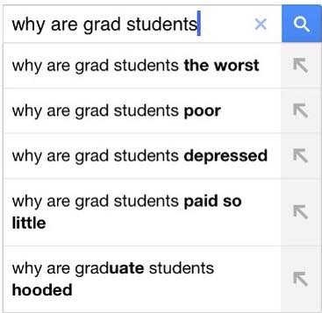
What is research?
Find answers, solve problems
In M.Sc., you take the first few steps on how to do research: novelty is not necessary but encouraged.
In Ph.D., you are to prove that you can do research: novelty is a must.
The following are critical:
Analyzing data and the results: frog story.
Being precise and conclusive
In CS:
Propose new solutions/algorithms to problems
Compare algorithms/studies
Collect data/dataset for studies
Propose a formalism, theory, framework…

Slide 3
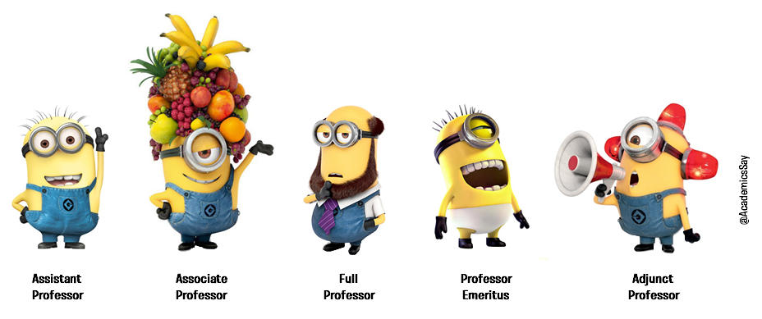
An academic career
Undergraduate degree
Master of Science
degree
Doctor of Philosophy
degree
Assistant Professor
Associate Professor
Professor

Slide 4
What does an academician do?
Teach
Undergraduate courses
Graduate courses
Research
Direct projects in hot/new problems
Publish contributions
Attend conferences to present contributions
Administrative duties
Dept. Chair, Vice Chair, Committees etc.

Slide 5
‘Good’ aspects of being an academician
Money
Time
Infrastructure
Flexibility
Tourism
Wide range of options
Moral satisfaction
Poor alternatives

Slide 6
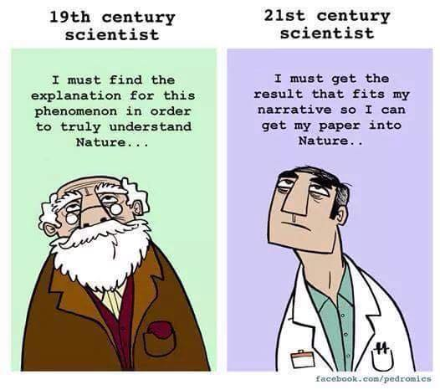
Doing “good” research
Limits:
Effort
Time
Money
Bad influences:
Publications/theses: quality vs. quantity
Advice:
Put a brick on an existing wall.

Slide 7
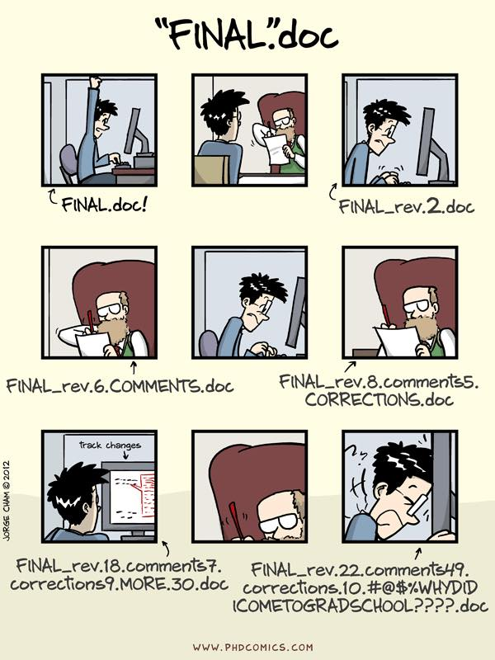
Overview on writing
Academic writing, thesis writing and ethical issues
Sinan Kalkan

Slide 8
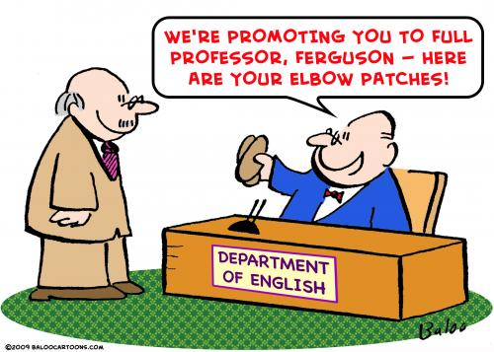
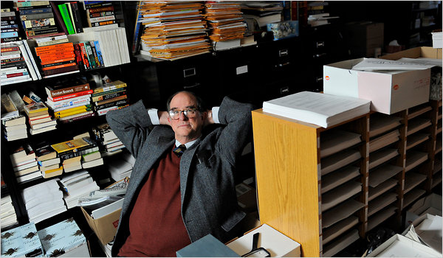
Why write?

Slide 9
We write
Technical reports
Conference articles
Journal articles
Magazine articles
Newspaper articles
Books
Theses

Slide 10
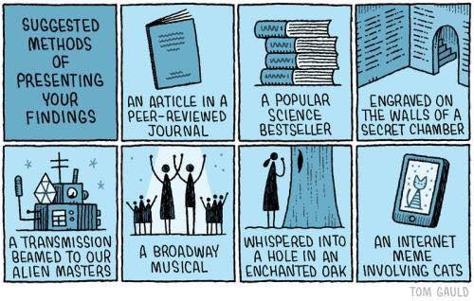
Courtesy of Tom Gauld.

Slide 11
Academic Writing
Important factors
Appearance
Spelling, grammar, formatting
Writing Style
Sentence flow
Organization
Connect the ideas
Content
The ideas
Adapted from: www.sds.uwo.ca/writing

Slide 12
Academic Writing: Be clear and precise
Be clear
Murphy’s law for academic writing: If it can be misinterpreted, it will misinterpreted.
Choose words wisely. Wrong words may mean ambiguity, misinterpretation etc.
Be precise
Avoid words that are unclear (e.g., “good”, “bad”, “beautiful”)
Use descriptive, definite words
Examples:
“It was a good analysis” ☹
“The analysis addressed three major concerns …” ☺
Adapted from: www.sds.uwo.ca/writing

Slide 13
Academic Writing
Avoid absolute words
In academia, nothing is ever certain
Avoid “always”, “exactly”, “proves”, “never” etc.
Examples
“Figure 3 proves that …” ☹
“Figure 3 shows that …” or “In Figure 3, we see that …” ☺
“Deer mice never eat insects” ☹
“Deer mice are not known to eat insects” ☺
Adapted from: www.sds.uwo.ca/writing

Slide 14
Academic Writing
Check word meanings
English is a second language for us
Check meanings of words if in doubt
Many complications with prepositions especially:
Between: Comparing two things
Among: Comparing many things
Example:
I have a hard time choosing between Hamlet and Macbeth.
Among The Tempest, Othello and Julius Caesar, I would choose Othello.
Adapted from: www.sds.uwo.ca/writing

Slide 15
Academic Writing
Affect vs. effect
Lose vs. loose
But vs. However
So vs. Therefore
Adapted from: www.sds.uwo.ca/writing

Slide 16
Academic Writing
Be concise
Shortening the text without impacting clarity
Not the same as brevity
Usually improves clarity
If a word or phrase can be removed or shortened without losing meaning, do it
Repeating information
The end result, future plans
The result, plans
Unnecessary modifiers
Words that add little
Example:
Achieving peace without some kind of armistice is impossible.
Achieving peace without an armistice is impossible.
Adapted from: www.sds.uwo.ca/writing

Slide 17
Academic Writing
Unnecessary long descriptions
For the reason that
In light of the fact that
BECAUSE
Filler words like there is, there are, it is
There is evidence to suggest that fumigation causes...
Evidence suggests fumigation causes...
Proactive solutions
Active Voice
Positive Form
Subordination
Adapted from: www.sds.uwo.ca/writing

Slide 18
Academic Writing
Active voice
Subject is acting, not being acted upon
More direct and usually cuts out words
Examples:
Passive: The shoulder was rotated 70 degrees
Active: We rotated the shoulder 70 degrees
Passive: “In this thesis, a method for recognizing sign language gestures captured from a Kinect device is proposed”
Active: “I propose a method for recognizing sign language gestures captured from a Kinect device”.
Not used in all disciplines
Science:
Saline was added to treatment A.
I added saline to treatment A.
Treatment A contained saline.
Adapted from: www.sds.uwo.ca/writing

Slide 19
Academic Writing
Positive form
Convert negative phrases into positive
Eliminates phrases like “does not”, “will not”
Examples:
Method X does not perform very well on dataset A.
Method X performs better on dataset B.
Deer mice have not been shown to eat insects.
Deer mice primarily eat seeds and roots.
Subordination
Restructuring clauses within other clauses
Changes the relative importance, but also eliminates a lot of words
Examples:
The procedure was used to extract magnetite, and it took five steps.
The procedure was used to extract magnetite in five steps.
The five-step procedure was used to extract magnetite.
The five-step procedure extracted magnetite.
Adapted from: www.sds.uwo.ca/writing

Slide 20
In summary
Your text should be:
Concise/Precise/Specific
Clear
Elegant in every aspect

Slide 21
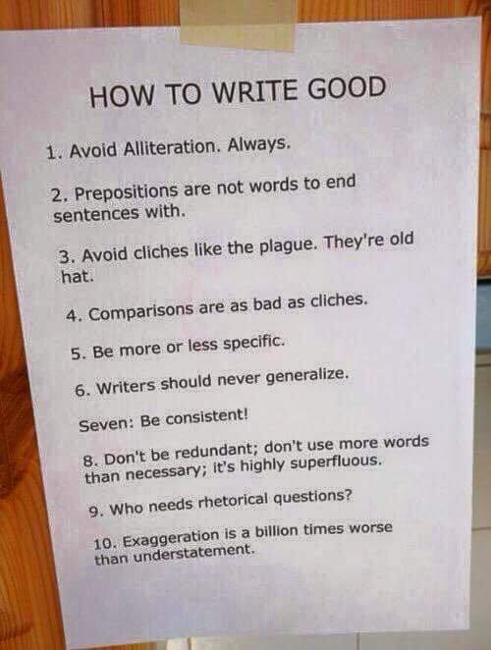

Slide 23
Technical Details

Slide 24
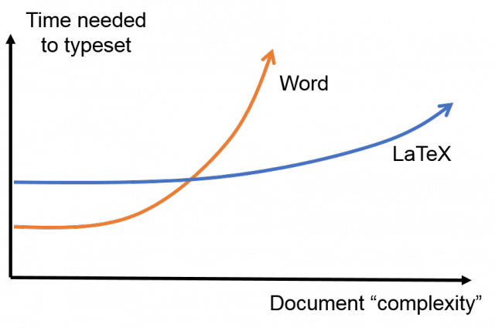
Format & Editor
Credit: JL Blanco
Use Latex
Use Latex
Use Latex
If not possible,
Use Latex
Templates are ready to use on fbe.metu.edu.tr
There are very good editors available
TexStudio & TeXnicCenter on Windows
Eclipse, Kile etc. on Linux

Slide 25
Figures, Equations, Tables etc.
Number your figures, tables, algorithms
And refer to them
Order them based on their referral order
Number your equations even if you don’t refer to them
Captions
Should be descriptive and precise
Captions are placed above tables and algorithms, and below figures

Slide 26
Figures
Use scalable vector graphics
Not bitmap
SHOW EXAMPLE FILES

Slide 27
Equations
Equations should be thought of as being part of the text
Therefore, they should end with a dot or a comma.

Slide 28
Formal Explanation of a Method
Introduce symbols
Don’t use the same symbol for two different meanings in a text
Write your steps as equations
“The method looks for all possible parameter values and chooses the one that maximizes the total weighted cost values”
“The method finds
$$θ^{∗}=\arg{\max_{θ}{\sum_{i ∈ I}{ω\left(i\right)×}}}p\left(c \right| i, θ)$$
Be precise
Multiplication symbol in mathematics and programming
«$×$» → multiplication in math (\times command in Latex)
«$∗$» → convolution (multiplication operation in Programming)

Slide 29
Case study: sorting
First, we need to define the problem
i.e., problem definition
Then, let us describe our method formally.

Slide 30
Sorting: Problem definition
Sorting is the problem of rearranging the numbers such that they are in increasing order.
Given a set of numbers $S=\left\{s_{1},s_{2},…,s_{n}\right\}$, $n∈ℕ^{+}$, sorting is finding a permutation of $S$, $S^{′},$such that:
$S^{′}=\{s_{1}^{′},s_{2}^{′},…,s_{n}^{′}\}$, and
$s_{i}^{′}≤s_{j}^{′}$ for any $0<i,j≤n$
vs.

Slide 31
Acronyms
First introduce
If in doubt, introduce
If introduced, use it
Don’t introduce if you don’t use it (e.g., in abstract)
Adapted from: www.sds.uwo.ca/writing

Slide 32
References
Things are very easy in Latex
Use bibtex for organizing and using your references
FBE and journals have templates for this. Use them.
Google scholar is very useful in this aspect
DEMONSTRATION HERE

Slide 33
Ethical Issues

Slide 34
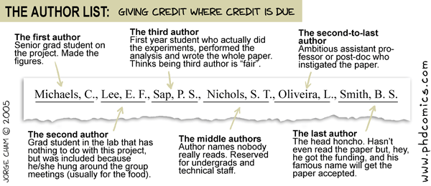
Collaboration & Attribution
Acknowledge your collaborators
Add them as authors if necessary
If in doubt, ask them
Author ordering is very critical.

Slide 35
Research Mis-conduct
Use all results
Don’t hide data/results/datasets that are not in accordance with your hypotheses
Use correct results
Don’t use “painted” results
Don’t submit an article to multiple sources in parallel
Don’t argue/submit what you haven’t done
Cite everything that you use
Software, code, document, figure, table etc.

Slide 36
Research misconduct
Video series: Do scientists cheat?
https://www.youtube.com/watch?v=VooaLRqTSPI

Slide 37
Plagiarism
From Latin word plagiarius (~ kidnapper, stealer)
In Turkish,
«aşırma», «intihal».
From Wikipedia:
“Plagiarism is the "wrongful appropriation" and "stealing and publication" of another author's "language, thoughts, ideas, or expressions" and the representation of them as one's own original work. The idea remains problematic with unclear definitions and unclear rules. The modern concept of plagiarism as immoral and originality as an ideal emerged in Europe only in the 18th century, particularly with the Romantic movement.”
“Plagiarism is considered academic dishonesty and a breach of journalistic ethics. It is subject to sanctions like penalties, suspension, and even expulsion.”
“Plagiarism is not a crime per se but in academia and industry, it is a serious ethical offense,[6][7] and cases of plagiarism can constitute copyright infringement.”

Slide 38
Plagiarism
Wikipedia:
“According to T. Fishman, plagiarism occurs when someone uses words, ideas, or work products:
Attributable to another identifiable person or source
Without attributing the work to the source from which it was obtained
In a situation in which there is a legitimate expectation of original authorship
In order to obtain some benefit, credit, or gain which need not be monetary”
Other definitions from different universities (Wikipedia):
"use, without giving reasonable and appropriate credit to or acknowledging the author or source, of another person's original work, whether such work is made up of code, formulas, ideas, language, research, strategies, writing or other form.“
"... use of another's work, words, or ideas without attribution,“
"... using a source's language without quoting, using information from a source without attribution, and paraphrasing a source in a form that stays too close to the original.“
"deliberate" use of "someone else's language, ideas, or other original (not common-knowledge) material without acknowledging its source.“

Slide 39
Plagiarism
Wikipedia: “Common forms of student plagiarism:
Submitting someone’s work as their own.
Taking passages from their own previous work without adding citations.
Re-writing someone’s work without properly citing sources.
Using quotations, but not citing the source.
Interweaving various sources together in the work without citing.
Citing some, but not all passages that should be cited.
Melding together cited and uncited sections of the piece.
Providing proper citations, but fails to change the structure and wording of the borrowed ideas enough.
Inaccurately citing the source.
Relying too heavily on other people’s work. Fails to bring original thought into the text.”

