Slide 1
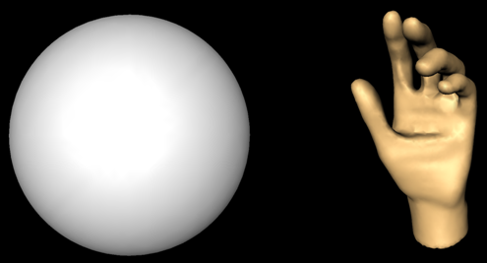
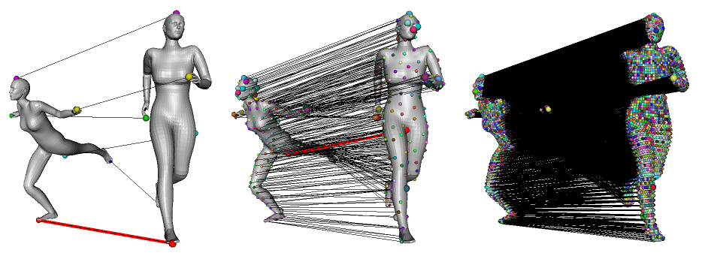
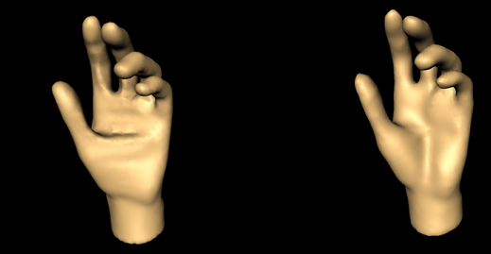
Mesh Processing: From Creation to Comparison
Assoc. Prof. Yusuf Sahillioğlu
Video of this talk available at: https://youtu.be/uhu4k3JaN6w
Computer Eng. Dept. Turkey

Slide 2
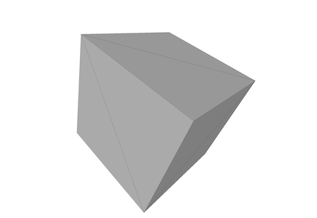
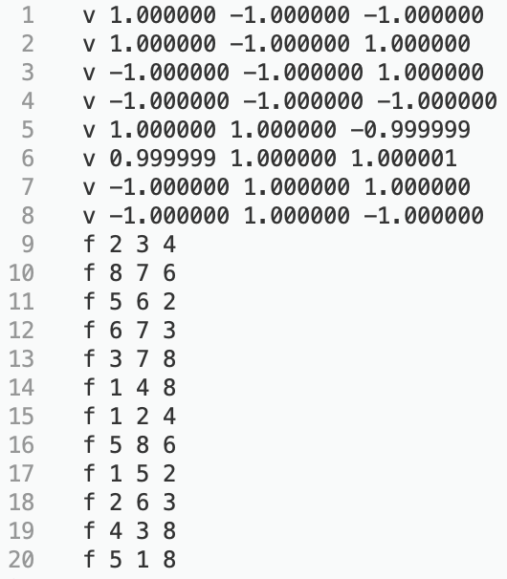
Surface Mesh
Representing geometry and topology as a polygon mesh.
2/42

Slide 3
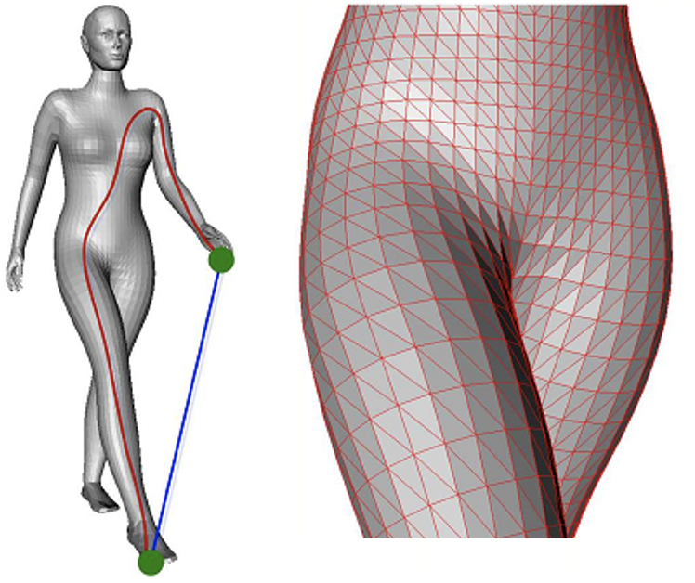
Surface Mesh
Representing geometry and topology as a polygon mesh.
3/42

Slide 4
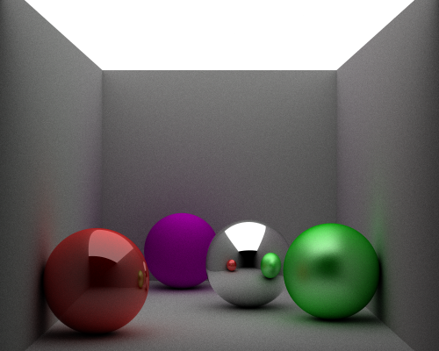
MP vs. CG
Computer graphics //CENG 477
Rendering
Ray tracing
Rasterization
Transformations
y
y
x
x
z
z
4/42

Slide 5
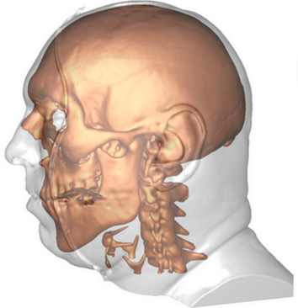
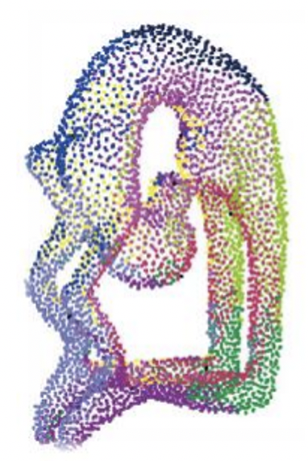
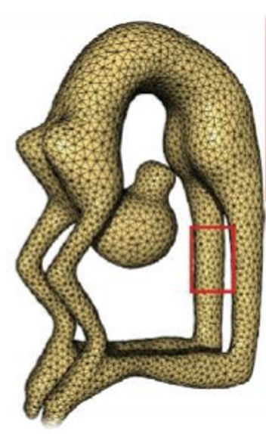
MP vs. CG
Mesh Processing //CENG 789
Reconstruction
5/42

Slide 6
MP vs. CG
Mesh Processing //CENG 789
Reconstruction
Analysis
6/42

Slide 7
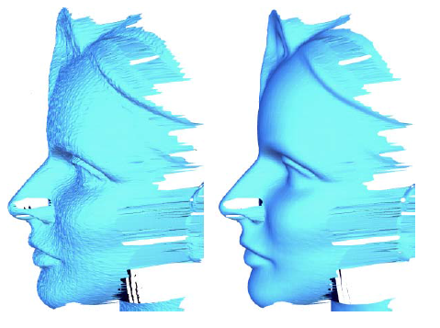
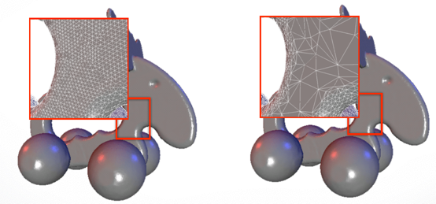
MP vs. CG
Mesh Processing //CENG 789
Reconstruction
Analysis
Smoothing/Remeshing
7/42

Slide 8
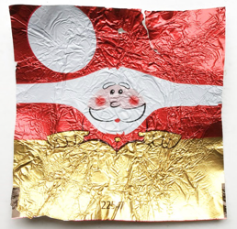
MP vs. CG
Mesh Processing //CENG 789
Parameterization
Deformation
Registration
Fabrication
I’ll focus on my papers on Reconstruction and Analysis
(Creation) (Comparison)
8/42

Slide 9
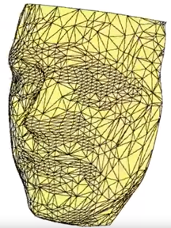
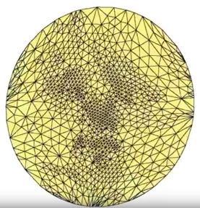
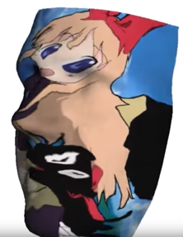
MP vs. CG
Mesh Processing //CENG 789
Parameterization
Deformation
Registration
Fabrication
I’ll focus on my papers on Reconstruction and Analysis
(Creation) (Comparison)
9/42

Slide 10
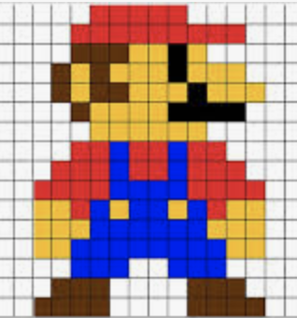
MP vs. IP
Image Processing //CENG 466
Regularity
IP: Every pixel has 4 neighbors
MP: Every edge is incident to 2 faces
Exchange of ideas IP → MP
Seam Carving for Content-Aware Image Resizing, S. Avaidan, A. Shamir, SIGGRAPH, 2007.
Geometry Seam Carving, E. Dekkers, L. Kobbelt, Computer-Aided Design, 2014.
10/42

Slide 11
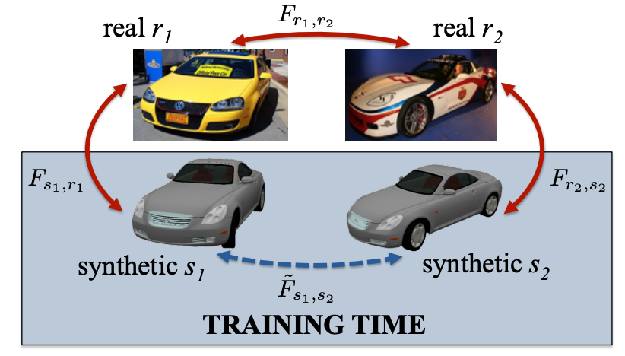
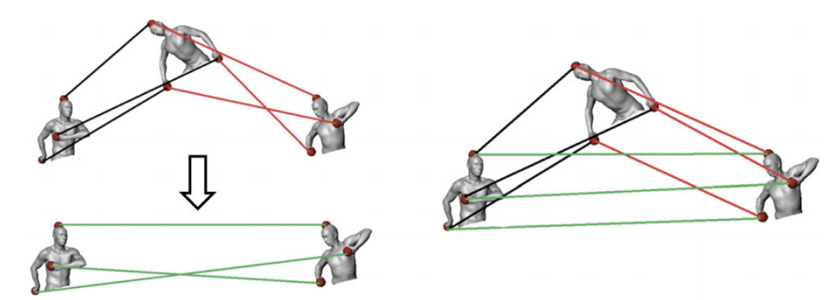
MP vs. IP
Image Processing //CENG 466
Regularity
IP: Every pixel has 4 neighbors
MP: Every edge is incident to 2 faces
Exchange of ideas MP → IP
Multiple shape correspondence by dynamic programming, Y. S., Y. Yemez, Computer Graphics Forum, 2014.
Learning Dense Correspondence via 3D-guided Cycle Consistency, T. Zhou et al., CVPR, 2016.
11/42

Slide 12
Reconstruction
Input: 3D point samples
Output: Surface fit to the point samples
3D point samples can be acquired passively or actively
Stereoscopic images
Multiple silhouettes
Emitters
LIDAR, Laser Scanner, Kinect, ToF
12/42

Slide 13
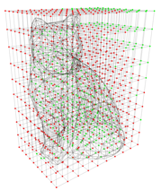
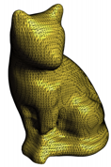
Reconstruction
Input: 3D point samples
Output: Surface fit to the point samples
3D point samples can be acquired passively or actively
Stereoscopic images
Multiple silhouettes
Emitters
LIDAR, Laser Scanner, Kinect, ToF
Alternative input: Scalar field defined over a 3D grid (CT)
Defines surface implicitly
Implicit methods, e.g., Marching Cubes, to extract the surface.
13/42

Slide 14
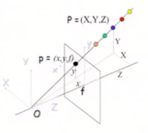
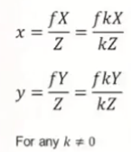
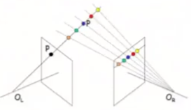
Reconstruction
Input: 3D point samples; how to get them?
Stereoscopy
Depth ambiguity handled by a second image
14/42

Slide 15
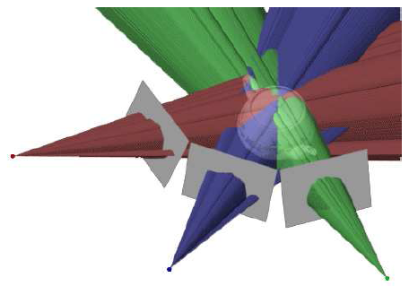
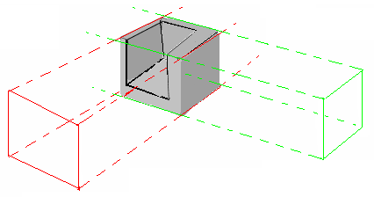
Reconstruction
Input: 3D point samples; how to get them?
Silhouettes
Idea | Weakness
 | Hidden Concavity
15/42

Slide 16
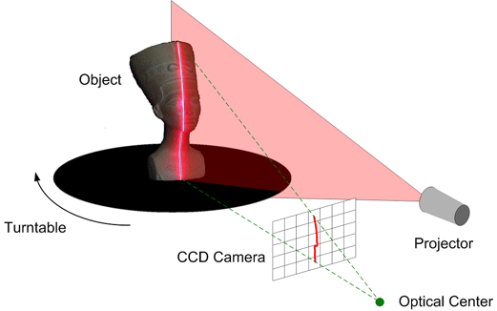
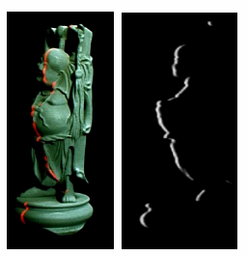
Reconstruction
Input: 3D point samples; how to get them?
Structured light
Idea | Weakness
 | Occlusion
16/42

Slide 17
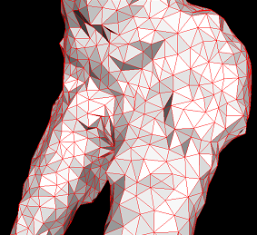
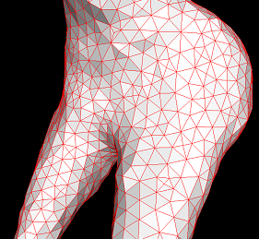
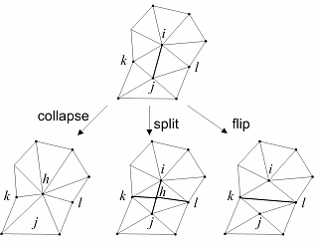
Reconstruction
Input: 3D point samples
Output: Surface; how to get it?
Iterate
Move each vertex P with v(P, B) in the direction of its normal N(P), as Fext suggests:
Regularize the mesh by Fint
Collapse edges with length smaller than εmin
Split edges with length exceeding εmax = 2εmin
Flip edges where necessary, favoring the vertices with valences close to 6
Till convergence
Coarse-to-Fine Surface Reconstruction from Silhouettes and Range Data Using Mesh Deformation, Y. S., Y. Yemez, CVIU, 2010.
17/42

Slide 18
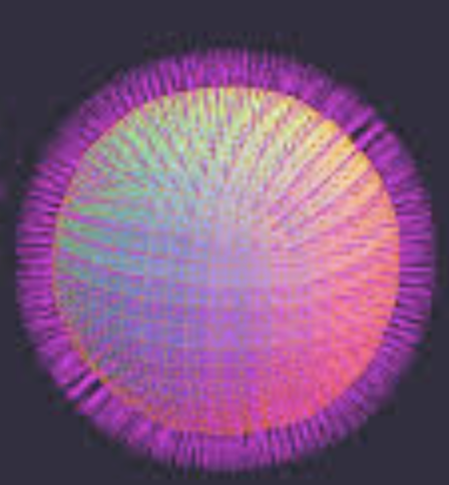
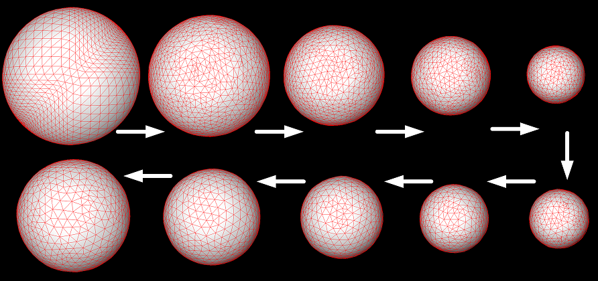
Reconstruction
Input: 3D point samples
Output: Surface; how to get it?
Fext: constant external force (F(P) = –εmin/2 * N(P))
Coarse-to-Fine Surface Reconstruction from Silhouettes and Range Data Using Mesh Deformation, Y. S., Y. Yemez, CVIU, 2010.
18/42

Slide 19
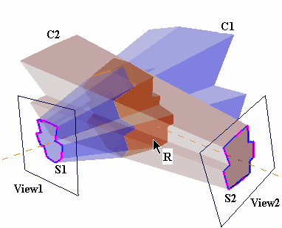
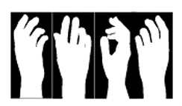
Reconstruction
Input: 3D point samples
Output: Surface; how to get it?
Fext: force based on silhouettes
Coarse-to-Fine Surface Reconstruction from Silhouettes and Range Data Using Mesh Deformation, Y. S., Y. Yemez, CVIU, 2010.
19/42

Slide 20
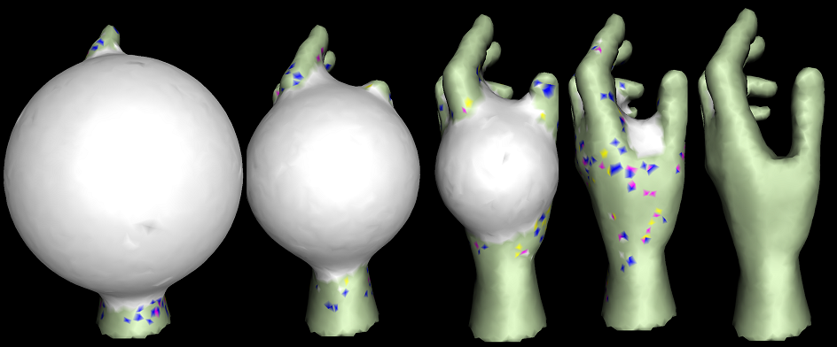
Reconstruction
Input: 3D point samples
Output: Surface; how to get it?
Fext: force based on silhouettes
Coarse-to-Fine Surface Reconstruction from Silhouettes and Range Data Using Mesh Deformation, Y. S., Y. Yemez, CVIU, 2010.
20/42

Slide 21
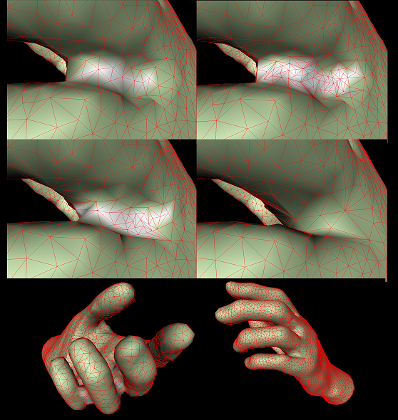
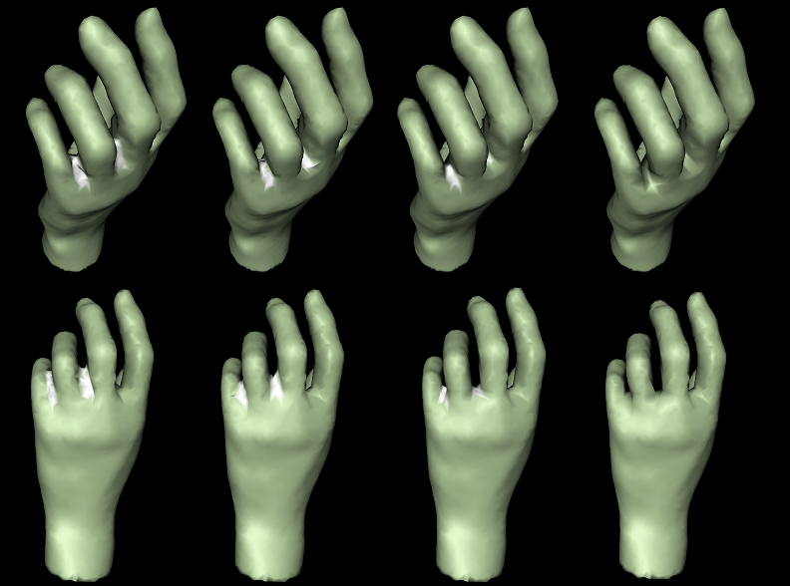
Reconstruction
Input: 3D point samples
Output: Surface; how to get it?
Fext: force based on silhouettes
Coarse-to-Fine Surface Reconstruction from Silhouettes and Range Data Using Mesh Deformation, Y. S., Y. Yemez, CVIU, 2010.
21/42

Slide 22
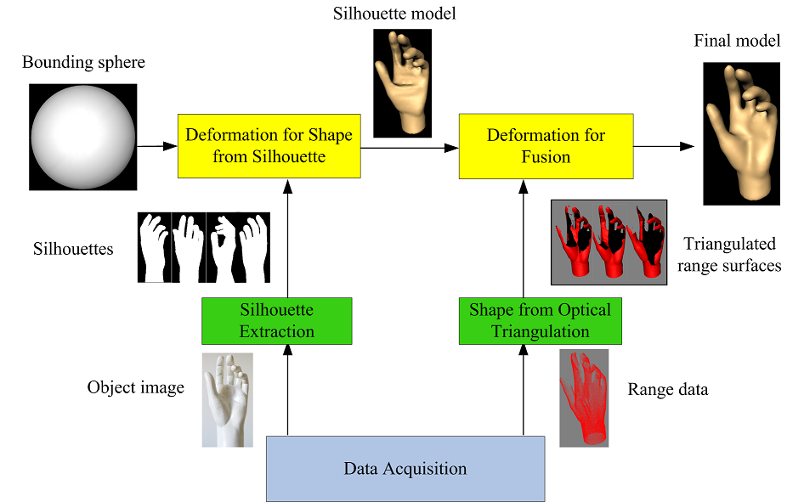
Reconstruction
Input: 3D point samples
Output: Surface; how to get it?
Hidden concavity problem solved using range/laser surface
Coarse-to-Fine Surface Reconstruction from Silhouettes and Range Data Using Mesh Deformation, Y. S., Y. Yemez, CVIU, 2010.
22/42

Slide 23
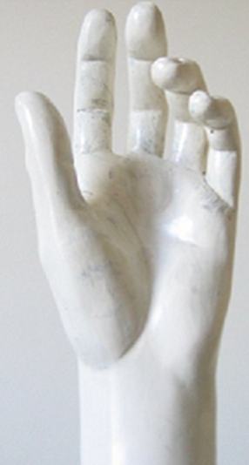
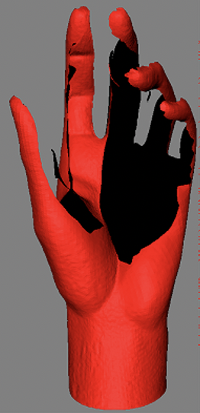
Reconstruction
Input: 3D point samples
Output: Surface; how to get it?
Hidden concavity problem solved using range/laser surface
Coarse-to-Fine Surface Reconstruction from Silhouettes and Range Data Using Mesh Deformation, Y. S., Y. Yemez, CVIU, 2010.
23/42

Slide 24
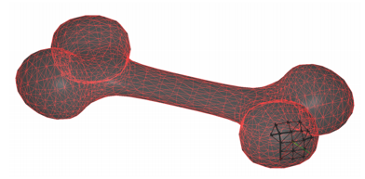
Reconstruction
Input: 3D point samples
Output: Surface; how to get it?
Mesh up laser point cloud as follows
Find local neighborhood Li of each point in the 3D point cloud input
For each Li compute tangent plane using PCA
Project all points in Li to the tangent plane and compute their 2D Delaunay triangulation
Merge all these local triangulations into a global one
Coarse-to-Fine Surface Reconstruction from Silhouettes and Range Data Using Mesh Deformation, Y. S., Y. Yemez, CVIU, 2010.
24/42

Slide 25
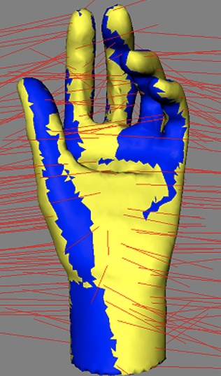
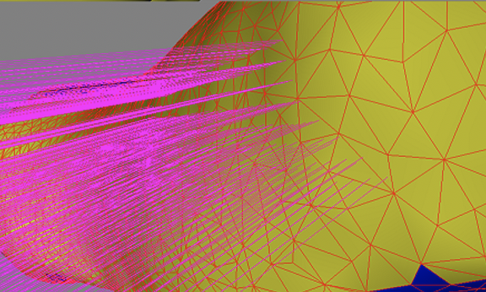
Reconstruction
Input: 3D point samples
Output: Surface; how to get it?
Refine the silhouette-based mesh using an updated Fext(P) based on carvers assigned to triangles that share the vertex P
Coarse-to-Fine Surface Reconstruction from Silhouettes and Range Data Using Mesh Deformation, Y. S., Y. Yemez, CVIU, 2010.
25/42

Slide 26
Comparison/Correspondence
Once we have the meshes (reconstruction), we want to relate them with each other to enable nice apps, such as
Shape interpolation:
Deformation transfer:
Attribute transfer:
Shape registration:
Shape matching:
Statistical analysis:
26/42

Slide 27
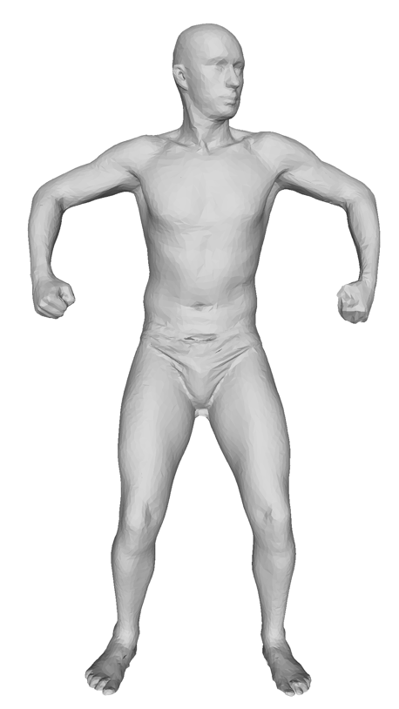
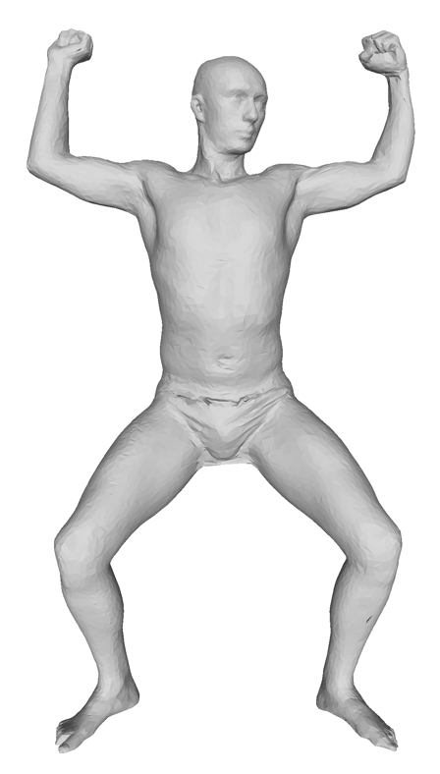
Correspondence
Solution idea
Quantify the quality of a given map
Then search the map space using this metric
s_{i}
t_{j}
t_{m}
|.35 - .95| = .6 ☹
|.34 - .48| = .14 ☹
s_{l}
s_{i}
s_{l}
t_{m}
t_{j}
A bad/high-distortion map.
27/42

Slide 28
Correspondence
Looking at all N! permutations is infeasible
Minimize this metric (or its variants) using:
Greedy optimization, Y. S., Y. Yemez, CVPR, 2010
Combinatorial optimization, Y. S., Y. Yemez, Computer Graphics Forum, 2011, 2012, 2013, 2014
Expectation-Maximization (EM), Y. S., Y. Yemez, PAMI, 2012
Dynamic Programming, Y. S., Y. Yemez, Computer Graphics Forum, 2014
Deformation, Y. S., L. Kavan, Medical Image Analysis, 2015
Genetic optimization, Y. S., Transactions on Graphics 2018
Survey, Y. S., The Visual Computer, 2020
28/42

Slide 29
Correspondence
Looking at all N! permutations is infeasible
Minimize this metric (or its variants) using:
Greedy optimization, Y. S., Y. Yemez, CVPR, 2010
Combinatorial optimization, Y. S., Y. Yemez, Computer Graphics Forum, 2011, 2012, 2013, 2014
Expectation-Maximization (EM), Y. S., Y. Yemez, PAMI, 2012
Dynamic Programming, Y. S., Y. Yemez, Computer Graphics Forum, 2014
Deformation, Y. S., L. Kavan, Medical Image Analysis, 2015
Genetic optimization, Y. S., Transactions on Graphics 2018
Survey, Y. S., The Visual Computer, 2020
29/42

Slide 30
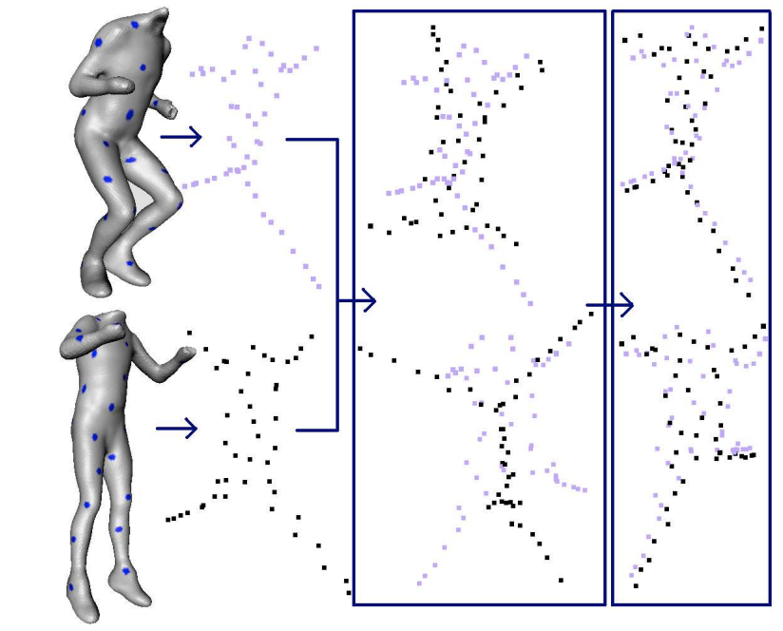
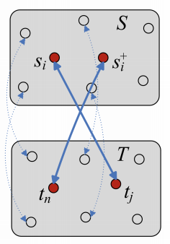
Correspondence
Looking at all N! permutations is infeasible
Minimize this metric (or its variants) using:
Initial correspondence via MDS (left) is refined by greedy optimization based on neighbor voting (right).
3D Shape Correspondence by Isometry-Driven Greedy Optimization, Y. S., Y. Yemez, CVPR, 2010.
Detail-Preserving Mesh Unfolding for Nonrigid Shape Retrieval, Y. S., L. Kavan, Transactions on Graphics, 2016.
30/42

Slide 31
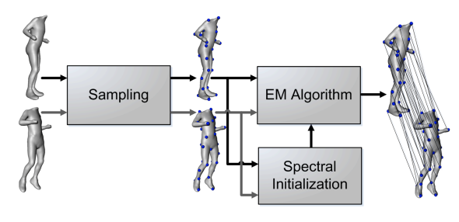
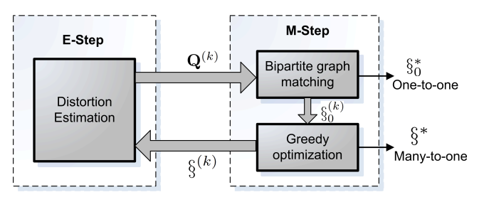
Correspondence
Looking at all N! permutations is infeasible
Minimize this metric (or its variants) using:
Isometric cost of matching si to tj for all pairs (Q matrix in E-Step) guides graph matching and refinement which results in a better map to estimate Q (M-step). Repeat.
Minimum-Distortion Isometric Shape Correspondence Using EM Algorithm, Y. S., Y. Yemez, PAMI, 2012.
31/42

Slide 32
Correspondence
Looking at all N! permutations is infeasible
Minimize this metric (or its variants) using:
Represent a permutation as a chromosome and evolve many of them into the fittest one that yields the min-distortion map
A Genetic Isometric Shape Correspondence Algorithm with Adaptive Sampling, Y. S., Transactions on Graphics, 2018.
32/42

Slide 33
Correspondence
Looking at all N! permutations is infeasible
Minimize this metric (or its variants) using:
Represent a permutation as a chromosome and evolve through genetic operators xover and mutation
A Genetic Isometric Shape Correspondence Algorithm with Adaptive Sampling, Y. S., Transactions on Graphics, 2018.
33/42

Slide 34
Correspondence
Looking at all N! permutations is infeasible
Minimize this metric (or its variants) using:
Represent a permutation as a chromosome and evolve through genetic operators xover and mutation
A Genetic Isometric Shape Correspondence Algorithm with Adaptive Sampling, Y. S., Transactions on Graphics, 2018.
34/42

Slide 35
Correspondence
Looking at all N! permutations is infeasible
Minimize this metric (or its variants) using:
Improved bilateral maps: scale-invariance, fuzzy voting.
Bilateral Maps for Partial Matching, O. van Kaick., H. Zhang, G. Hamarneh, Computer Graphics Forum, 2013.
35/42

Slide 36
Correspondence
Looking at all N! permutations is infeasible
Minimize this metric (or its variants) using:
Improved bilateral maps: scale-invariance, fuzzy voting.
Bilateral Maps for Partial Matching, O. van Kaick., H. Zhang, G. Hamarneh, Computer Graphics Forum, 2013.
36/42

Slide 37
Correspondence
Looking at all N! permutations is infeasible
Minimize this metric (or its variants) using:
Improved bilateral maps: scale-invariance, fuzzy voting.
Bilateral Maps for Partial Matching, O. van Kaick., H. Zhang, G. Hamarneh, Computer Graphics Forum, 2013.
37/42

Slide 38
Correspondence
Looking at all N! permutations is infeasible
Minimize this metric (or its variants) using:
Improved bilateral maps: scale-invariance, fuzzy voting.
Bilateral Maps for Partial Matching, O. van Kaick., H. Zhang, G. Hamarneh, Computer Graphics Forum, 2013.
38/42

Slide 39
Interpolation
Correspondence in action: shape interpolation
Interpolate through the shortest path of inter-shapes
Part-Based Data-Driven 3D Shape Interpolation, M. Aydınlılar., Y. S., Computer-Aided Design, 2020.
39/42

Slide 40
Skeleton
Correspondence in action: skeleton extraction/transfer
Transfer the skeleton in source mesh to the target mesh using surface mesh correspondences
3D Skeleton Transfer for Meshes and Clouds, Ç. Seylan., Y. S., Graphical Models, 2019.
40/42

Slide 41
Skeleton
Correspondence in action: inverse problem, skin extract
Transfer the source mesh to the target skeleton using skeleton correspondences
XXX, Ç. Seylan., Y. S., under revision, 2020.
41/42

Slide 42
Thanks
Papers, codes, executables, lectures, ..: http://ceng.metu.edu.tr/~ys
Y. S., Assoc. Prof.
42/42

