Slide 1
A Genetic Isometric Shape Correspondence Algorithm with Adaptive Sampling
Yusuf Sahillioğlu
SIGGRAPH Asia 2018
Computer Eng. Dept. Turkey

Slide 2
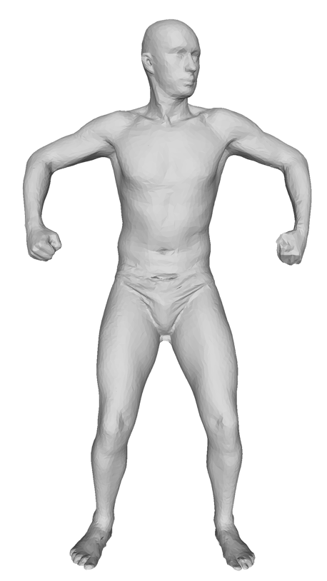
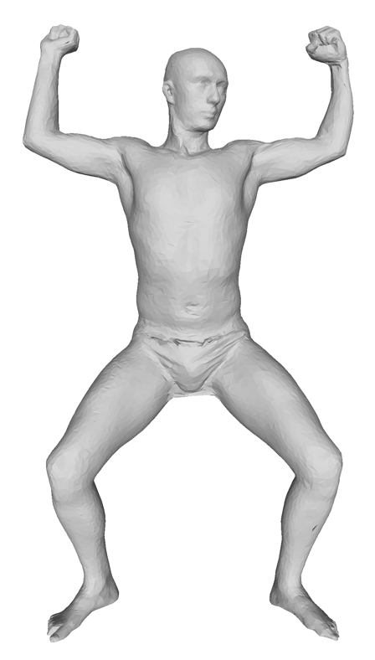
Problem Statement
Goal: Find one-to-one correspondence between a
pair of isometric (or nearly isometric) shapes.

Slide 3
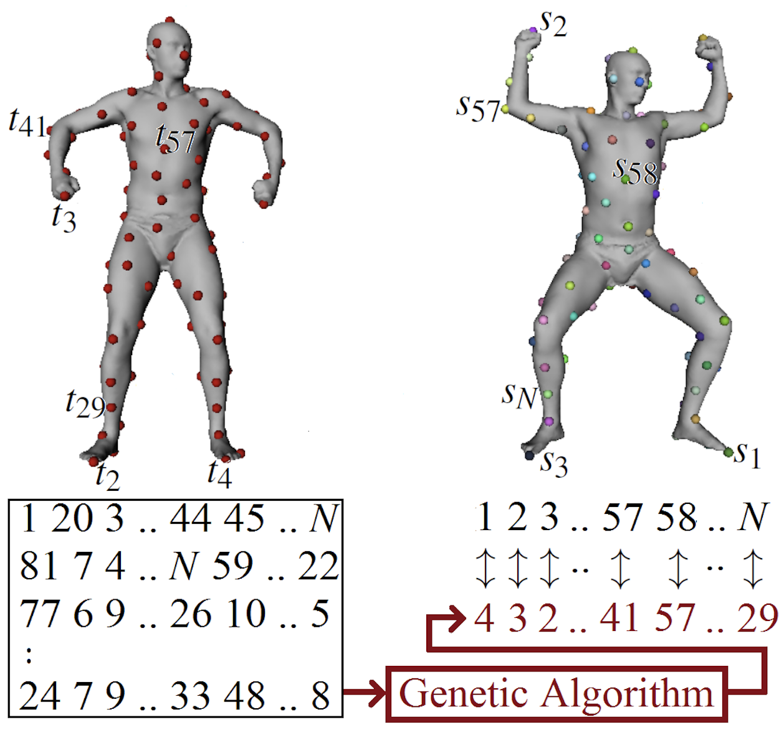
Problem Statement
Goal: Find sparse one-to-one correspondence between a pair of isometric (or nearly isometric) shapes.

Slide 4
Problem Statement
Goal: Find sparse one-to-one correspondence between a pair of isometric (or nearly isometric) shapes using GA.

Slide 5
Applications
Correspondence information needed in many apps such as
Shape interpolation:
Deformation transfer:
Attribute transfer:
Shape registration:
Shape matching:
Statistical analysis:
[Kilian et al. 2007]
[Sumner & Popovic 2014]
[Sahillioğlu & Kavan 2015]
[Chang & Zwicker 2008]
[Sahillioğlu & Kavan 2016]
[Allen et al. 2003]

Slide 6
Contributions
Natural connection established: GA and correspondence.
EvoLisa: Evolving color & geometry
of semi-transparent polygons.
1 20 3 .. 44 45 .. 99
81 7 4 .. 99 59 .. 22
60 1 8 .. 11 25 .. 7
77 6 9 .. 26 10 .. 5
4 12 5 .. 26 27 .. 44
4 1 11 .. 61 19 .. 8
4 3 2 .. 41 57 .. 29
80 4 8 .. 39 52 .. 53
30 5 8 .. 36 28 .. 4
5 17 34 .. 1 83 .. 90
[Alsing,Hua]

Slide 7
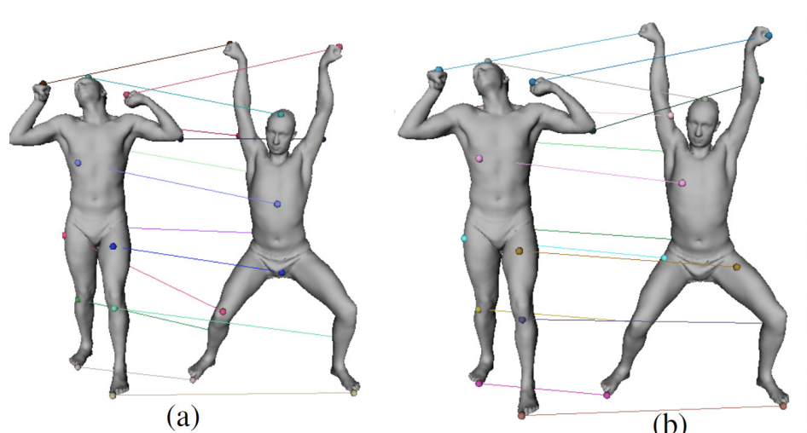
Contributions
Existing maps improved: Adaptive Sampling scheme.

Slide 8
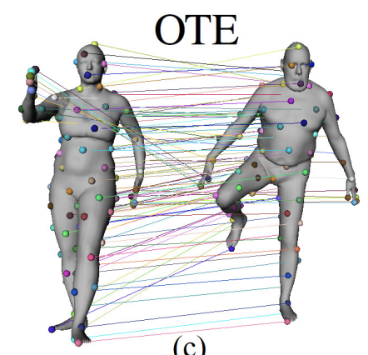
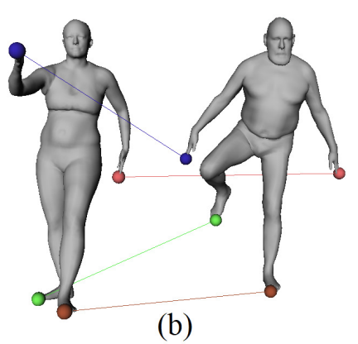
Contributions
Auto-initialization provided: dense match.
Four landmark matches for [Aigerman and Lipman 2015].

Slide 9
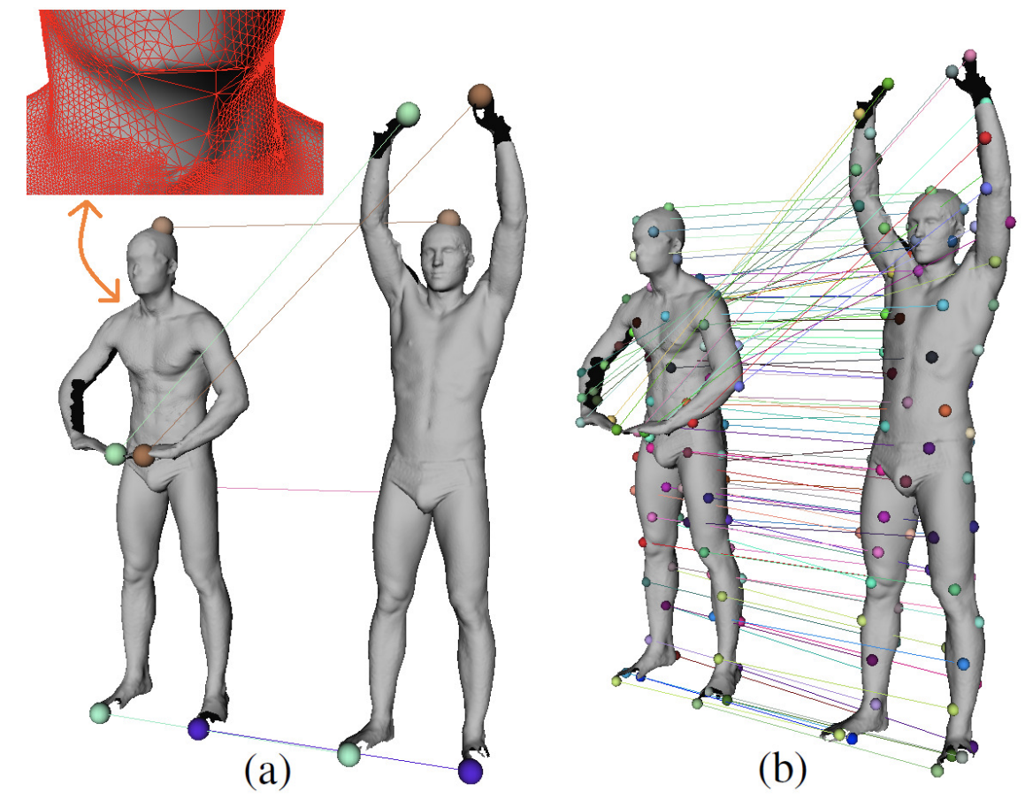
Contributions
Auto-initialization provided: real-world scan registration.
Six (left) or more (right) landmark matches for FAUST scans [Bogo et al. 2014].

Slide 10
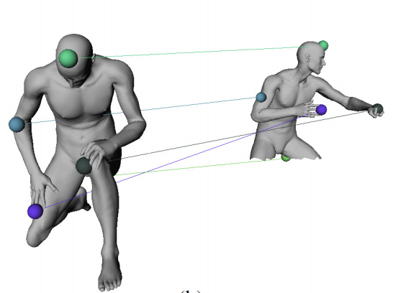
Contributions
Simple extension demonstrated: partial matching.
More challenging partial matching problem solved with a simple extension.

Slide 11
Method: Overview
Permutation creation task carried out by genetic algorithm.
Looking for the best/fittest permutation/chromosome of samples/genes that matches w/ the fixed samples: 1 2 .. N.

Slide 12
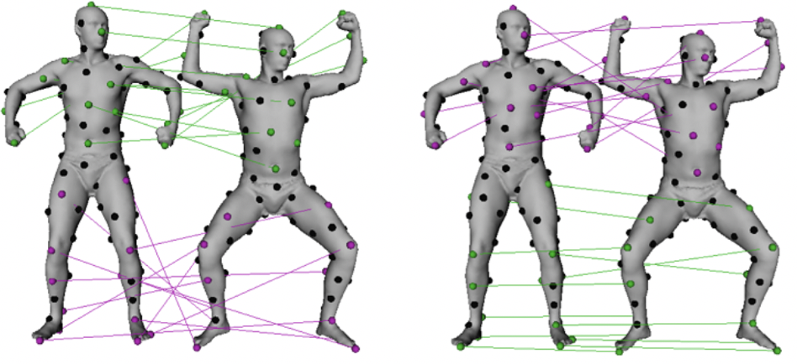
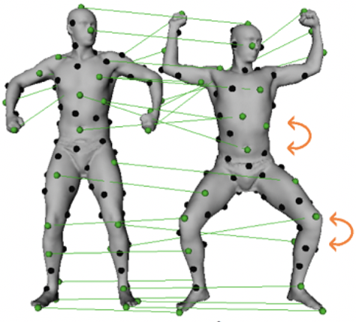
Method: Design Decisions
Healthy parts of two bijections xovered into a better one.

Slide 13
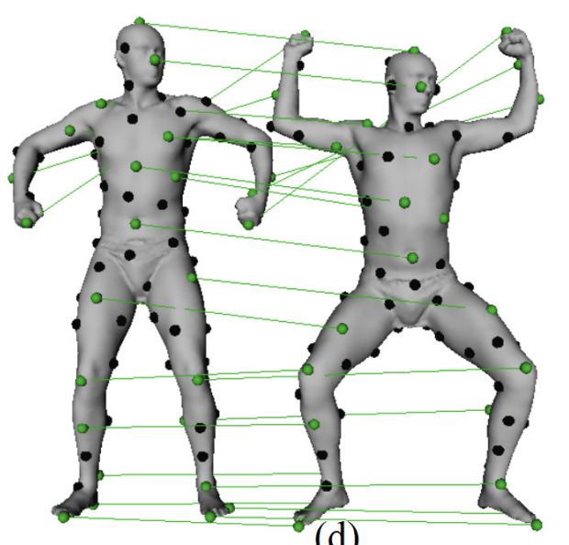
Method: Design Decisions
Individual map mutated into a better one.

Slide 14
Method: Design Decisions
Fitness of a given chromosome representing permutation
where is the bijection that maps i^{th} sample to sample,
and ,
which is a variant of the isometric distortion measures used in
[Bronstein et al.’06, Huang et al.’08, Sahillioğlu & Yemez’11].
^{th}

Slide 15
Method: Design Decisions
Fitness of a given chromosome representing permutation
s_{i}
t_{j}
t_{m}
|.35 - .95| = .6 ☹
|.34 - .48| = .14 ☹
s_{l}
s_{i}
s_{l}
t_{m}
t_{j}
A bad/high-distortion map.

Slide 16
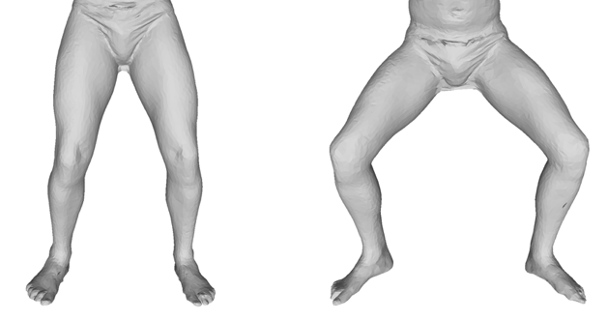
Method: Initial Population
Current population evolved to the next generation.
Initial population based on geodesic consistency.
and : Vector of geodesic distances to a few special samples that are already accurately matched – see Initial Bijection.
Initial match candidates for each sample s_{i} are {t_{j}} that satisfy
< .125 (toe to knee half geo)
: Special sample matches.
: s_{i} and its initial match
s_{i}
candidates.

Slide 17
Method: Initial Population
Current population evolved to the next generation.
Initial population based on geodesic consistency.
About 10 candidates per sample (for N=100 case).
Each initial chromosome filled by picking a random candidate for its i^{th} gene. Population size always 10N, i.e. 1000 chromosomes.
Duplicates prevented to preserve bijection.
Some samples to random matches, not initial match candidates.
: Special sample matches.
: s_{i} and its initial match
s_{i}
candidates.

Slide 18
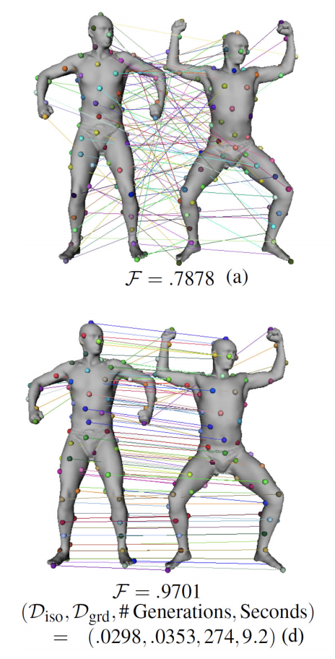
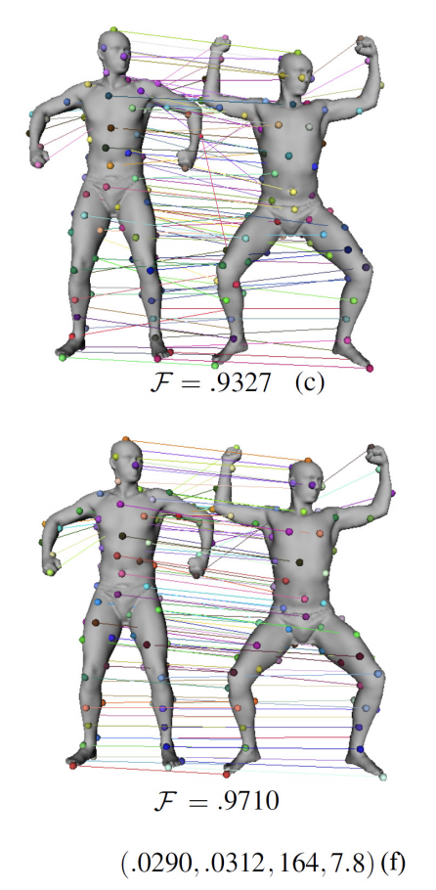
Method: Initial Population
Current population evolved to the next generation.
Random initial population (left) also lead to a good final generation, but not as fast & accurate as our initialization.
Fittest members of
initial (top) and
final (bottom)
populations
shown.

Slide 19
Method: Evolution of Population
Current population evolved to the next generation through genetic operators.
Current population divided into good and bad parts based on chromosome fitnesses.
Some chromosomes in the bad part replaced by the crossovered child of two good parents.
Some chromosomes mutated for individual improvement.
Elitism for free: best chromosome copied to the next gen.

Slide 20
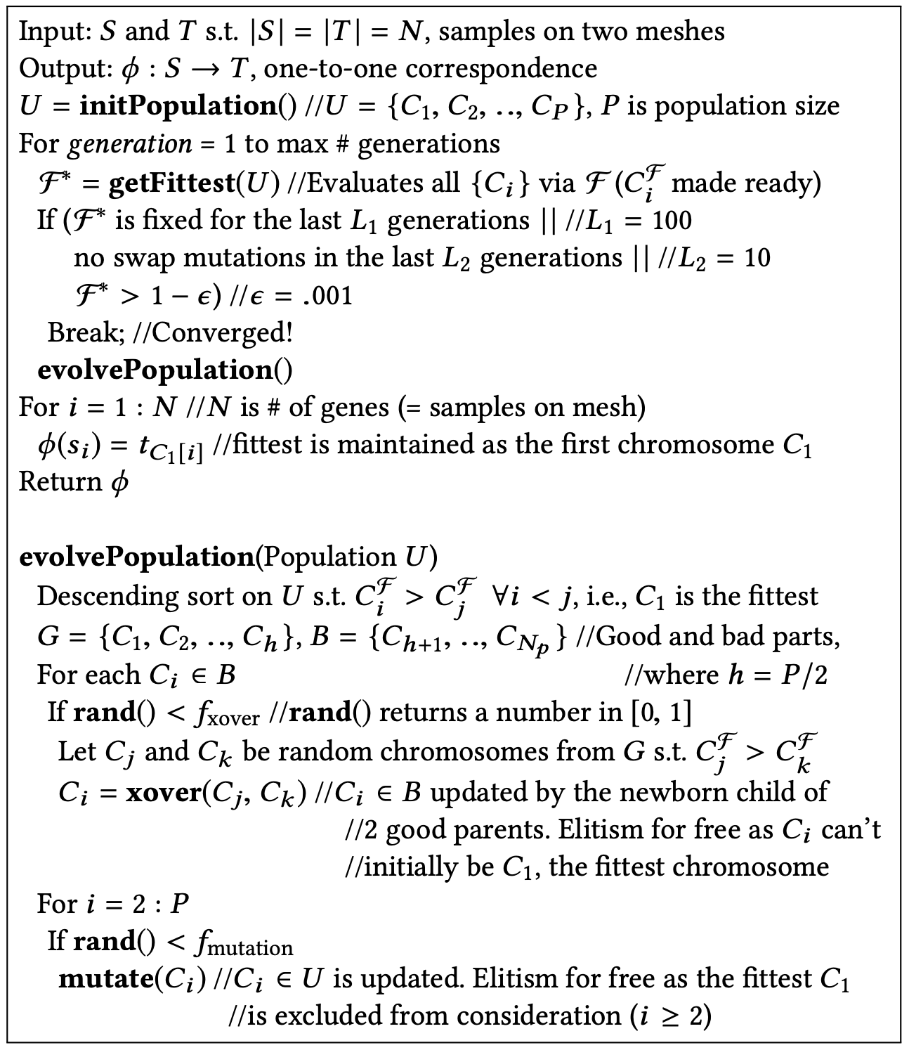
Method: Evolution of Population
Current population evolved to the next generation through genetic operators.

Slide 21
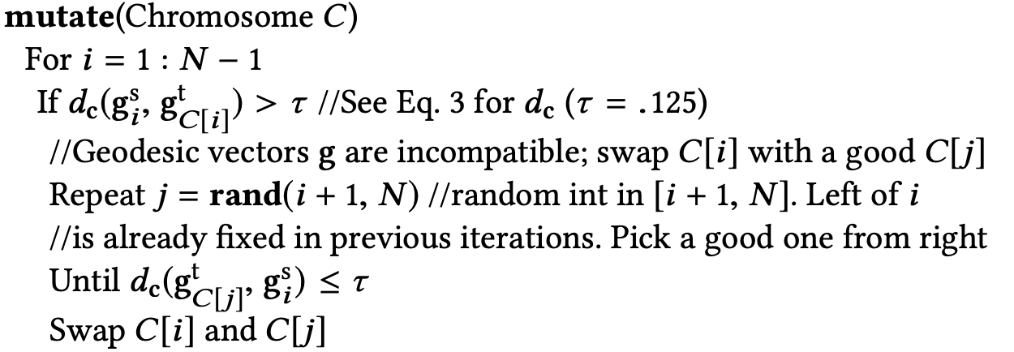
Method: Evolution of Population
Current population evolved to the next generation through genetic operators.
Crossover: duplication-free (bijection), winner/loser-based.
Mutation: duplication-free, geodesic vector compatibility.
Resulting child:
Slide 16

Slide 22
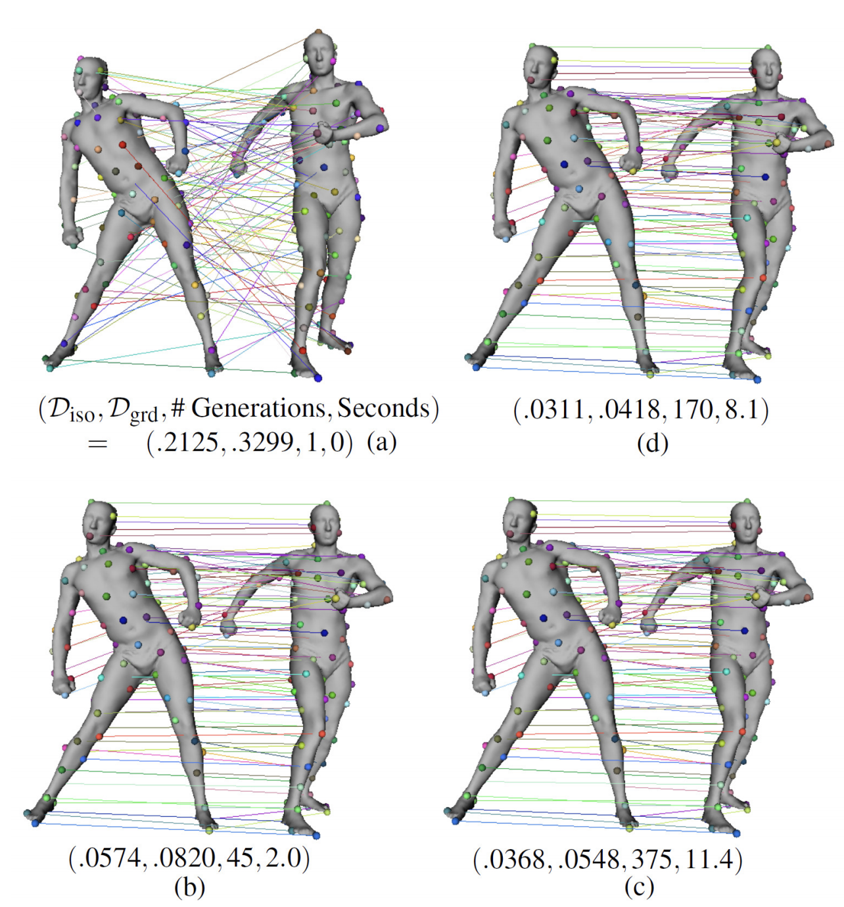
Method: Evolution of Population
Current population evolved to the next generation through genetic operators, whose relative advantages visualized:
Fittest members shown.
random initialization.
result w/ muts only.
result w/ xovs only.
result w/ both on.

Slide 23
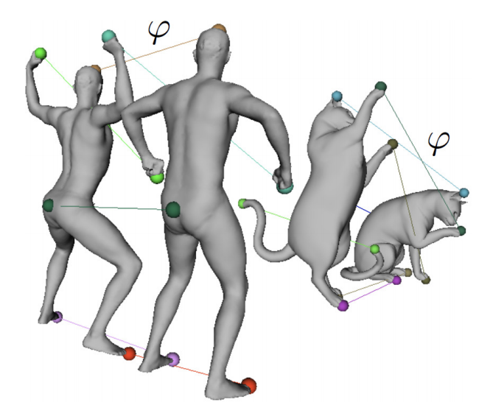
Method: Initial Bijection
While evaluating , to make this frequent op. fast.
Few special samples by FPS w/ a special stopping condition.
Initial population of chromosomes evolved through Slide19.

Slide 24
Adaptive Sampling
Matched samples relocated in a local neighborhood by considering geodesic consistency & sampling regularization.
Given a map (bijection or not) = {(s_{i}, t_{j})}, new target sample locations computed such that (s_{i}, t_{j}) is a better match than (s_{i}, t_{j}) was.
New sampling radius on target r (based on new {t_{j}}) asked to look like the radius of the source samples r_{s}.
Coordinate descent idea: if moving from t_{j} to t_{k} in its 1-ring improves , then t_{j} = t_{k} performed. Process repeated.

Slide 25
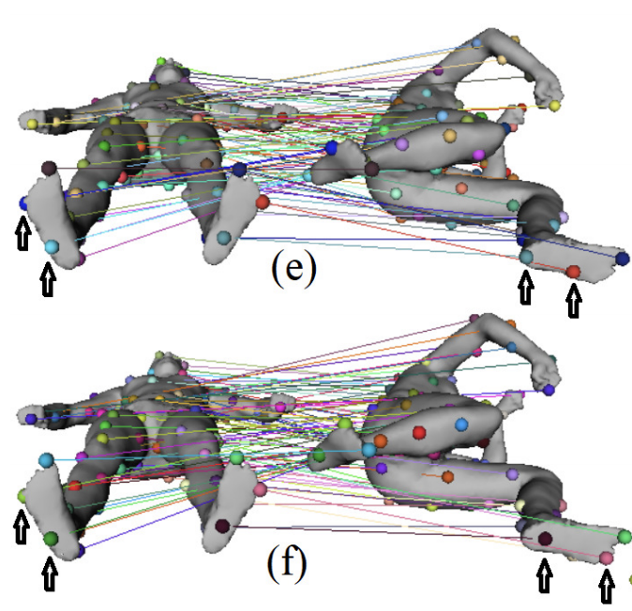
Adaptive Sampling
Matched samples relocated in a local neighborhood by considering geodesic consistency & sampling regularization.
Sole without AS.
Sole with AS.

Slide 26
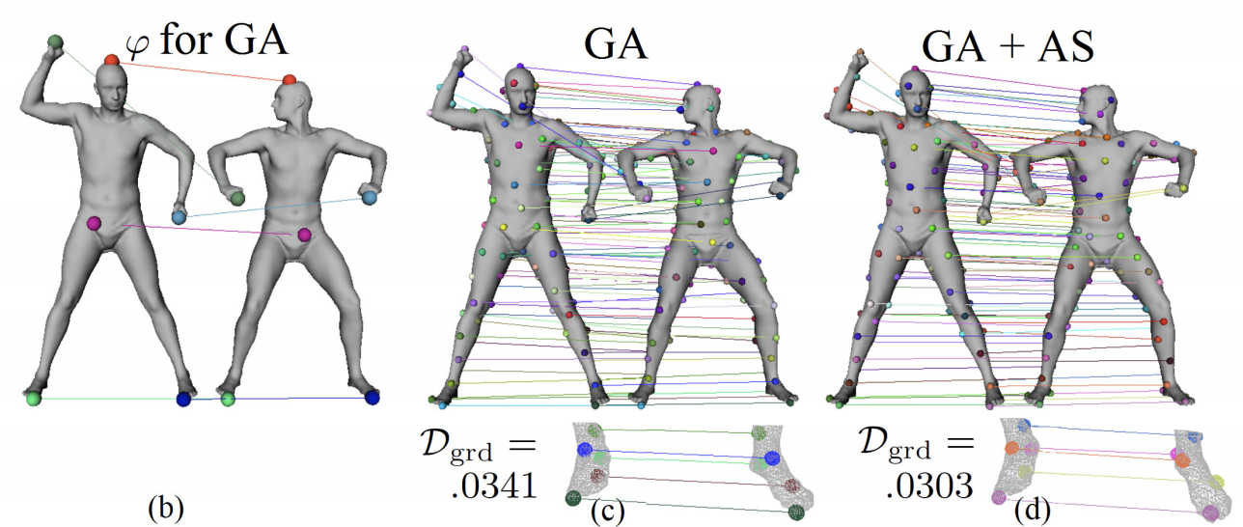
Adaptive Sampling
Matched samples relocated in a local neighborhood by considering geodesic consistency & sampling regularization.

Slide 27
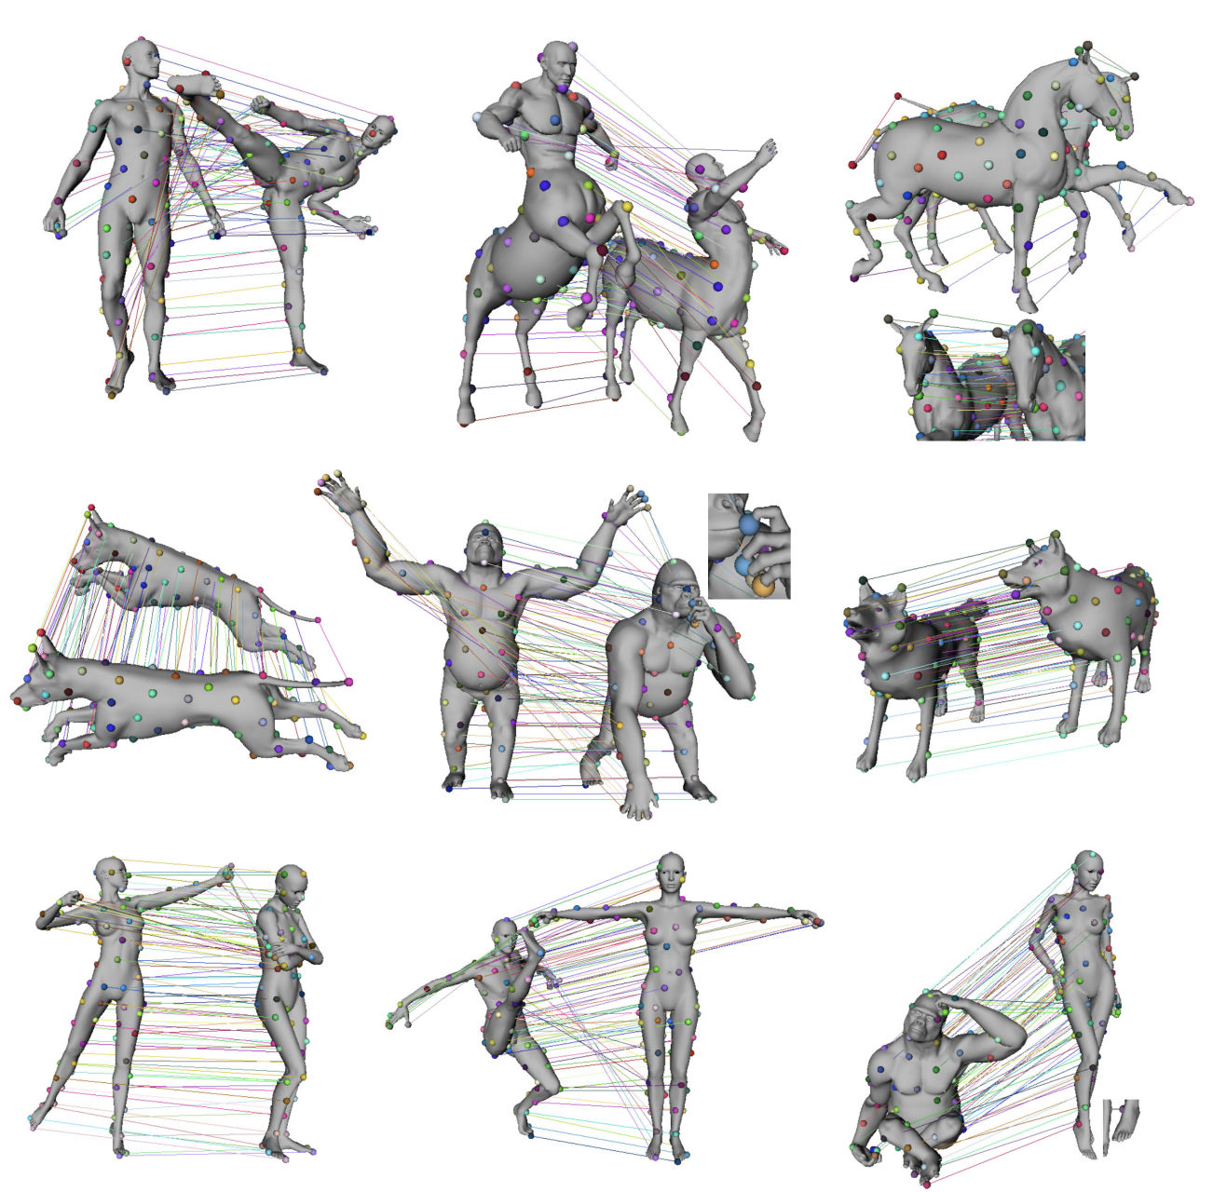
Results
Genetic maps on isometric (top 2 rows), nearly-isometric (bottom left-middle) cases. Limitation on non-isometries (gorilla-human).

Slide 28
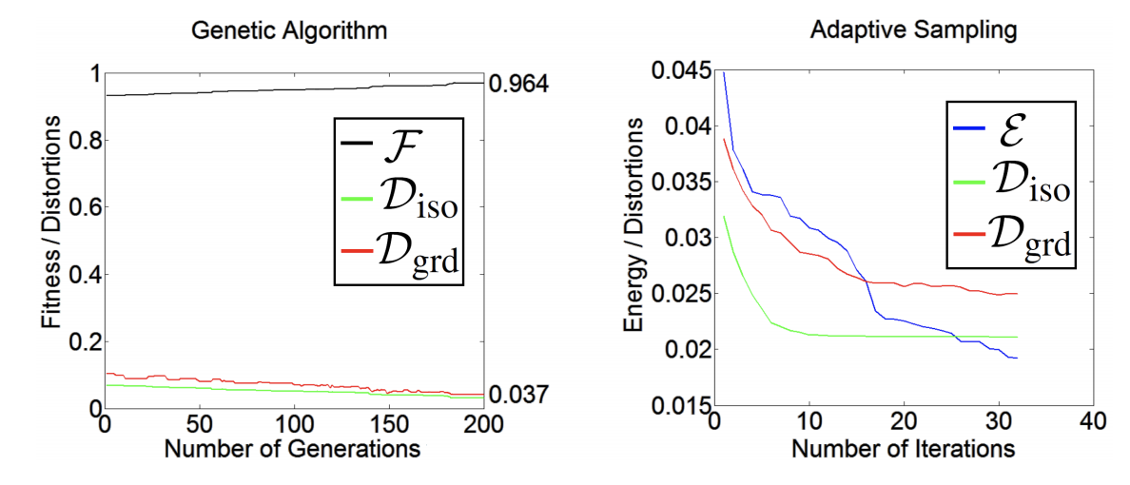
Results
Fitness guaranteed to increase in new generations (elitism).
Ground-truth distortion decreased in new generations.
AS takes the final distortion of GA and decreases it further.

Slide 29
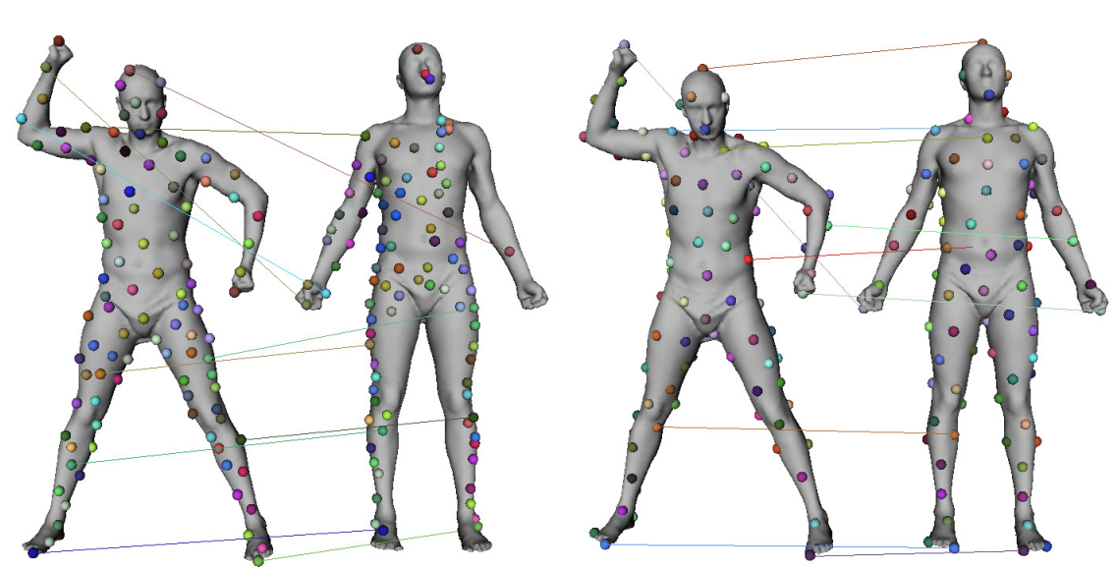
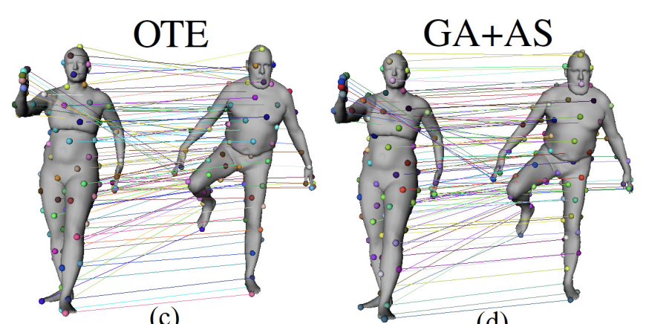
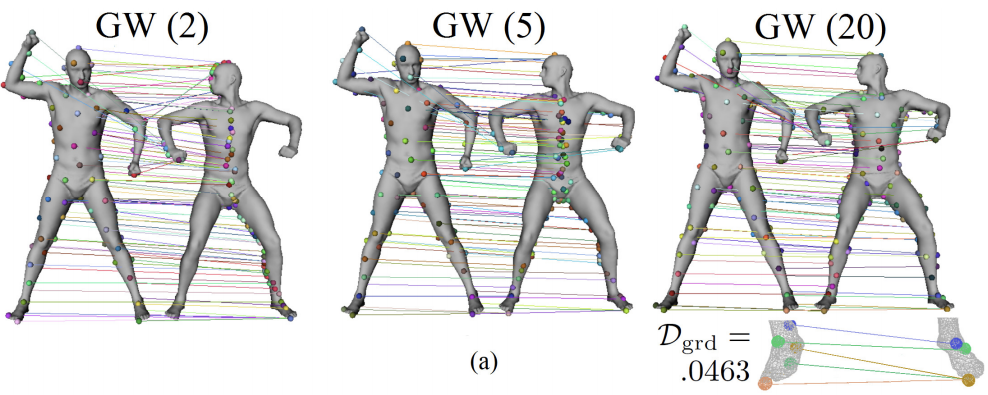
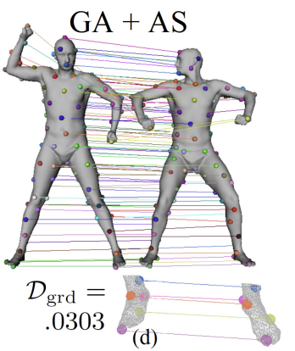
Results
Comparisons with BIM [Kim et al.’11], PS [Tevs et al.’11], OTE [Aigerman & Lipman’15], GW [Solomon et al.’16].
BIM and OTE fail on non-sphere topology but we do not. Holes fail PS but not us.
PS GA + AS
OTE GA + AS

Slide 30
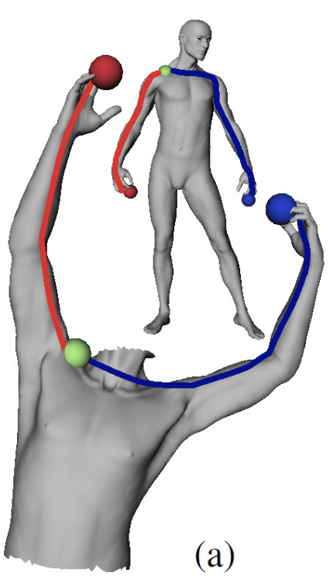
Future Work
Dense correspondence.
Non-isometric correspondence.
Partially-isometric correspondence.
Collection-wise consistent correspondence.
Partially-isometric matching already done by updating our fitness using the scale-invariant measure in [Sahillioğlu & Yemez’12] and introducing dummy entries that represent the unmatched samples on the full shape.
Full shape.
Partial shape.

Slide 31
Conclusion
First genetic algorithm presented for isometric shape correspondence problem.
Easy to implement, e.g., no algebra library.
Fast as space of permutations explored wisely.
Free of embedding errors, e.g., no parameterization.
Requires no initial input matches, no genus restrictions.
Robust against triangulation quality, mild geometric noise.
Adaptive Sampling algorithm presented for improvement of any sample-based correspondence method.

Slide 32
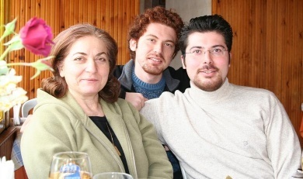
Thanks
Yusuf, Assoc. Prof.

